Slide 1
UNCLASSIFIED
OHS | OFFICE OF HOMELAND SECURITY
Office of Homeland Security
Homeland Security Forum
Frank J. Pace
Administrator
3 May 2023
UNCLASSIFIED

Slide 2
UNCLASSIFIED
OHS | Agenda
08:00 Networking
08:30 Welcome, Administrative Remarks, Event Overview; Administrator Frank Pace
08:45 Threat Overview – Hawaii Statewide Threat Assessment; Criminal Intelligence Analyst, Molly Smith
09:15 Office of Homeland Security Initiatives; Planning and Operations Chief, Jimmie Collins
Near Term Planning Priorities
Annual Homeland Security Summit
Defense Community Infrastructure Pilot Program
Critical Infrastructure Assessment Cadre
Calendar of Events
10:00 Break
10:15 Honolulu Police Department Cyber Crime Unit; Detective Thomas (Tommy) Iinuma
11:00 Targeted Violence Prevention; UHWO Behavior Intervention Team Chair, Beverly Baligad
11:45 Lunch Break
13:00 Port resiliency and the Port Restoration Task Force; Hawaii Emergency Management Agency Administrator, James Barros
13:45 Joint Terrorism Task Force overview; JTTF Coordinator, Earl Asato
14:30 Break
14:45 Introduction to the new state Department of Law Enforcement; Director, Jordan Lowe
15:15 Open Discussion
15:45 Closing Comments, Administrator Frank Pace
16:00 Adjourn
UNCLASSIFIED
2

Slide 3
UNCLASSIFIED
OHS | Agenda
08:00 Networking
08:30 Welcome, Administrative Remarks, Event Overview; Administrator Frank Pace
08:45 Threat Overview – Hawaii Statewide Threat Assessment; Criminal Intelligence Analyst, Molly Smith
09:15 Office of Homeland Security Initiatives; Planning and Operations Chief, Jimmie Collins
Near Term Planning Priorities
Annual Homeland Security Summit
Defense Community Infrastructure Pilot Program
Critical Infrastructure Assessment Cadre
Calendar of Events
10:00 Break
10:15 Honolulu Police Department Cyber Crime Unit; Detective Thomas (Tommy) Iinuma
11:00 Targeted Violence Prevention; UHWO Behavior Intervention Team Chair, Beverly Baligad
11:45 Lunch Break
13:00 Port resiliency and the Port Restoration Task Force; Hawaii Emergency Management Agency Administrator, James Barros
13:45 Joint Terrorism Task Force overview; JTTF Coordinator, Earl Asato
14:30 Break
14:45 Introduction to the new state Department of Law Enforcement; Director, Jordan Lowe
15:15 Open Discussion
15:45 Closing Comments, Administrator Frank Pace
16:00 Adjourn
UNCLASSIFIED
3

Slide 4
UNCLASSIFIED
OHS | Administrator Pace
Opening Remarks
Administrator Frank Pace
UNCLASSIFIED
4

Slide 5
UNCLASSIFIED
OHS | Agenda
08:00 Networking
08:30 Welcome, Administrative Remarks, Event Overview; Administrator Frank Pace
08:45 Threat Overview – Hawaii Statewide Threat Assessment; Criminal Intelligence Analyst, Molly Smith
09:15 Office of Homeland Security Initiatives; Planning and Operations Chief, Jimmie Collins
Near Term Planning Priorities
Annual Homeland Security Summit
Defense Community Infrastructure Pilot Program
Critical Infrastructure Assessment Cadre
Calendar of Events
10:00 Break
10:15 Honolulu Police Department Cyber Crime Unit; Detective Thomas (Tommy) Iinuma
11:00 Targeted Violence Prevention; UHWO Behavior Intervention Team Chair, Beverly Baligad
11:45 Lunch Break
13:00 Port resiliency and the Port Restoration Task Force; Hawaii Emergency Management Agency Administrator, James Barros
13:45 Joint Terrorism Task Force overview; JTTF Coordinator, Earl Asato
14:30 Break
14:45 Introduction to the new state Department of Law Enforcement; Director, Jordan Lowe
15:15 Open Discussion
15:45 Closing Comments, Administrator Frank Pace
16:00 Adjourn
UNCLASSIFIED
5

Slide 6
UNCLASSIFIED
OHS | Administrator Pace
Threat Overview – Hawaii Statewide Threat Assessment
Criminal Intelligence Analyst, Molly Smith
UNCLASSIFIED
6

Slide 7
UNCLASSIFIED//FOR OFFICIAL USE ONLY
HSFC | Hawaii State Fusion Center
Office of Homeland Security
Hawaii State Fusion Center
Statewide Threat Assessment 2022
Criminal Intelligence Analyst Molly Smith
Hawaii State Fusion Center
3 May 2023
UNCLASSIFIED//FOR OFFICIAL USE ONLY

Slide 8
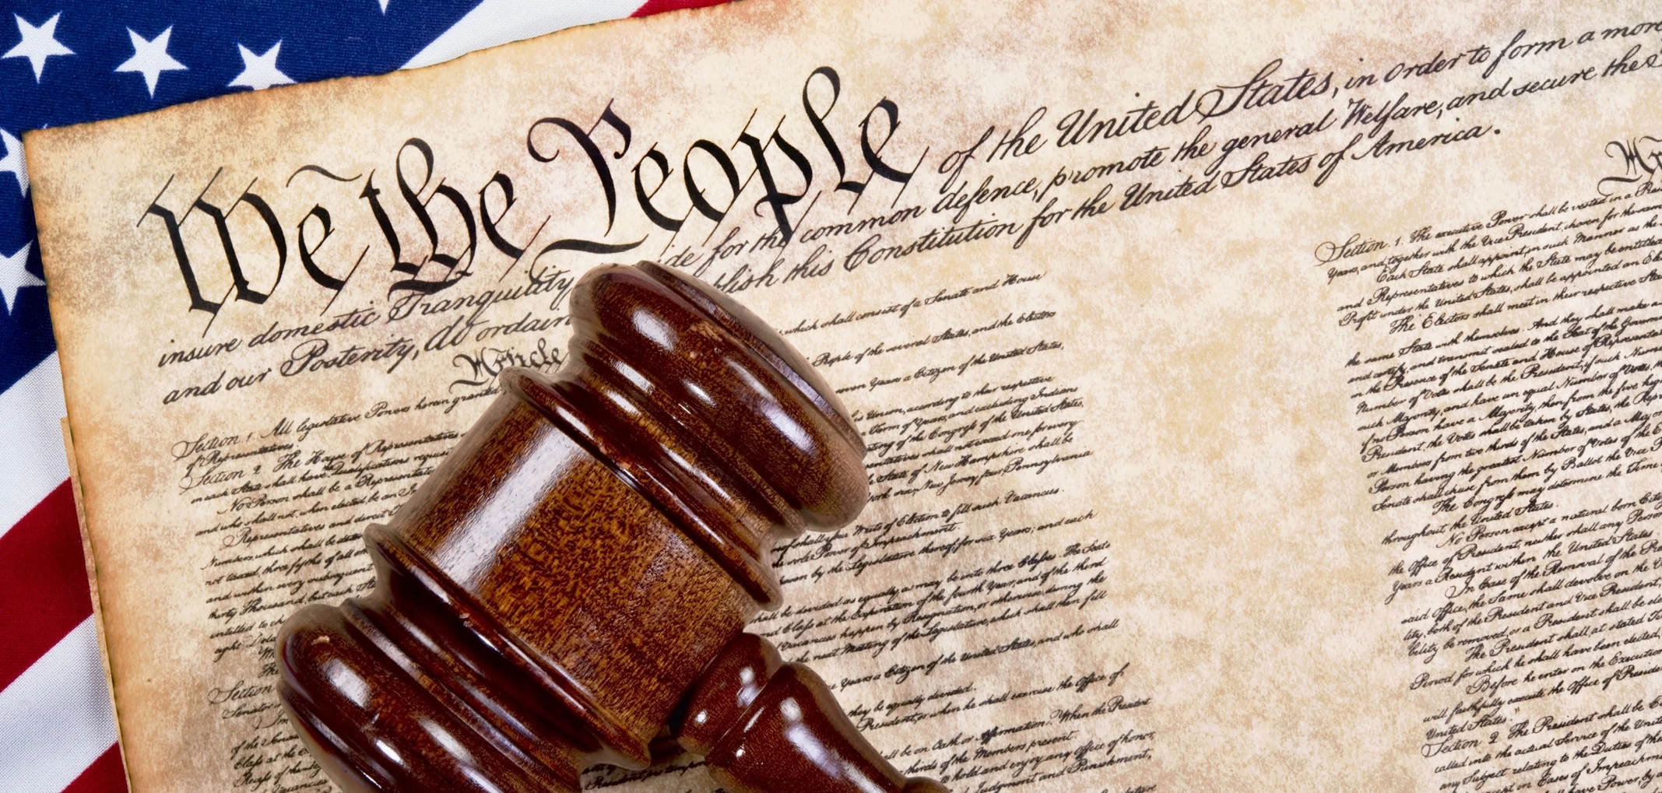
UNCLASSIFIED//FOR OFFICIAL USE ONLY
HSFC | Civil Rights Civil Liberties (CRCL)
The Hawaiʻi State Fusion Center recognizes that U.S. citizens have constitutionally protected rights to practice religion, assemble, speak, and petition. HSFC safeguards these rights under the U.S. Constitution and the Constitution of the State of Hawaii, and reports on only those activities where criminal activity occurs, or the potential use of incitement rhetoric could be used to instigate criminal activity. Additionally, potential criminal activity conducted by certain member(s) of a group does not negate the constitutional rights of the group itself or its law-abiding participants to exercise their rights to practice religion, assemble, speak, or petition.
8
UNCLASSIFIED//FOR OFFICIAL USE ONLY

Slide 9
UNCLASSIFIED//FOR OFFICIAL USE ONLY
HSFC | Scope and Threat Assessment Overview
There are no known specific, credible threats to the State of Hawaiʻi.
Scope
(U//FOUO) The Hawaiʻi State Fusion Center (HSFC) has developed the Statewide Threat Assessment to inform stakeholders and partners of pertinent issues and threats to the State of Hawaiʻi. Threats can include but are not limited to potential international and domestic terrorism, criminal, cyber, and critical infrastructure threats. This assessment is intended to provide an overview of potential threats and may not represent all potential threats from an all-hazards perspective.
(U//FOUO) This assessment was prepared in collaboration with state, local, and federal law enforcement, and military as well as public and private sector partners. This assessment is updated annually.
(U//FOUO) This product addresses various, terroristic, criminal,
and critical infrastructure threats to the State of Hawaiʻi.
Concurrently, this assessment does not address or assess
constitutionally protected speech or activities.
9
UNCLASSIFIED//FOR OFFICIAL USE ONLY

Slide 10
UNCLASSIFIED//FOR OFFICIAL USE ONLY
HSFC | Key Judgements
(U//FOUO) The HSFC assesses threats to critical infrastructure such as food, water, and energy supply chains pose the greatest threat to Hawaiʻi.
(U) Critical vulnerabilities listed in the Hawaiʻi Homeland Security Strategy include popular tourism locations; military and law enforcement facilities; extremist organizations with geographic connections to Hawaiʻi; educational institutions; maritime activities; and cybersecurity.
10
UNCLASSIFIED//FOR OFFICIAL USE ONLY

Slide 11
HSFC | Terrorism Threats
UNCLASSIFIED//FOR OFFICIAL USE ONLY
(U//FOUO) The HSFC is not aware of any specific, credible foreign or domestic terroristic threats to the State of Hawaiʻi.
The DHS states that the primary terrorist threat to the U.S. will stem from lone offenders and small cells of individuals including Domestic Violent Extremists (DVEs) and foreign terrorist-inspired Homegrown Violent Extremists (HVEs).
11
UNCLASSIFIED//FOR OFFICIAL USE ONLY

Slide 12
UNCLASSIFIED//FOR OFFICIAL USE ONLY
HSFC | (U) Domestic Terrorism and Anti-Government Anti-Authority Violent Extremism
(U//FOUO) Domestic terrorist organizations (DTO) remain at a heightened national threat level. The DHS assesses white supremacist extremists (WSE) are the most persistent and lethal threat group in the United States with Anti-Government/Anti-Authority Violent Extremism (AGAAVE) groups being another iteration of DTOs.10 Both of these groups, including those with specific political and social issues unique to Hawaiʻi, have been associated with plots against law enforcement and the U.S. government.
(U) In December 2022, the founder of the Hawaiʻi Chapter of the Proud Boys was sentenced to four years in prison for his actions during the breach of the United States Capitol on 6 January 2021. Nicholas Ochs, of Honolulu, pleaded guilty to obstruction of an official proceeding.
12
UNCLASSIFIED//FOR OFFICIAL USE ONLY

Slide 13
UNCLASSIFIED//FOR OFFICIAL USE ONLY
HSFC | Cyber Threats
(U//FOUO) On a national level, threats to cybersecurity infrastructure remain heightened. In the State of Hawaiʻi, it is no different. Hawaiʻi has been the target and proposed target of cyberattacks. Furthermore, in 2022, Hawaiʻi had 1,703 victims of cybercrimes with losses totaling $35,776,983 ranking at 39th of the 57 states and U.S. territories.
In late December 2021, a cyberattack disabled access to online servers for the operations of TheBus and TheHandi-Van.
On 10 October 2022, a media release was posted by the OHS stating the Daniel K. Inouye International Airport had been affected by a Distributed Denial of Service (DDos) attack which was possibly linked to other DDos attacks across the U.S.
13
UNCLASSIFIED//FOR OFFICIAL USE ONLY

Slide 14
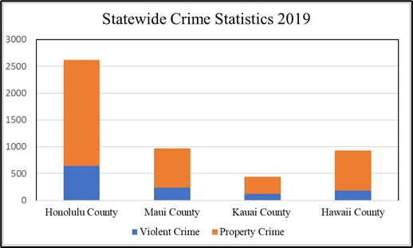
UNCLASSIFIED//FOR OFFICIAL USE ONLY
HSFC | Criminal Threats
(U//FOUO) The most up-to-date statewide crime reporting data is from 2019. With this data being over three years old – and a lot of change occurring in the interim – it is likely crime statistics and trends will vary in the coming years.
(U) Property Crime
In 2022, throughout the State of Hawaiʻi, there has been a significant number of arrests made relating to property crimes.
(U) Violent Crime
Violent crime is occurring less often than property crime. Complete data for 2022 is not yet available, therefore it is difficult to assess if violent crime is trending upward or downward.
(U//FOUO) The HSFC assesses as the State of Hawaiʻi
continues to open to tourism post-pandemic incidences
of all types of crime may see changes comparatively to
pre-pandemic numbers. As the Hawaiʻi State Fusion
Center expands its capabilities and connectivity across
islands, analysis of criminal trends will continue to
expand and improve in coming years.
(U) Source: https://ag.hawaii.gov/cpja/rs/cih/
14
UNCLASSIFIED//FOR OFFICIAL USE ONLY
Notes:
Property Crime: Catalytic Converter thefts were up 33% nationwide, from 1 Jan – 30 June 2022 reportedly 1,390 burglaries on Oahu. In 2019 Hawaii and Maui , ounty saw over 700 reported property crimes and Kauai county saw over 300
Violent Crime: the numbers of murders, aggravated assaults, forcible sexual assaults, and robberies on Oʻahu increased by approximately 5.6%, Kauai County 73 search warrants

Slide 15
UNCLASSIFIED//FOR OFFICIAL USE ONLY
HSFC | Sector-Specific Threats to Critical Infrastructure
(U) Energy
(U//FOUO) The HSFC assesses the Hawaiʻi energy sector critical infrastructure is easily accessible and requires little preparation to plan an attack, providing a potentially devastating outcome throughout the islands.
(U) Transportation
(U//FOUO) Airport security is of the upmost importance to continue to keep the State of Hawaiʻi’s economy and commerce running smoothly, making Hawaiʻi’s airports attractive targets to bad actors or foreign terrorist organizations.
(U) Food and Agriculture
(U//FOUO) Food and Agriculture sector’s security and sustainability are important to Hawaiʻi’s critical infrastructure sectors. According to the
Hawaiʻi Department of Business Economic Development and
Tourism, Hawaiʻi imports between 85%-90% of its food.
15
UNCLASSIFIED//FOR OFFICIAL USE ONLY

Slide 16
UNCLASSIFIED//FOR OFFICIAL USE ONLY
HSFC | Sector-Specific Threats to Critical Infrastructure
(U) Government Facilities
(U//FOUO) Throughout Hawaiʻi there are city and county, state, federal, and consulate government buildings. These buildings remain targets for malicious, bad actors through physical intrusion and network intrusion to gain information regarding U.S. systems and/or government held data. The HSFC assesses threats to government facilities and data will continue to be enduring.
(U) Healthcare and Public Health
(U//FOUO) Across the country in 2022, there have been physical attacks on healthcare facilities and healthcare workers. Healthcare facilities and healthcare workers have become popular targets for bad actors to exploit. The HSFC assesses cyberattacks and physical threats will continue to be a persistent to healthcare and public health systems in 2023.
16
UNCLASSIFIED//FOR OFFICIAL USE ONLY

Slide 17
UNCLASSIFIED//FOR OFFICIAL USE ONLY
HSFC | Foreign Malign Influence
(U) Foreign Malign Influence (FMI), identified as any hostile effort undertaken by a foreign government through overt or covert actions, poses a significant threat to democracy and U.S. interests.
The goal of these foreign influence operations directed against the United States is to spread disinformation, sow discord, and, ultimately, undermine confidence in democratic institutions and values. FMI activity impacting Hawaiʻi include:
(U) In July 2022, The U.S. Department of Justice unsealed an indictment charging a Russian man, working in tandem with Russian intelligence, for allegedly orchestrating a years-long foreign malign influence campaign that used various U.S. political groups to sow discord, spread pro-Russian propaganda, and interfere in elections within the United States from December 2014 to March 2022.
17
UNCLASSIFIED//FOR OFFICIAL USE ONLY

Slide 18
UNCLASSIFIED//FOR OFFICIAL USE ONLY
HSFC | Misinformation, Disinformation, and Malinformation
(U) Foreign and domestic threat actors use misinformation, disinformation, and malinformation (MDM) campaigns to cause chaos, confusion, and division. These malign actors are seeking to interfere with and undermine U.S. democratic institutions and national cohesiveness. MDM activities impacting Hawaiʻi include:
(U) In 2020, China’s state media channels and government officials claimed that COVID-19 had originated in the United States and had been brought to China by a member of the U.S. military. Such narratives were present earlier among conspiracy theory communities online, but China’s extensive information operations networks amplified these narratives broadly across traditional and social media to redirect criticism from China’s own handling of the outbreak and to attempt to discredit its geopolitical rivals.
(U//FOUO) The HSFC assess these nationwide efforts from foreign
adversaries to spread MDM and influence public opinion are likely
affecting the State of Hawaiʻi as it likely is in other states.
18
UNCLASSIFIED//FOR OFFICIAL USE ONLY

Slide 19
UNCLASSIFIED//FOR OFFICIAL USE ONLY
HSFC |Intelligence Gaps and Outlook for 2023
Intelligence Gaps
(U//FOUO) What, if any, overarching data is there of criminal arrests and charges in Hawaiʻi? Has there been a major increase or decrease, empirically, in human trafficking, street gang violence, property crime, and other violent crimes?
(U//FOUO) What, if any, critical infrastructure suspicious activity reporting is the HSFC not aware of? Is there further data available to analyze to help continued discussions and planning for potential terrorist or targeted violence attacks against critical infrastructure?
(U//FOUO) To what extent, if any, are transnational organized crime entities operating in Hawaiʻi?
Outlook for 2023
(U//FOUO) The HSFC assesses threats to the State of Hawaiʻi
by terrorists, extremists, other violent actors, and malicious cyber
actors will endure.
19
UNCLASSIFIED//FOR OFFICIAL USE ONLY

Slide 20
UNCLASSIFIED//FOR OFFICIAL USE ONLY
HSFC | Questions
Questions?
Molly Smith, Criminal Intelligence Analyst
Molly.j.smith@hawaii.gov
Hawaii State Fusion Center: HSFC@hawaii.gov
Submit Tips / Leads at https://hsfc.hawaii.gov
20
UNCLASSIFIED//FOR OFFICIAL USE ONLY

Slide 21
UNCLASSIFIED
OHS | Agenda
08:00 Networking
08:30 Welcome, Administrative Remarks, Event Overview; Administrator Frank Pace
08:45 Threat Overview – Hawaii Statewide Threat Assessment; Criminal Intelligence Analyst, Molly Smith
09:15 Office of Homeland Security Initiatives; Planning and Operations Chief, Jimmie Collins
Near Term Planning Priorities
Annual Homeland Security Summit
Defense Community Infrastructure Pilot Program
Critical Infrastructure Assessment Cadre
Calendar of Events
10:00 Break
10:15 Honolulu Police Department Cyber Crime Unit; Detective Thomas (Tommy) Iinuma
11:00 Targeted Violence Prevention; UHWO Behavior Intervention Team Chair, Beverly Baligad
11:45 Lunch Break
13:00 Port resiliency and the Port Restoration Task Force; Hawaii Emergency Management Agency Administrator, James Barros
13:45 Joint Terrorism Task Force overview; JTTF Coordinator, Earl Asato
14:30 Break
14:45 Introduction to the new state Department of Law Enforcement; Director, Jordan Lowe
15:15 Open Discussion
15:45 Closing Comments, Administrator Frank Pace
16:00 Adjourn
UNCLASSIFIED
21

Slide 22
UNCLASSIFIED
OHS | Administrator Pace
Office of Homeland Security Initiatives
Planning and Operations Chief, Jimmie Collins
UNCLASSIFIED
22

Slide 23
UNCLASSIFIED
OHS | Office of Homeland Security Initiatives
Near Term Planning Priorities
Annual Homeland Security Summit
Defense Community Infrastructure Pilot Program
Critical Infrastructure Assessment Cadre
Calendar of Events
UNCLASSIFIED
23

Slide 24
UNCLASSIFIED
OHS | Near Term Planning Priorities
Targeted Violence Prevention Strategy Implementation Plan: develop a 3-year Implementation Plan that includes the 11 goals from the Strategy and related Objectives, Tasks, Outputs, Outcomes, and Measures of Implementation, and Lead Implementor
Critical Infrastructure Security & Resilience Strategy Implementation Plan: develop and execute to establish a critical infrastructure data management system
conduct a comprehensive inventory and baseline interdependency assessment of the state’s critical infrastructure and their dependencies/interdependencies
collect and document data and information that portrays the critical infrastructure ecosystem in Hawaii to better characterize vulnerability and risk in order to inform resource prioritization of resilience activities.
Statewide Cybersecurity Strategy and Implementation Plan(s): develop a statewide multi-year strategy and supporting Implementation Plan(s) Subrecipient Cyber Incident Response Plans
including development and implementation of county/entity Cyber Incident Response Plan Exercises
Statewide Cyber Workforce Development Strategy and County/Entity-Level Implementation Plans: to include a continuous testing, evaluation, and structured assessments approach, as well as data gathering schema and metrics.
UNCLASSIFIED
24

Slide 25
UNCLASSIFIED
OHS | Annual Homeland Security Summit
Annual, regional, Homeland Security Summit event
Projected for October 2024.
Activities:
training
plenary sessions
breakout groups
vendor show to support/sponsor some of the major activities
Components:
caterers, transportation, hotel
registration, web page, photographers
florists, audio, and speakers for the event
Topic tracks (notional, initial thoughts)
cybersecurity
targeted violence prevention
emerging threats
homeland (civil) defense
UNCLASSIFIED
25

Slide 26
UNCLASSIFIED
OHS | Defense Community Infrastructure Program
The DOD Office of Local Community Cooperation (OLDCC) is now accepting applications for the Defense Community Infrastructure Pilot (DCIP) Program.
DCIP is designed to address deficiencies in community infrastructure, supportive of a military installation, in order to enhance military value, cadet training at covered educational institutions, installation resilience, and military family quality of life.
OLDCC will only accept proposals submitted through Grants.gov for the DCIP Program through 5 p.m. PDT on June 23, 2023.
The official grant notice is available: here.
A public webinar will be held at 3 p.m. EDT on April 13, 2023. The webinar link will be posted here.
UNCLASSIFIED
26

Slide 27
UNCLASSIFIED
OHS | Critical Infrastructure Assessment Cadre
For critical infrastructure stakeholders, by critical infrastructure stakeholders
Voluntary, nonregulatory assessments supported by the state’s Hawaii Critical Infrastructure Security & Resilience Program (CISRP) Strategy, Planning Framework, and Implementation Guide.
Risk-based protective programs - prevent, deter, and mitigate; while enabling timely, efficient response and restoration.
A core tenant of the statewide CISRP depends upon the voluntary collaboration of private (and to a smaller extent public) sector owners and operators. OHS works locally to foster this collaboration and facilitate technical assistance to support enhancement of the security and resilience of the state's critical infrastructure.
UNCLASSIFIED
27
Notes:
The Hawaii Office of Homeland Security is developing capability and capacity to conduct specialized security and resilience assessments on the critical infrastructure in the state.
These assessments are intended to assist OHS and its partners— state and county government entities and private industry—in better understanding and managing statewide risk to critical infrastructure.
The assessments will examine infrastructure vulnerabilities, interdependencies, capability gaps, and the consequences of their disruption.
Security and resilience assessments, combined with infrastructure planning programs and capabilities, forms a holistic approach to enhance critical infrastructure resilience to all hazards.
These voluntary, nonregulatory assessments are a foundational element of the state’s Hawaii Critical Infrastructure Security & Resilience Program (CISRP) Strategy, Planning Framework, and Implementation Guide.
That guide calls for risk-based implementation of protective programs designed to prevent, deter, and mitigate the risk of an incident while enabling timely, efficient response and restoration in an all-hazards, post-event situation.
A core tenant of the statewide CISRP depends upon the voluntary collaboration of private (and to a smaller extent public) sector owners and operators. OHS works locally to foster this collaboration and facilitate technical assistance to support enhancement of the security and resilience of the state's critical infrastructure.

Slide 28
UNCLASSIFIED
OHS | Critical Infrastructure Assessment Cadre
Security Assessment at First Entry (SAFE)
a rapid physical security assessment that assists facility owners and operators in implementing effective security programs
a structured review of a facility’s existing security measures and delivers feedback on observed vulnerabilities and options for improving security
entails a brief walk-through of a site and discussion of its existing security features and concerns
A SAFE visit will
Focus on physical security;
Take only a few hours to complete; and
Be objective.
OUTCOMES FROM VISIT - a short report containing:
A list of commendable actions: existing practices that are noteworthy for their effectiveness and that should be continue.
A list of vulnerabilities and options for consideration: areas that could benefit from additional attention from a security perspective—areas relating to security management, entry control, perimeter security, and other physical security measures. Each identified vulnerability will have one or more mitigation options for owners and operators to consider.
A list of individuals, agencies, and organizations: Useful points of contact for owners and operators as they proceed with efforts to improve a facility’s security posture.
Helpful links and references: Resources that provide more information about security options and ways to implement them.
UNCLASSIFIED
28
Notes:
Looking for participants for a 31 May 23, 10-1200 training at Rm 113, Bldg 306; 3949 Diamond Head Road, Honolulu HI 96816.
20 pax cap.
Contact me here or directly at jimmie.l.collins@hawaii.gov or 808-223-2099.

Slide 29
UNCLASSIFIED
OHS | Critical Infrastructure Assessment Cadre
Infrastructure Survey Tool (IST)
voluntary, web-based assessment to identify and document the overall security and resilience of a facility.
IST focuses on:
Identifying facilities’ physical security, security forces, security management, information sharing, protective measures, and dependencies related to preparedness, mitigation, response, resilience, and recovery;
Identifying security areas of possible improvements;
Creating facility protective and resilience measures indices that show a comparison to similar facilities that have completed ISTs; and
Tracking progress toward improving critical infrastructure security.
OUTCOMES FROM VISIT - a written report containing:
a description of the facility and its possible vulnerabilities as well as options to mitigate identified vulnerabilities
information is eligible for protection from disclosure under the Protected Critical Infrastructure Information Program
OHS uses this information for steady-state analysis, special-event planning, and incident management
UNCLASSIFIED
29

Slide 30
UNCLASSIFIED
OHS | Calendar of Events
2023 National Special Events (SEAR) Quarterly Review | 05/04/23 | 05/04/23
ICEI MOU Quarterly | 05/04/23 | 05/04/23
HSFC Quarterly Campus Security Leaders | 05/04/23 | 05/04/23
INDOPACOM DSCA Monthly Collaboration Meeting | 05/04/23 | 05/04/23
TTE Consultation Group | 05/05/23 | 05/05/23
Makani Pahili - Operational Leaders Executive Education Seminar | 05/08/23 | 05/08/23
C&C's Mass Violence Incident Annex & Family Assistance Center Appendix | 05/12/23 | 05/12/23
McCain Institute Prevention Practitioners Network (PPN) Programs Committee | 05/15/23 | 05/15/23
Government Cyber Threats - panel | 05/18/23 | 05/18/23
GridEx VII FPM | 05/23/23 | 05/23/23
OHS/HI-EMA Sync Meeting | 05/25/23 | 05/25/23
INDOPACOM DSCA Monthly Collaboration Meeting | 05/25/23 | 05/25/23
Gap Finder TTX (HING) | 05/25/23 | 05/26/23
SAFE CI Assessment Tool Training | 05/31/23 | 05/31/23
Clear Path XI Social Media Drill MSEL Development Mtg | 06/05/23 | 06/05/23
Cyber Dawn Exercise @ CA | 06/12/23 | 06/16/23
FBI Cyber Conference | 06/15/23 | 06/15/23
OHS/HI-EMA Sync Meeting | 06/29/23 | 06/29/23
INDOPACOM DSCA Monthly Collaboration Meeting | 06/29/23 | 06/29/23
Hawaii Threat Assessment Conference | 07/10/23 | 07/14/23
Clear Path 23 FPM | 07/18/23 | 07/18/23
Homeland Security Forum | 07/20/23 | 07/20/23
Critical Infrastructure Security & Resilience
Cybersecurity
Emerging Threats
Terrorism and Targeted Violence
Multiple
Other
UNCLASSIFIED
30

Slide 31
UNCLASSIFIED
OHS | OFFICE OF HOMELAND SECURITY
Office of Homeland Security
Point of Contact:
Ms. Jimmie L Collins
Chief, Planning and Operations
Hawaii Office of Homeland Security
jimmie.l.collins@hawaii.gov
office: 808-369-3570
cell: 808-223-2099
UNCLASSIFIED

Slide 32
UNCLASSIFIED
OHS | Agenda
08:00 Networking
08:30 Welcome, Administrative Remarks, Event Overview; Administrator Frank Pace
08:45 Threat Overview – Hawaii Statewide Threat Assessment; Criminal Intelligence Analyst, Molly Smith
09:15 Office of Homeland Security Initiatives; Planning and Operations Chief, Jimmie Collins
Near Term Planning Priorities
Annual Homeland Security Summit
Defense Community Infrastructure Pilot Program
Critical Infrastructure Assessment Cadre
Calendar of Events
10:00 Break
10:15 Honolulu Police Department Cyber Crime Unit; Detective Thomas (Tommy) Iinuma
11:00 Targeted Violence Prevention; UHWO Behavior Intervention Team Chair, Beverly Baligad
11:45 Lunch Break
13:00 Port resiliency and the Port Restoration Task Force; Hawaii Emergency Management Agency Administrator, James Barros
13:45 Joint Terrorism Task Force overview; JTTF Coordinator, Earl Asato
14:30 Break
14:45 Introduction to the new state Department of Law Enforcement; Director, Jordan Lowe
15:15 Open Discussion
15:45 Closing Comments, Administrator Frank Pace
16:00 Adjourn
UNCLASSIFIED
32

Slide 33
UNCLASSIFIED
OHS | Agenda
08:00 Networking
08:30 Welcome, Administrative Remarks, Event Overview; Administrator Frank Pace
08:45 Threat Overview – Hawaii Statewide Threat Assessment; Criminal Intelligence Analyst, Molly Smith
09:15 Office of Homeland Security Initiatives; Planning and Operations Chief, Jimmie Collins
Near Term Planning Priorities
Annual Homeland Security Summit
Defense Community Infrastructure Pilot Program
Critical Infrastructure Assessment Cadre
Calendar of Events
10:00 Break
10:15 Honolulu Police Department Cyber Crime Unit; Detective Thomas (Tommy) Iinuma
11:00 Targeted Violence Prevention; UHWO Behavior Intervention Team Chair, Beverly Baligad
11:45 Lunch Break
13:00 Port resiliency and the Port Restoration Task Force; Hawaii Emergency Management Agency Administrator, James Barros
13:45 Joint Terrorism Task Force overview; JTTF Coordinator, Earl Asato
14:30 Break
14:45 Introduction to the new state Department of Law Enforcement; Director, Jordan Lowe
15:15 Open Discussion
15:45 Closing Comments, Administrator Frank Pace
16:00 Adjourn
UNCLASSIFIED
33

Slide 34
UNCLASSIFIED
OHS | Administrator Pace
Honolulu Police Department Cyber Crime Unit
Detective Thomas (Tommy) Iinuma
UNCLASSIFIED
34

Slide 35
CID Cyber Crimes and Digital Forensics Examination
Honolulu Police Department

Slide 36
Cyber Crimes Unit – 2022 Stats
1,670 Assigned cyber crime cases
418 Digital forensics examination
Cyber Investigation:
Unauthorized Computer Access / Hacking
Online fraudulent charges
Online scams
Ransomware

Slide 37
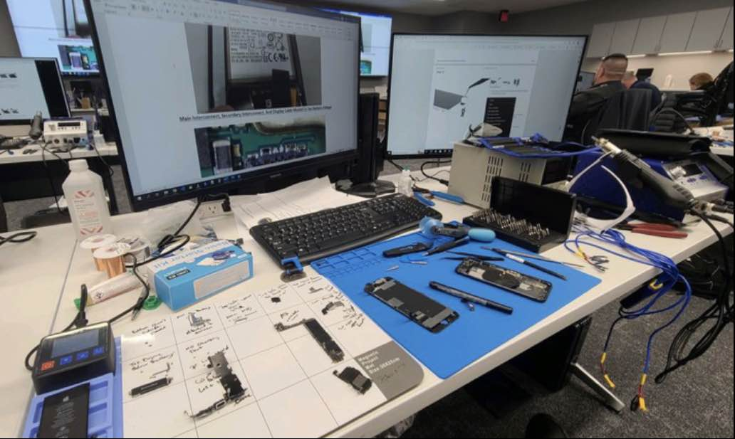
Digital Forensics Examination
Phones
Tablets
Smart Watches
Computers
Vehicles

Slide 38
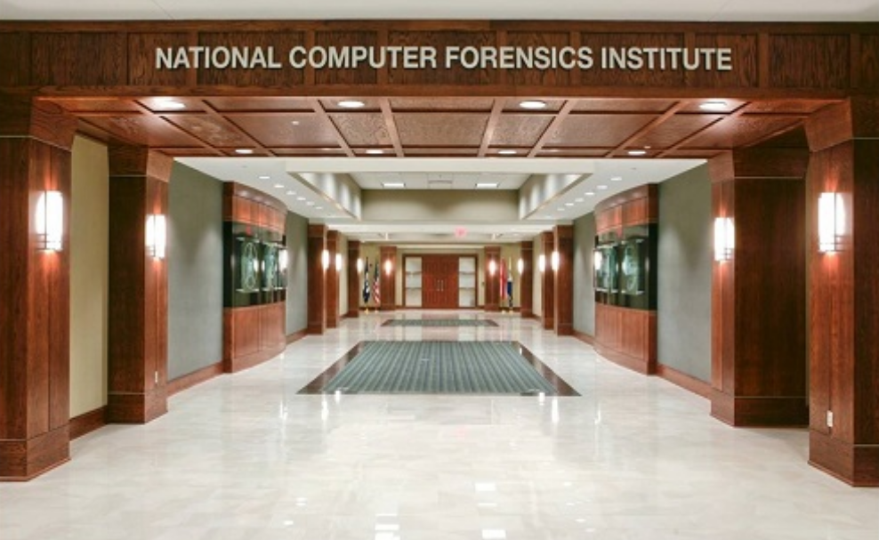
Training and Certification
National Computer Forensics Institute - USSS
Hoover, Alabama
Cyber Crimes and Digital Forensics Investigation
SANS Institute
Global leader in Cyber Security and Digital Forensics
National White Collar Crime Center (NW3C)
Internet Crimes Against Children
Many more…

Slide 39
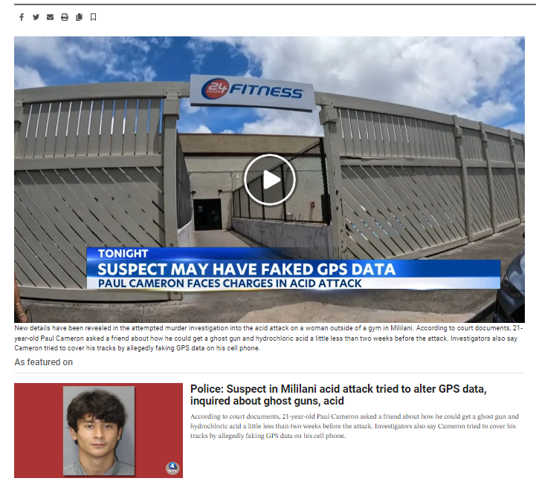
HPD Cyber Crimes Unit – Recent News

Slide 40
Assistance Requests
HPD Digital forensics requests
CID Homicide Detail
CID Sex Assault Detail
Traffic Division
We will assist all local, state, and federal agencies

Slide 41
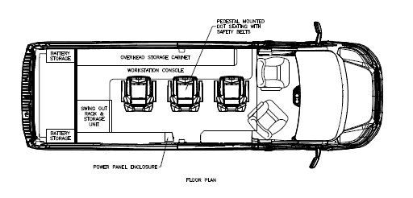
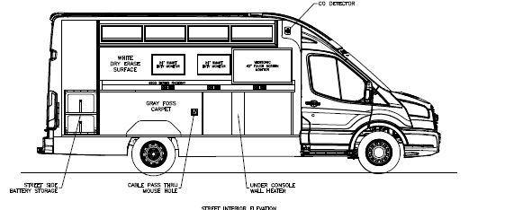
CID Cyber Current Goal Cyber Command Response Vehicle
Mobile Digital Forensics Lab
Respond to anywhere in Honolulu

Slide 42
The following are the current capabilities of the HPD digital forensics lab:
Cellular Phone Examinations
Logical Extractions
Cellebrite
GrayKey
XRY
Data Pilot
Physical Extractions
Chip-off
ISP
Will only work on older Android devices

Slide 43
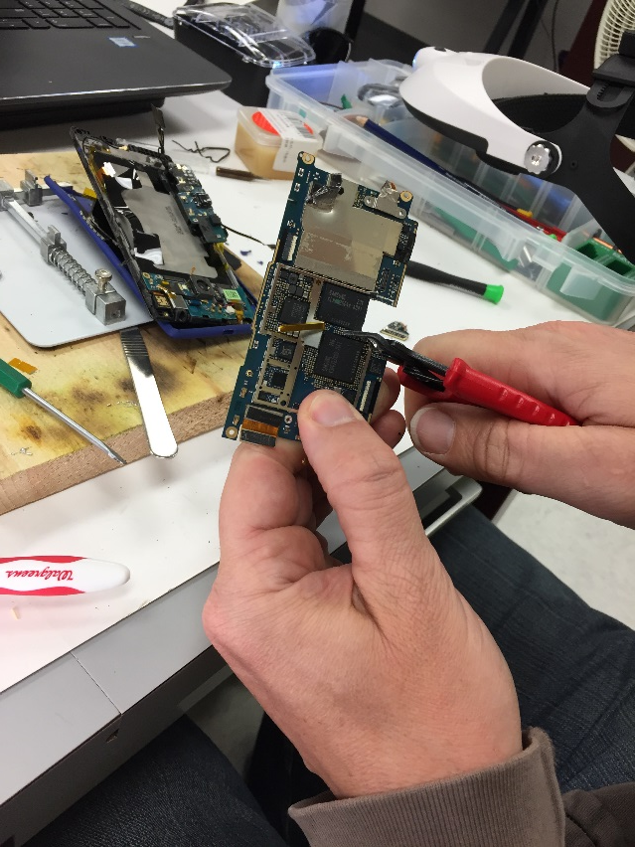
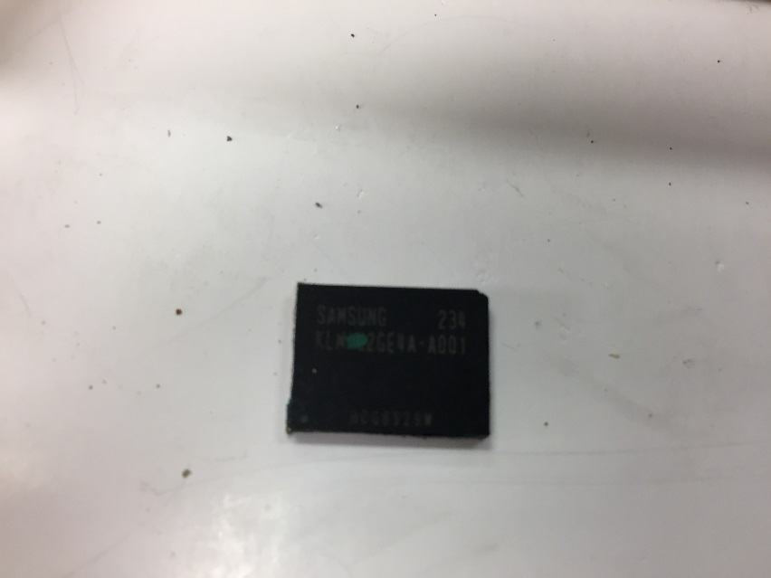
Chip Off

Slide 44
SQLite Database Extraction
The ability to locate unparsed data from Apps
DCIM_APPLE.plist
iOS artifact
Keeps track of the last image or video taken on the device
Can be used to determine if an image or video was taken and then deleted

Slide 45
Knowledge C Database
We can get this with the GrayKey Extraction
iOS only
This log file shows everything that happened on the device
This means that even if the suspect deleted a file, the log may show this deletion
The log may also show what programs are used and when
We can use the log to create a Timeline of user activity on the device

Slide 46
UFED4PC Camera
If the data needed if visible on the phone but can not be extracted or parsed
Can take Images or Videos of the Phone

Slide 47
Locked Devices
Graykey
Can unlock iPhones
Can unlock some Samsung and Motorola phones
Cellebrite Premium (We should be receiving this soon)
Can unlock iPhones
Can unlock many Android phones

Slide 48
Broken Phones
Extractions from broken phones
The ability to extract data off of phones with broken screen
The ability to extract data off phones that no longer boot

Slide 49
Computers and Laptops
We can do a full physical extraction from these devices
May hold evidence from phones if the devices were synched
May hold evidence of files on Cloud Services like OneDrive or Dropbox
We can retrieved deleted data from these device

Slide 50
RAM Analysis
We can analyze RAM memory using Volatility 3
Important information can be located in RAM that may no longer be accessible on the hard drive.
Files may be in RAM that are no longer on the drive

Slide 51
DVR Extraction
We use DVR Examiner to extract video from DVRs
This will work on locked DVRs
Broken DVRs if the hard drive is still working
Supports many DVR systems

Slide 52
Vehicle Forensics (BERLA)
We can extract data from the Infotainment center of some vehicles
The information may include the following:
GPS Location
Contacts
Videos and Images
Massages from phones
Vehicle Events
Connected Devices

Slide 53
Skimmer Detection
We can track Bluetooth skimmers using a tool proved by the NCFI
Drive or walk around an area were the skimmers may be installed

Slide 54
Mega Search
We have a program that is designed to located torrent download files based on the file HASH and size
This is much faster than any other tool and can complete a computer in 2 to 3 minutes
This can be used on-scene to determine which computers to take as evidence

Slide 55
Mega Parser
We have a program that is designed to parse large amounts of data for evidence
This can be used on the following
Search Warrant Returns
Cellular Phone Extractions
Volatile Data Collections such as Kape
The program can process RAM memory and put the results in a database
Can import CSV files and Kape directly into a database

Slide 56
Questions?

Slide 57
UNCLASSIFIED
OHS | Agenda
08:00 Networking
08:30 Welcome, Administrative Remarks, Event Overview; Administrator Frank Pace
08:45 Threat Overview – Hawaii Statewide Threat Assessment; Criminal Intelligence Analyst, Molly Smith
09:15 Office of Homeland Security Initiatives; Planning and Operations Chief, Jimmie Collins
Near Term Planning Priorities
Annual Homeland Security Summit
Defense Community Infrastructure Pilot Program
Critical Infrastructure Assessment Cadre
Calendar of Events
10:00 Break
10:15 Honolulu Police Department Cyber Crime Unit; Detective Thomas (Tommy) Iinuma
11:00 Targeted Violence Prevention; UHWO Behavior Intervention Team Chair, Beverly Baligad
11:45 Lunch Break
13:00 Port resiliency and the Port Restoration Task Force; Hawaii Emergency Management Agency Administrator, James Barros
13:45 Joint Terrorism Task Force overview; JTTF Coordinator, Earl Asato
14:30 Break
14:45 Introduction to the new state Department of Law Enforcement; Director, Jordan Lowe
15:15 Open Discussion
15:45 Closing Comments, Administrator Frank Pace
16:00 Adjourn
UNCLASSIFIED
57

Slide 58
UNCLASSIFIED
OHS | Targeted Violence Prevention Strategy
1
Outreach & Education
2
Training
3
Suspicious Activity Reporting
4
Behavioural Intervention / Threat Assessment Teams
5
Intelligence Analysis
6
Other Groups
UNCLASSIFIED
58

Slide 59
UNCLASSIFIED
OHS | Administrator Pace
Targeted Violence Prevention
UHWO Behavior Intervention Team Chair, Beverly Baligad
UNCLASSIFIED
59

Slide 60
Presenters:
Bev Baligad, UH West Oahu

Slide 61
1. HI State Targeted Violence Prevention Strategy

Slide 62
Pillar 2: Behavior Intervention/Threat Assessment Teams
“While there are important ongoing efforts to create, train, and implement BI/TATs, particularly within state educational (K-12 and higher-ed) institutions, statewide institutionalization of an operationally effective, multi-domain, coordinated network of implementation partners is the direction this strategy aims to take.”
https://dod.hawaii.gov/ohs/files/2022-HAWAII-TARGETED-VIOLENCE-PREVENTION-STRATEGY_FINAL.pdf
Notes:
If IPA was presented with these set of facts, what would you have done? What supports, if any would you have suggested?
Is a student like Student B one that IPA may run into in this school? Many schools have different, sometimes mixed demographics. why or why not?

Slide 63
Threat Team Hawaii (TTH): Challenges
Severe drop off of General Stakeholder membership
Sporadic engagement- Consult group
Outdated manual/handbook
Little to no data collection
Consult group = Steering Committee (double duty!)
No leadership structure
No stakeholder surveys
No networking opportunities
Notes:
In addition to the previous slides, add these identified factors. NOW what would IPA do? What programs or supports would you have used? What gaps (program, supports or functions) did you identify?
What issues would your school see as an issue or barrier to programs, access or supports?
What do you think would have been alternate ways to approach the issue?

Slide 64
Threat Team Hawaii (TTH): Opportunities
Approved leadership structure: Consult group, Chair/Vice Chair, Steering Committee (co-Leads)
Adoption of a logo and badge (marketing purposes)
Ongoing recruitment: Members, Consult Group, Committee members
Discussions regarding types of data we should be collecting
Surveys to determine needs of the general stakeholders (training, etc.)
Manual/handbook overhaul
Meetings every other month
More networking events
Notes:
In addition to the previous slides, add these identified factors. NOW what would IPA do? What programs or supports would you have used? What gaps (program, supports or functions) did you identify?
What issues would your school see as an issue or barrier to programs, access or supports?
What do you think would have been alternate ways to approach the issue?

Slide 65
2. 2021 US DHS Targeted Violence Threat Prevention (TVTP) Grant: School Behavior Intervention/Threat Assessment Management (BITAM) Team Pilots
* 2021 Department of Homeland Security TVTP Grant # EMW-2021-GR-00045
Principal Investigator: Bev Baligad, UHWO
Amount: Approx $780k

Slide 66
“Functional” Structure
Chancellor
VCA
Administrator
BIT Chair (1)
BIT Support(1)
4. Human Resources (2)
1. Student Affairs
-Student Conduct Officer (1)
-Student ADA/504
Coordinator (1)
UHWO
BIT
5. Campus Security (2)
2. Academic Advising (2)
6. “Ancillary Members”
Link to Policy Team/EOC:
Public Information Officer (1)
EHSO (1)
Auxiliary Svcs (1)
3.Counseling/Mental Health (2)
“ECHO Alpha” [UH West Oahu]

Slide 67
UHWO BIT Relationships: The Bigger Picture
TTH, Community Partners (Fusion Center)
LEVEL 2 BITAT
Emergency
Mgmt
UHWO Policy Team
(Executive Ldrs; EOC)
Facilities Management
UHWO Behavior
Intervention
Team
LEVEL 1 BITAT
*Although the risk management focus was a driver for the creation of our BIT, this relationship structure was developed post implementation of the BIT.

Slide 68
Current HI State BITAM Team Implementation Efforts
* 2021 Department of Homeland Security TVTP Grant # EMW-2021-GR-00045
5 pilot “Level 1” team implementations: (2) k-12; (3) Higher ed
National Best Practices
Training, guidance, consulting
Building connections with other ECHO trained teams
Connection with TTH (Level 2)
Notes:
END: 11:40

Slide 69
3. 2022 US DHS Targeted Violence Threat Prevention (TVTP) Grant: Community Approach to Building & Sustaining HI BITAM Efforts
* 2022 Department of Homeland Security TVTP Grant # EMW-2022-GR-APP-00072
Principal Investigator: Bev Baligad, UHWO
Amount: Approx $533k

Slide 70
Building Capacity: Hawaii Threat Assessment Conference (HTAC)
* 2022 Department of Homeland Security TVTP Grant # EMW-2022-GR-APP-00072
1st HTAC scheduled for July 10th- July 14th , 2023 FREE
Location: UH West Oahu; lots of parking
National Threat Assessment Center (NTAC), US DHS National Threat Evaluation and Reporting (NTER) Office Confirmed
Basic/Foundation Trainings (Mon, Tues, Wed)
Advanced Presentations/Trainings (Thurs/Fri)
Seating limited, first come, first served

Slide 71
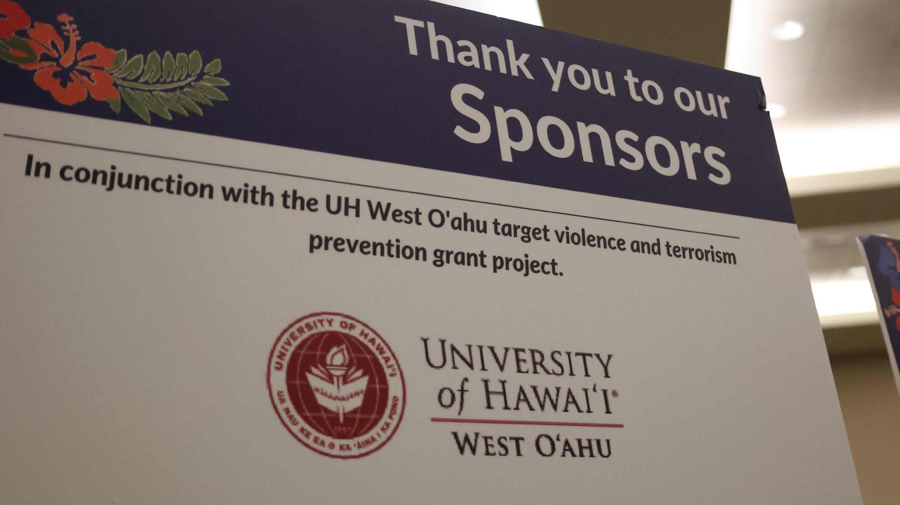
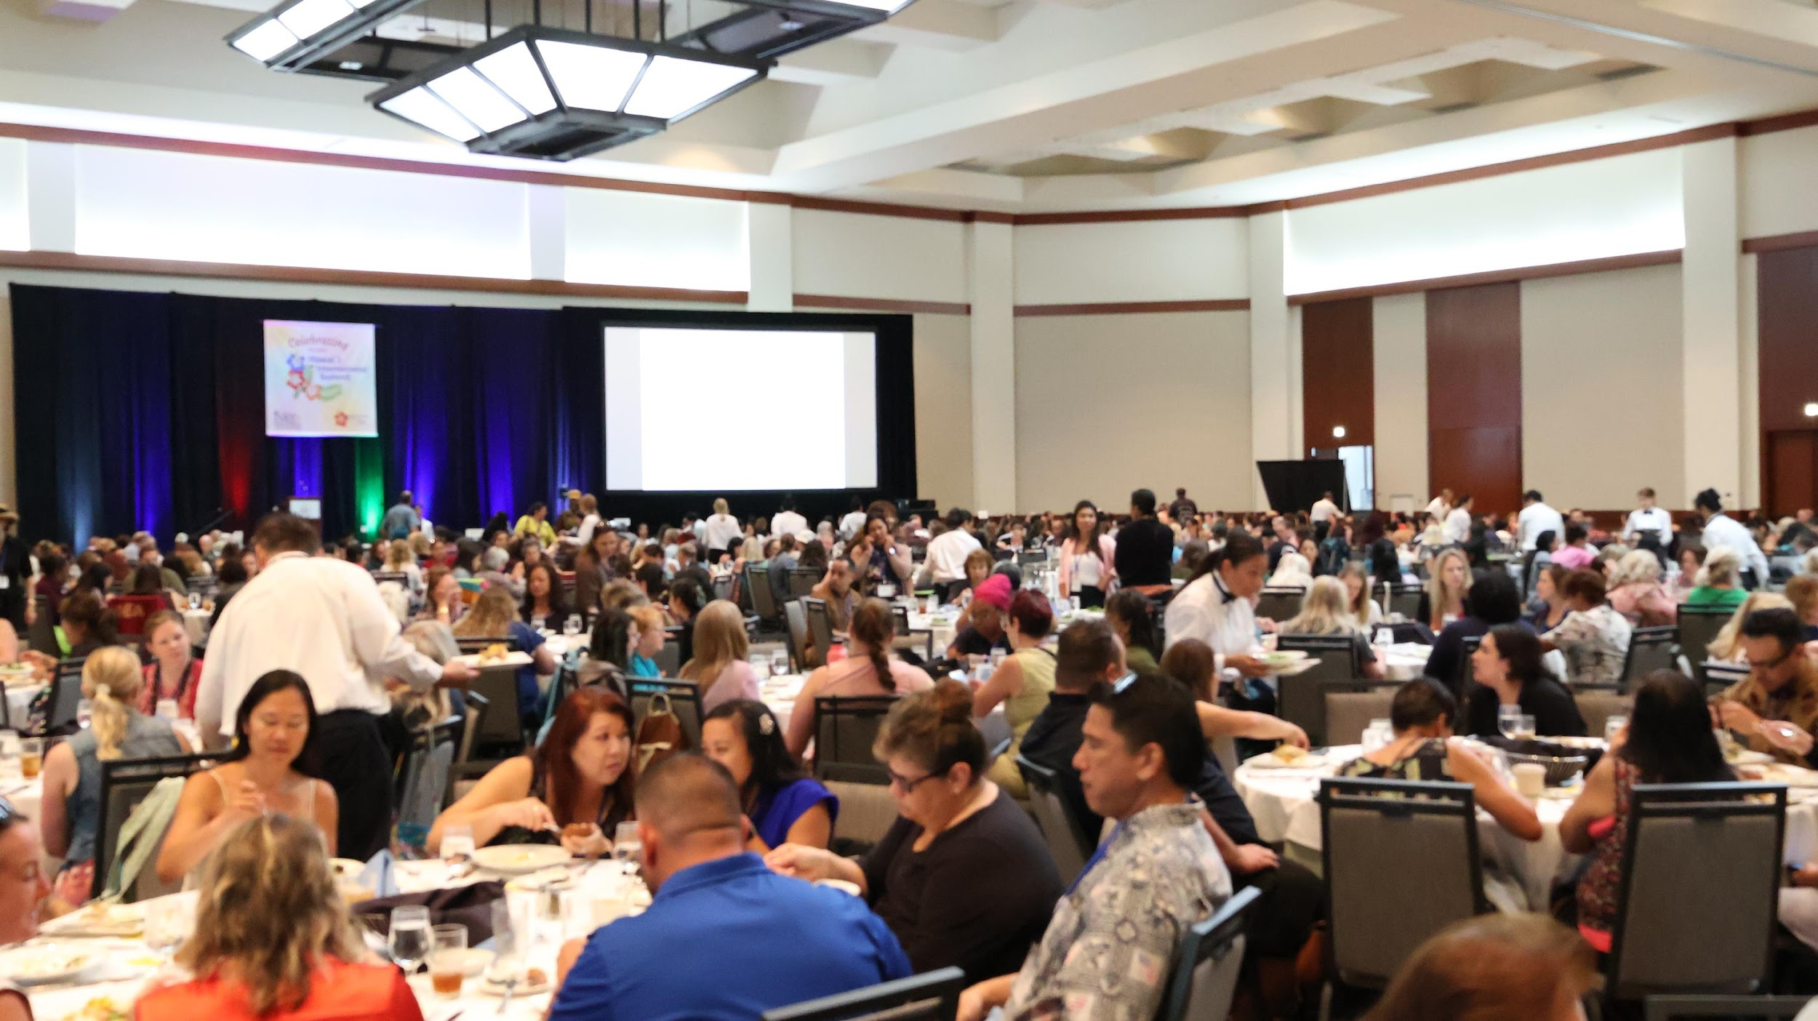
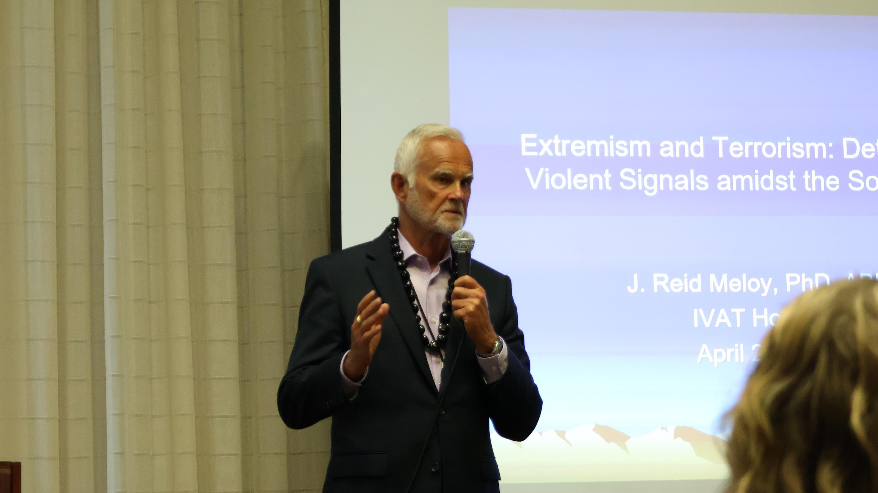
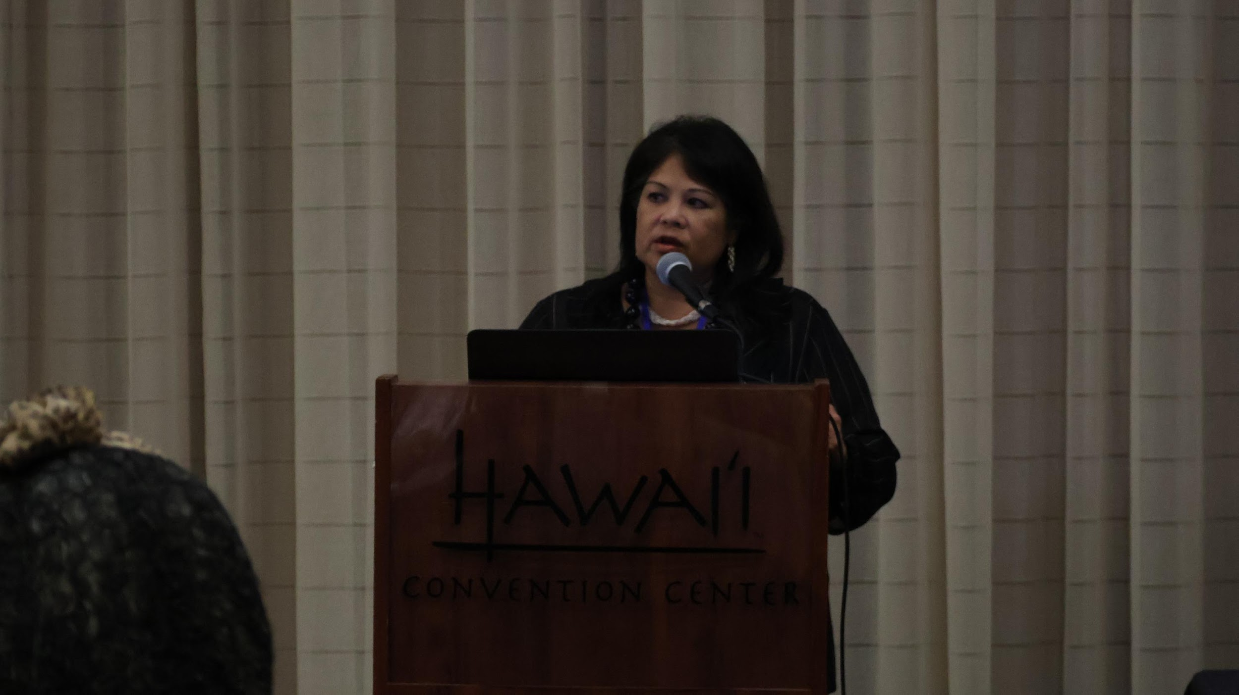
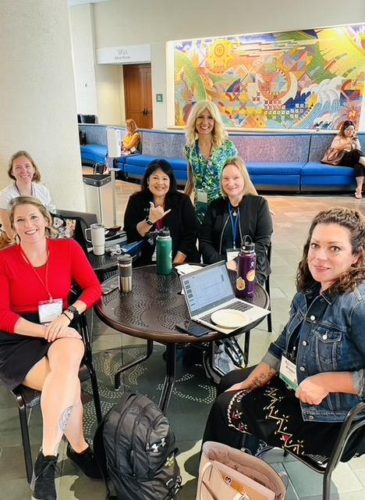
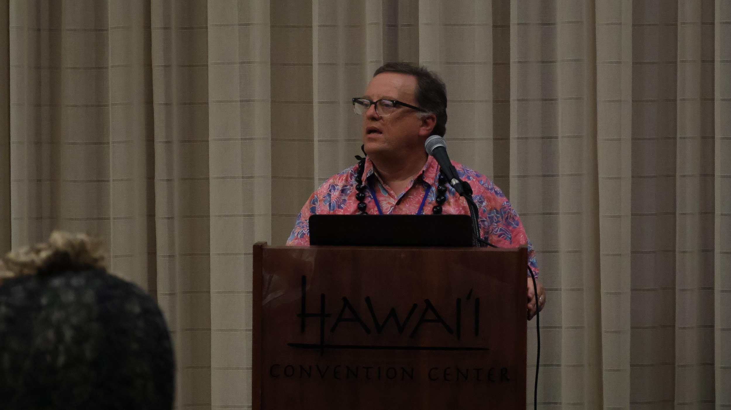
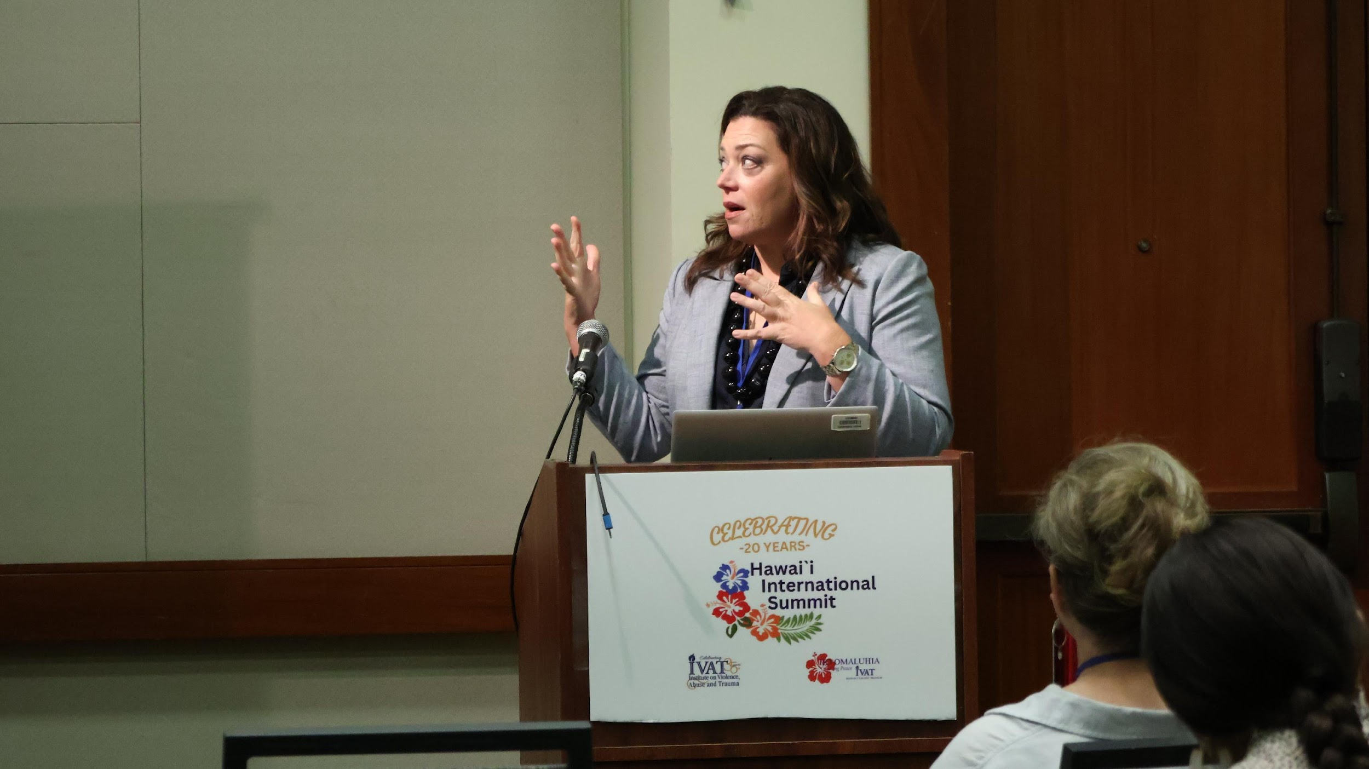
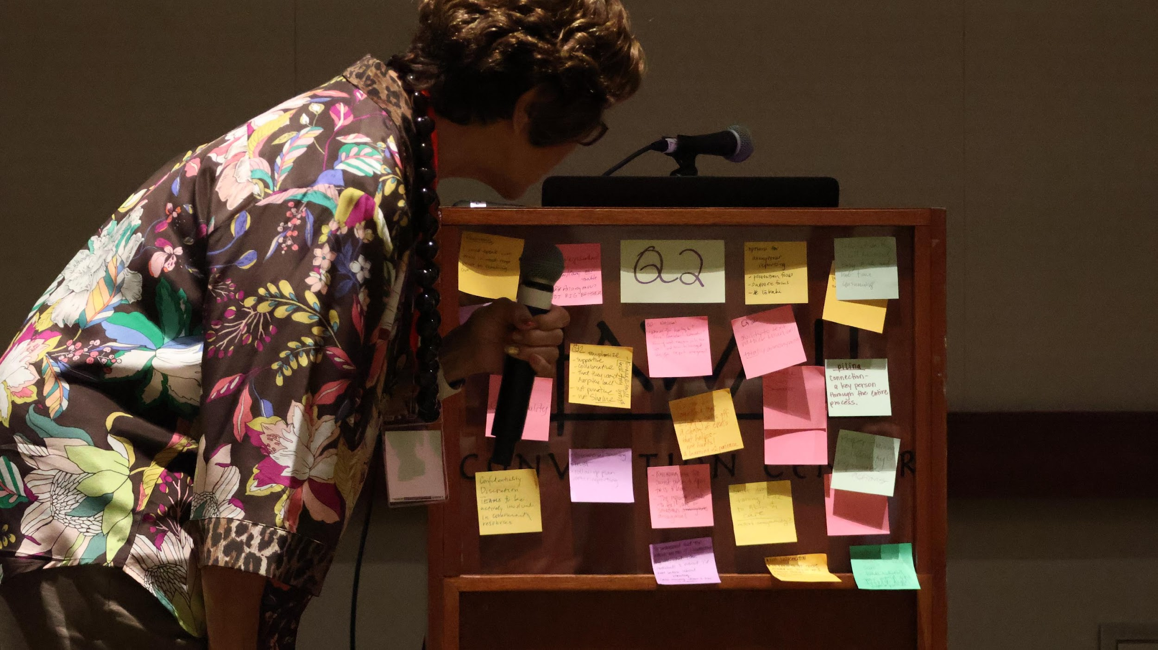
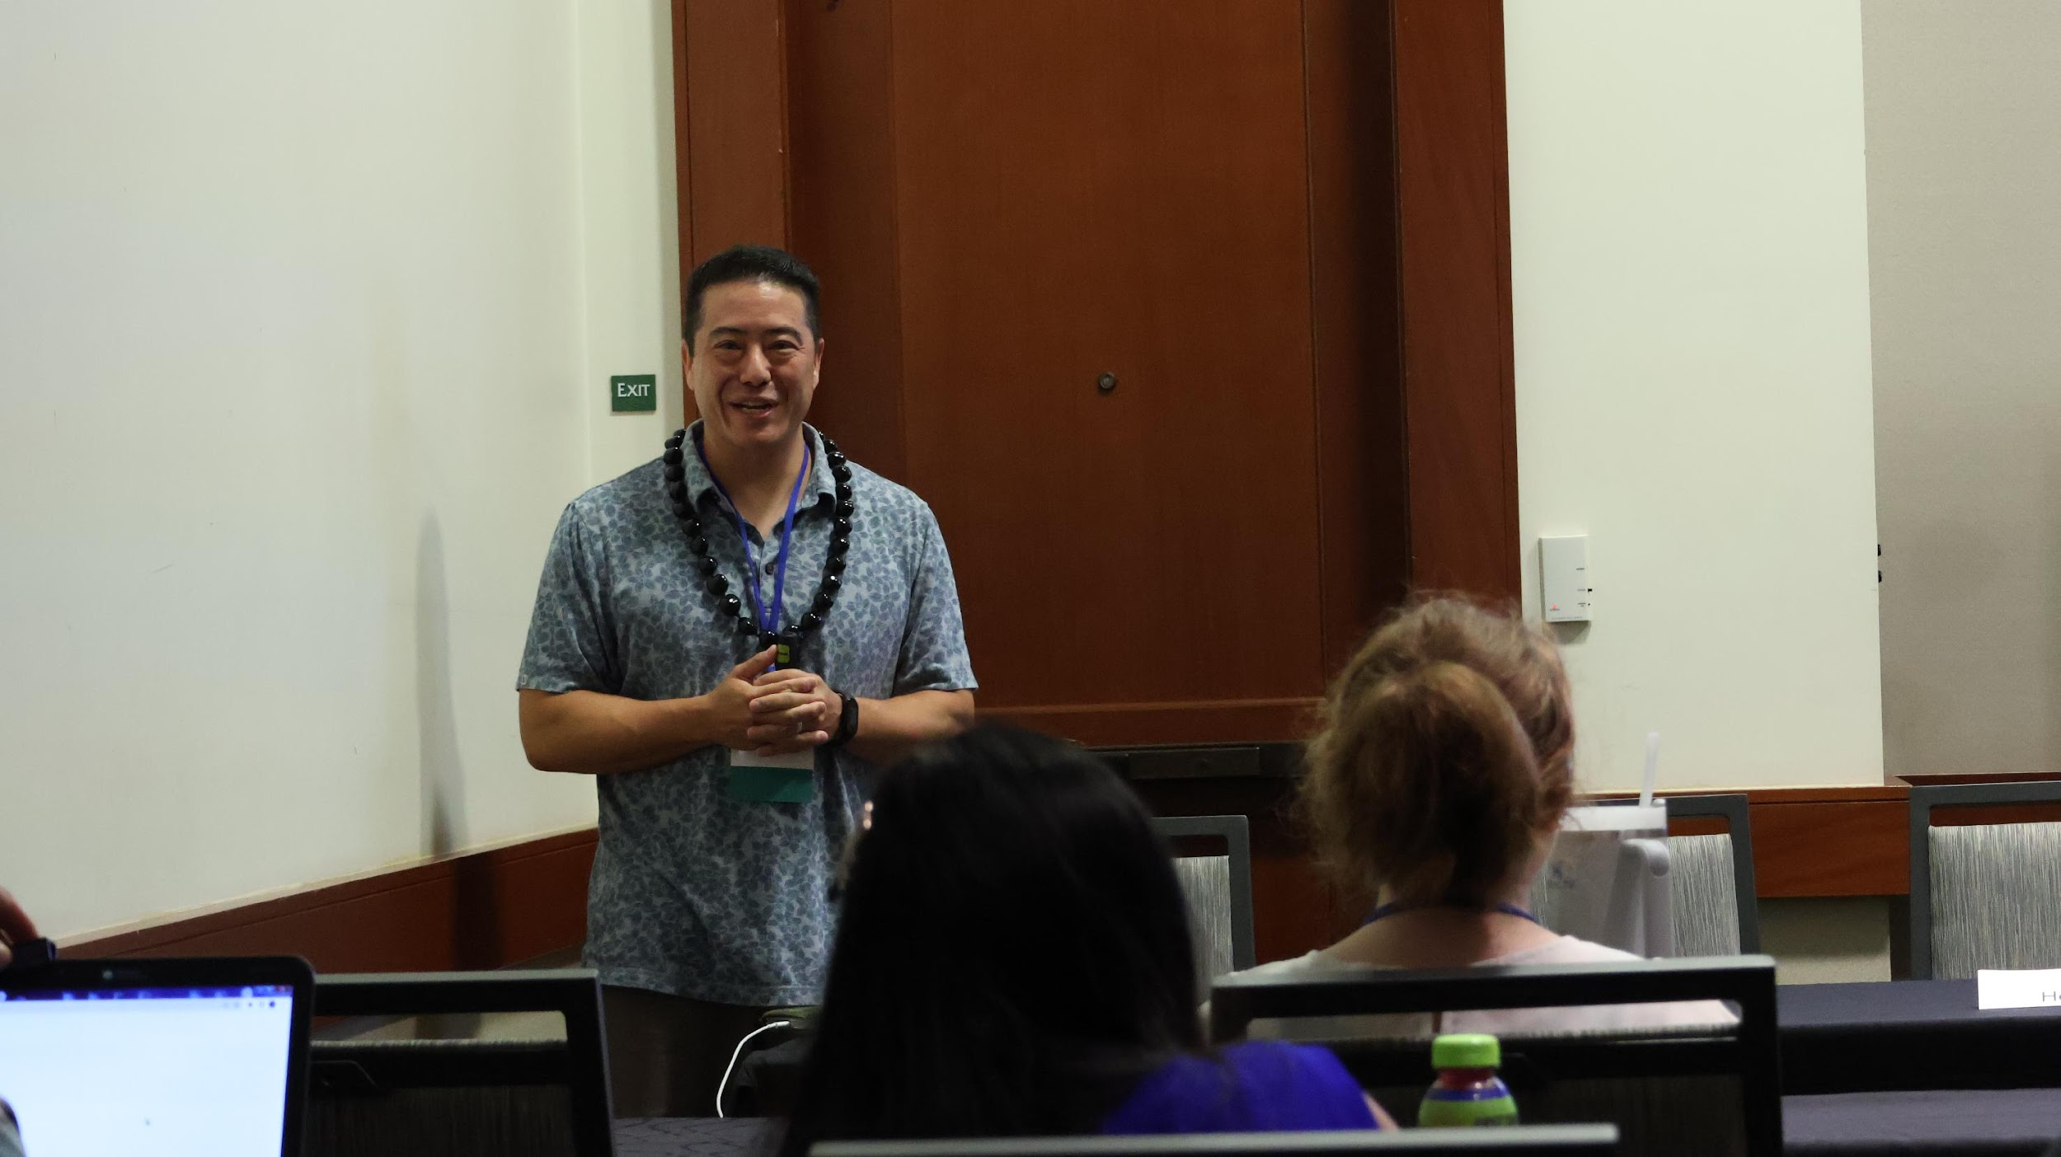
Community Awareness: Institute on Violence, Abuse and Trauma (IVAT)
* 2022 Department of Homeland Security TVTP Grant # EMW-2022-GR-APP-00072
Notes:
3 day suspension occurs in 2018.
The involuntary withdrawal date was October 28th of 2021.

Slide 72
Mahalo!
If you have any questions or would like to learn more about BITAM efforts in HI, please contact:
Bev Baligad, J.D.
(E) bbaligad@hawaii.edu
(T) 808.689.2934

Slide 73
UNCLASSIFIED
OHS | Agenda
08:00 Networking
08:30 Welcome, Administrative Remarks, Event Overview; Administrator Frank Pace
08:45 Threat Overview – Hawaii Statewide Threat Assessment; Criminal Intelligence Analyst, Molly Smith
09:15 Office of Homeland Security Initiatives; Planning and Operations Chief, Jimmie Collins
Near Term Planning Priorities
Annual Homeland Security Summit
Defense Community Infrastructure Pilot Program
Critical Infrastructure Assessment Cadre
Calendar of Events
10:00 Break
10:15 Honolulu Police Department Cyber Crime Unit; Detective Thomas (Tommy) Iinuma
11:00 Targeted Violence Prevention; UHWO Behavior Intervention Team Chair, Beverly Baligad
11:45 Lunch Break
13:00 Port resiliency and the Port Restoration Task Force; Hawaii Emergency Management Agency Administrator, James Barros
13:45 Joint Terrorism Task Force overview; JTTF Coordinator, Earl Asato
14:30 Break
14:45 Introduction to the new state Department of Law Enforcement; Director, Jordan Lowe
15:15 Open Discussion
15:45 Closing Comments, Administrator Frank Pace
16:00 Adjourn
UNCLASSIFIED
73

Slide 74
UNCLASSIFIED
OHS | Agenda
08:00 Networking
08:30 Welcome, Administrative Remarks, Event Overview; Administrator Frank Pace
08:45 Threat Overview – Hawaii Statewide Threat Assessment; Criminal Intelligence Analyst, Molly Smith
09:15 Office of Homeland Security Initiatives; Planning and Operations Chief, Jimmie Collins
Near Term Planning Priorities
Annual Homeland Security Summit
Defense Community Infrastructure Pilot Program
Critical Infrastructure Assessment Cadre
Calendar of Events
10:00 Break
10:15 Honolulu Police Department Cyber Crime Unit; Detective Thomas (Tommy) Iinuma
11:00 Targeted Violence Prevention; UHWO Behavior Intervention Team Chair, Beverly Baligad
11:45 Lunch Break
13:00 Port resiliency and the Port Restoration Task Force; Hawaii Emergency Management Agency Administrator, James Barros
13:45 Joint Terrorism Task Force overview; JTTF Coordinator, Earl Asato
14:30 Break
14:45 Introduction to the new state Department of Law Enforcement; Director, Jordan Lowe
15:15 Open Discussion
15:45 Closing Comments, Administrator Frank Pace
16:00 Adjourn
UNCLASSIFIED
74

Slide 75
UNCLASSIFIED
OHS | Administrator Pace
Port resiliency and the Port Restoration Task Force
Hawaii Emergency Management Agency
Administrator, James Barros
UNCLASSIFIED
75

Slide 76
UNCLASSIFIED
OHS | Agenda
08:00 Networking
08:30 Welcome, Administrative Remarks, Event Overview; Administrator Frank Pace
08:45 Threat Overview – Hawaii Statewide Threat Assessment; Criminal Intelligence Analyst, Molly Smith
09:15 Office of Homeland Security Initiatives; Planning and Operations Chief, Jimmie Collins
Near Term Planning Priorities
Annual Homeland Security Summit
Defense Community Infrastructure Pilot Program
Critical Infrastructure Assessment Cadre
Calendar of Events
10:00 Break
10:15 Honolulu Police Department Cyber Crime Unit; Detective Thomas (Tommy) Iinuma
11:00 Targeted Violence Prevention; UHWO Behavior Intervention Team Chair, Beverly Baligad
11:45 Lunch Break
13:00 Port resiliency and the Port Restoration Task Force; Hawaii Emergency Management Agency Administrator, James Barros
13:45 Joint Terrorism Task Force overview; JTTF Coordinator, Earl Asato
14:30 Break
14:45 Introduction to the new state Department of Law Enforcement; Director, Jordan Lowe
15:15 Open Discussion
15:45 Closing Comments, Administrator Frank Pace
16:00 Adjourn
UNCLASSIFIED
76

Slide 77
UNCLASSIFIED
OHS | Administrator Pace
Joint Terrorism Task Force overview
JTTF Coordinator, Earl Asato
UNCLASSIFIED
77

Slide 78
UNCLASSIFIED
OHS | Agenda
08:00 Networking
08:30 Welcome, Administrative Remarks, Event Overview; Administrator Frank Pace
08:45 Threat Overview – Hawaii Statewide Threat Assessment; Criminal Intelligence Analyst, Molly Smith
09:15 Office of Homeland Security Initiatives; Planning and Operations Chief, Jimmie Collins
Near Term Planning Priorities
Annual Homeland Security Summit
Defense Community Infrastructure Pilot Program
Critical Infrastructure Assessment Cadre
Calendar of Events
10:00 Break
10:15 Honolulu Police Department Cyber Crime Unit; Detective Thomas (Tommy) Iinuma
11:00 Targeted Violence Prevention; UHWO Behavior Intervention Team Chair, Beverly Baligad
11:45 Lunch Break
13:00 Port resiliency and the Port Restoration Task Force; Hawaii Emergency Management Agency Administrator, James Barros
13:45 Joint Terrorism Task Force overview; JTTF Coordinator, Earl Asato
14:30 Break
14:45 Introduction to the new state Department of Law Enforcement; Director, Jordan Lowe
15:15 Open Discussion
15:45 Closing Comments, Administrator Frank Pace
16:00 Adjourn
UNCLASSIFIED
78

Slide 79
UNCLASSIFIED
OHS | Agenda
08:00 Networking
08:30 Welcome, Administrative Remarks, Event Overview; Administrator Frank Pace
08:45 Threat Overview – Hawaii Statewide Threat Assessment; Criminal Intelligence Analyst, Molly Smith
09:15 Office of Homeland Security Initiatives; Planning and Operations Chief, Jimmie Collins
Near Term Planning Priorities
Annual Homeland Security Summit
Defense Community Infrastructure Pilot Program
Critical Infrastructure Assessment Cadre
Calendar of Events
10:00 Break
10:15 Honolulu Police Department Cyber Crime Unit; Detective Thomas (Tommy) Iinuma
11:00 Targeted Violence Prevention; UHWO Behavior Intervention Team Chair, Beverly Baligad
11:45 Lunch Break
13:00 Port resiliency and the Port Restoration Task Force; Hawaii Emergency Management Agency Administrator, James Barros
13:45 Joint Terrorism Task Force overview; JTTF Coordinator, Earl Asato
14:30 Break
14:45 Introduction to the new state Department of Law Enforcement; Director, Jordan Lowe
15:15 Open Discussion
15:45 Closing Comments, Administrator Frank Pace
16:00 Adjourn
UNCLASSIFIED
79

Slide 80
UNCLASSIFIED
OHS | Administrator Pace
Introduction to the new state Department of Law Enforcement
Director, Jordan Lowe
UNCLASSIFIED
80

Slide 81
Department of State Law Enforcement
Impacts of Separating Law Enforcement from Corrections and Consolidating Statewide Law Enforcement

Slide 82
Purpose
Establish a new Department of Law Enforcement to consolidate state law enforcement, investigations, and homeland security
Rename the Department of Public Safety to the Department of Corrections and Rehabilitation

Slide 83
Department of Public Safety Challenges
Difficult to find a Director with both corrections AND law enforcement background
Corrections and law enforcement have distinctly different and unique missions
Training requirements are significantly different between correction officers and law enforcement officers

Slide 84
Current State Law Enforcement Entities
Department of the Attorney General Investigations Division
Department of Land and Natural Resources Division of Conservation and Resources Enforcement
Department of Public Safety Internal Affairs Office
Department of Public Safety Narcotics Enforcement Division
Department of Public Safety Sheriffs Division
Department of Transportation Harbor Police

Slide 85
State Law Enforcement Coalition (SLEC)
SLEC was created after 9/11 to improve interagency communications within the law enforcement community
Law enforcement is more efficient when command and control is centralized under a single unified command structure
SLEC works together to respond to emergencies, major events, civil disturbances and other challenges that confront the state
Department of State Law Enforcement will use SLEC experiences to build a stronger law enforcement coalition

Slide 86
Benefits of Consolidation
Centralized command and control for critical incident management
Force multiplier for smaller law enforcement agencies
Interoperable communications and operational flexibility
Efficiency of statewide law enforcement operations
Ability to handle complex multi-island investigations
Standardized report writing
Unified systems and network

Slide 87
Uniform Standards
Law Enforcement Standards Board
Consistent recruitment standards
Statewide training for law enforcement
Standardized policies and procedures
CALEA accreditation for all state law enforcement entities
Standardized accountability policies and protocols
Reduction of liability

Slide 88
Hawaii State Fusion Center
Transferring the duties and responsibilities of the Office of Homeland Security and the Fusion Center from Department of Defense to the Department of Law Enforcement
Being attached to a law enforcement entity will maximize the potential of the Fusion Center
Access to law enforcement sensitive information
Law enforcement investigators assigned to follow-up on intelligence leads
Coordinate on equal footing with other law enforcement agencies (Federal, State and local)

Slide 89
Organizational Structure

Slide 90
Corrections Changes
No changes to Corrections overall mission
Need one (1) additional Deputy Director for Corrections and Rehabilitation and one (1) private secretary
Separating LE from Corrections would allow both entities to concentrate on their respective roles within the criminal justice system
Corrections will effectively take over all court transports originating from correctional facilities
LE would effectively take over all court transports originating from County Police Department to Court, then to Correctional facilities for all new intakes

Slide 91
Department of Corrections and Rehabilitation Organizational Chart

Slide 92
Timeline
January 2022 – Bill introduction
July 2022 – Create Department of Law Enforcement; transition team to assist Director with planning and implementation
July 2023 – All law enforcement personnel, equipment, funds, etc. transferred to new department

Slide 93
UNCLASSIFIED
OHS | Agenda
08:00 Networking
08:30 Welcome, Administrative Remarks, Event Overview; Administrator Frank Pace
08:45 Threat Overview – Hawaii Statewide Threat Assessment; Criminal Intelligence Analyst, Molly Smith
09:15 Office of Homeland Security Initiatives; Planning and Operations Chief, Jimmie Collins
Near Term Planning Priorities
Annual Homeland Security Summit
Defense Community Infrastructure Pilot Program
Critical Infrastructure Assessment Cadre
Calendar of Events
10:00 Break
10:15 Honolulu Police Department Cyber Crime Unit; Detective Thomas (Tommy) Iinuma
11:00 Targeted Violence Prevention; UHWO Behavior Intervention Team Chair, Beverly Baligad
11:45 Lunch Break
13:00 Port resiliency and the Port Restoration Task Force; Hawaii Emergency Management Agency Administrator, James Barros
13:45 Joint Terrorism Task Force overview; JTTF Coordinator, Earl Asato
14:30 Break
14:45 Introduction to the new state Department of Law Enforcement; Director, Jordan Lowe
15:15 Open Discussion
15:45 Closing Comments, Administrator Frank Pace
16:00 Adjourn
UNCLASSIFIED
93

Slide 94
UNCLASSIFIED
OHS | Discussion
Discussion
Questions/Comments?
UNCLASSIFIED
94

Slide 95
UNCLASSIFIED
OHS | Agenda
08:00 Networking
08:30 Welcome, Administrative Remarks, Event Overview; Administrator Frank Pace
08:45 Threat Overview – Hawaii Statewide Threat Assessment; Criminal Intelligence Analyst, Molly Smith
09:15 Office of Homeland Security Initiatives; Planning and Operations Chief, Jimmie Collins
Near Term Planning Priorities
Annual Homeland Security Summit
Defense Community Infrastructure Pilot Program
Critical Infrastructure Assessment Cadre
Calendar of Events
10:00 Break
10:15 Honolulu Police Department Cyber Crime Unit; Detective Thomas (Tommy) Iinuma
11:00 Targeted Violence Prevention; UHWO Behavior Intervention Team Chair, Beverly Baligad
11:45 Lunch Break
13:00 Port resiliency and the Port Restoration Task Force; Hawaii Emergency Management Agency Administrator, James Barros
13:45 Joint Terrorism Task Force overview; JTTF Coordinator, Earl Asato
14:30 Break
14:45 Introduction to the new state Department of Law Enforcement; Director, Jordan Lowe
15:15 Open Discussion
15:45 Closing Comments, Administrator Frank Pace
16:00 Adjourn
UNCLASSIFIED
95
Notes:
Cyber forensics in exercise (Cyber Storm)?

Slide 96
UNCLASSIFIED
OHS | Administrator Pace
Closing Comments
Administrator Frank Pace
UNCLASSIFIED
96
Notes:
20 July
Location (confirmed):
University of Hawaiʻi – West Oʻahu
Multi-purpose Room - Building C208
91-1001 Farrington Hwy
Kapolei, HI 96707
Agenda: TBD
Notes:
Placeholder/agenda NLT 6/9
Read aheads NLT 7/7

Slide 97
UNCLASSIFIED
OHS | Agenda
08:00 Networking
08:30 Welcome, Administrative Remarks, Event Overview; Administrator Frank Pace
08:45 Threat Overview – Hawaii Statewide Threat Assessment; Criminal Intelligence Analyst, Molly Smith
09:15 Office of Homeland Security Initiatives; Planning and Operations Chief, Jimmie Collins
Near Term Planning Priorities
Annual Homeland Security Summit
Defense Community Infrastructure Pilot Program
Critical Infrastructure Assessment Cadre
Calendar of Events
10:00 Break
10:15 Honolulu Police Department Cyber Crime Unit; Detective Thomas (Tommy) Iinuma
11:00 Targeted Violence Prevention; UHWO Behavior Intervention Team Chair, Beverly Baligad
11:45 Lunch Break
13:00 Port resiliency and the Port Restoration Task Force; Hawaii Emergency Management Agency Administrator, James Barros
13:45 Joint Terrorism Task Force overview; JTTF Coordinator, Earl Asato
14:30 Break
14:45 Introduction to the new state Department of Law Enforcement; Director, Jordan Lowe
15:15 Open Discussion
15:45 Closing Comments, Administrator Frank Pace
16:00 Adjourn
UNCLASSIFIED
97

