Slide 1
Supply Chain Attacks: The XZ Utils SSH Backdoor Vulnerability
CPT Sean McQuade (Regional Cyber Center – Pacific)
The Overall Classification for this Brief is UNCLASSIFIED

Slide 2
Disclaimer
The views and opinions presented herein are those of the author and do not necessarily represent the views of DoD or the Army. Appearance of, or reference to, any commercial products or services does not constitute DoD or Army endorsement of those products or services. The appearance of external hyperlinks does not constitute DoD or Army endorsement of the linked websites, or the information, products or services therein.
Notes:
https://www.army.mil/socialmedia/personal/

Slide 3
Vulnerability Significance
“An unlikely combination of errors and circumstances” led to the discovery of a 5 tenths of a second (${10}^{−1}s)$SSH login anomaly.
Notes:
CVE-2024-3094
https://access.redhat.com/security/cve/CVE-2024-3094
“An unlikely combination of errors and circumstances that led to this one being discovered, a “500000-microsecond-blunder*” Piskvorrr; Sadjad
https://news.ycombinator.com/item?id=40059892
Today’s Threat Environment (Increasingly focused, sophisticated cyber adversaries; Increased upstream reliance on free and open-source (FOSS) software; Delays in communicating threat advisories and mitigations; Privatization of vulnerability and exploit information)
https://www.crowdstrike.com/global-threat-report/
https://www.rapid7.com/blog/post/2024/05/21/rapid7-releases-the-2024-attack-intelligence-report/
“The problem is that it really depends on your stack/application. A score pretends to be an absolute frame of reference to work on, and this is hardly reliable to assess real risk and impact.A CVSS 10 on several internal services with all user input being filtered may be substantially less risky than a public facing component using a library with a CVSS 2.5 depending on your application and vulnerability.
The only correct way is to assess risk is analyze how you utilize each component and determine if your application would run into the issue to begin with. This work cannot be hand-waved away with a simple number despite this practice being the hot fad in cybersecurity.” Redserk https://news.ycombinator.com/item?id=40059892

Slide 4
Agenda
Introduction
Supply Chain Attacks Overview
XZ Utils
Open-Source Development Process
Timeline
Backdoor Overview
Social Engineering
Mitigations
Potential Threat Actor Capabilities
Potential Threat Actor Intent
Closing Remarks
Discussion

Slide 5
Supply Chain Attacks Overview
Stuxnet Attack [A]
Stuxnet Attack [A]
Stuxnet Attack [A]
Stuxnet Attack [A]
Stuxnet Attack [A]
Stuxnet
Attack
Target
Breach
SolarWinds Breach
Microsoft Compromises
XZ Utils Backdoor
Siemens operational technology manipulated to damage Iranian centrifuges
Third-party vendor compromise enabled pivot to Target’s internal network
Malicious update pushed remote access trojan to customers globally
Popular open-source software backdoor exposed just prior to exploitation
Exchange server compromises allowed initial access globally
2010
2013
2020
2021
2024
Notes:
Supply Chain Attacks Overview
-Physical Attack Vector (Designed, Compromised, Planted)
-Software attack vectors (Designed, Compromised - Commercial Software Products, Upstream Dependencies Closed and Open-Source Supply Chains)
[1] https://www.fortinet.com/resources/cyberglossary/supply-chain-attacks
[2] https://www.sentinelone.com/cybersecurity-101/what-is-supply-chain-attack/
[3] https://www.manageengine.com/log-management/cyber-security/supply-chain-attack-types.html
[4] https://www.crowdstrike.com/cybersecurity-101/cyberattacks/supply-chain-attacks/
Supply Chain Attacks Timeline (Not Exhaustive)
[A] Stuxnet Attack
“In the 2010 attack, the Stuxnet attackers exploited several zero-day vulnerabilities in Microsoft Windows to ultimately gain access to Siemens software and the PLCs (Operational Technology – SCADA Systems). This was done to gain access to and effectively damage high-speed centrifuges at the Iranian Bushehr nuclear power plant.”
https://www.darkreading.com/ics-ot-security/siemens-plcs-still-vulnerable-stuxnet-like-cyberattacks
[B] Target Breach
“In November and December 2013, cyber thieves executed a successful cyber attack against Target, one of the largest retail companies in the United States. The attackers surreptitiously gained access to Target’s computer network, stole the financial and personal information of as many as 110 million Target customers, and then removed this sensitive information from Target’s network to a server in Eastern Europe”
“Target gave network access to a third-party vendor, a small Pennsylvania HVAC company, which did not appear to follow broadly accepted information security practices. The vendor’s weak security allowed the attackers to gain a foothold in Target’s network.”
https://www.commerce.senate.gov/services/files/24d3c229-4f2f-405d-b8db-a3a67f183883
“The person who let the hackers into Target wasn’t even a Target employee and wasn’t bent on mischief. The person worked for Fazio Mechanical, a Pennsylvania-based HVAC company, a third-party vendor hired by Target. The Fazio employee fell for a phishing trick and opened an attachment in a fraudulent email the hackers had sent to him. Hidden in the email attachment lurked the Citadel Trojan horse—a malicious software program that took root in Fazio’s computers. The Citadel Trojan horse was nothing novel—it was a variant of a well-known malware package called ZeuS and is readily detectable by any major enterprise anti-virus software. But Fazio lacked the massive security infrastructure that Target had, allowing the malware to remain undetected on the Fazio computers. Through the Trojan horse, the hackers obtained Fazio’s log-in credentials for Target’s system.”
https://slate.com/technology/2022/04/breached-excerpt-hartzog-solove-target.html
[C] SolarWinds Compromise
“SolarWinds, a significant player in the software sphere, suffered an attack that began in September 2019. As a result of the attack, over 18,000 SolarWinds customers ended up installing updates containing malicious code. Hackers used it to steal customer data and then spy on other organizations.” “Many of SolarWinds’ customers use a system called Orion, which is a performance monitoring solution that tracks the status of SolarWinds' Orion customers. It has privileged access to gather performance data and other information from logs generated by customer IT assets. This made SolarWinds an ideal target for hackers who successfully gained access to several thousand companies' networks.”
https://www.fortinet.com/resources/cyberglossary/solarwinds-cyber-attack
“Hackers believed to be directed by the Russian intelligence service, the SVR, used that routine software update to slip malicious code into Orion's software. The Russians successfully compromised about 100 companies and about a dozen government agencies. The companies included Microsoft, Intel and Cisco; the list of federal agencies so far includes the Treasury, Justice and Energy departments, the Pentagon, and the Cybersecurity and Infrastructure Security Agency.
https://www.npr.org/2021/04/16/985439655/a-worst-nightmare-cyberattack-the-untold-story-of-the-solarwinds-hack
[D] Microsoft Exchange Server Compromise
“Hafnium, a Chinese group that’s been attacking a vulnerability in Microsoft Exchange Server to sneak into victims’ email inboxes and beyond.”
https://arstechnica.com/information-technology/2021/03/chinas-and-russias-spying-spree-will-take-years-to-unpack/
“First, it would gain access to an Exchange Server either with stolen passwords or by using the previously undiscovered vulnerabilities to disguise itself as someone who should have access. Second, it would create what’s called a web shell to control the compromised server remotely. Third, it would use that remote access – run from the U.S.-based private servers – to steal data from an organization’s network.”
https://www.cnbc.com/2021/03/09/microsoft-exchange-hack-explained.html
“The FBI’s operation targeted web shells that were dropped on compromised Microsoft Exchange servers during a widespread cyber campaign first discovered by US companies in January. Microsoft disclosed in early March the four zero-day vulnerabilities being exploited in Exchange server software. Microsoft and CISA subsequently released detection tools, extensive information, and patches. This set off a mad dash between multiple threat actors seeking to exploit the four zero days and entities trying to patch the vulnerabilities before they could be exploited. Microsoft and others have implicated a previously unknown Chinese group, HAFNIUM, as the original threat actor in the campaign. But in the days leading up to and since Microsoft’s disclosure, many other attackers began exploiting the zero days — to include installing the web shells to provide persistent access for follow-on attacks.”
https://breakingdefense.com/2021/04/doj-reveals-secret-fbi-op-to-clean-exchange-servers/
“Up to 60,000 computer systems exposed in Germany to Microsoft flaw: BSI”
https://www.reuters.com/article/us-usa-cyber-microsoft-germany/up-to-60000-computer-systems-exposed-in-germany-to-microsoft-flaw-bsi-idUSKBN2B2262/
“Tens of Thousands of Customers Appear to be Affected”\
https://www.wsj.com/articles/china-linked-hack-hits-tens-of-thousands-of-u-s-microsoft-customers-11615007991?mod=tech_lead_pos1
Timeline
https://www.csoonline.com/article/570653/the-microsoft-exchange-server-hack-a-timeline.html
[E] XZ Utils
Sources Throughout Presentation

Slide 6
XZ Utils
Open-source compression library
Used in many Linux distributions
Started in 2005 with a small group of collaborators
Lasse Collin sole maintainer
Notes:
https://tukaani.org/xz/
https://security.berkeley.edu/news/xz-utils
https://www.invicti.com/blog/web-security/xz-utils-backdoor-supply-chain-rce-that-got-caught/
“The xz-utils backdoor could have been the most serious software supply chain compromise since the solarwinds orion hack. Carefully hidden in a widely-used open-source library, the sophisticaeted backdoor could have allowed remote code execution (RCE) on millision of systems if it hadn’t accidentally been discovered.
What is xz?
xz is a general purpose data compression format present in nearly every Linux distribution, both community projects and commercial product distributions. Essentially, it helps compress (and then decompress) large file formats into smaller, more manageable sizes for sharing via file transfers.
https://www.redhat.com/en/blog/urgent-security-alert-fedora-41-and-rawhide-users

Slide 7
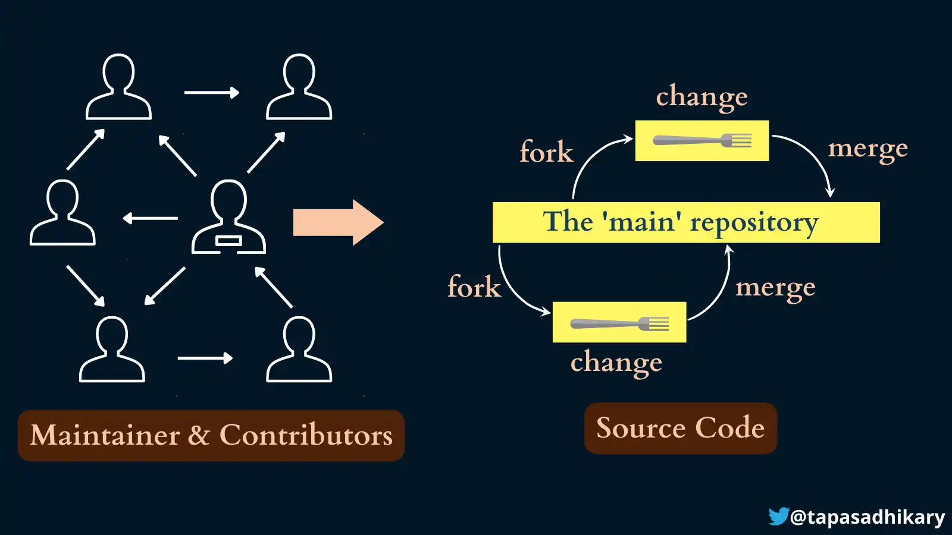
Open-Source Development Process
Notes:
Deep Dive into XZ Utils Backdoor - Columbia Engineering, Advanced Systems Programming Guest Lecture; Denzel Farmer; https://www.youtube.com/watch?v=Q6ovtLdSbEA
https://www.freecodecamp.org/news/a-practical-guide-to-start-opensource-contributions/

Slide 8
Timeline
2021
2022
2023
2024
OCTOBER
Jia Tan (JT) Emerges
MAY
Likely Pressure Campaign Begins
JANUARY
JT Becomes Maintainer
24 FEBRUARY
JT Commits XZ 5.6.0 (Backdoor)
JUNE
JT Tests Backdoor Infrastructure
09 MARCH
JT Commits XZ 5.6.1 (Backdoor)
29 MARCH
Andres Freund Discovery and Alert
Notes:
https://github.com/JiaT75
https://boehs.org/node/everything-i-know-about-the-xz-backdoor
https://www.cisa.gov/news-events/alerts/2024/03/29/reported-supply-chain-compromise-affecting-xz-utils-data-compression-library-cve-2024-3094
https://boehs.org/node/everything-i-know-about-the-xz-backdoor
https://lcamtuf.substack.com/p/technologist-vs-spy-the-xz-backdoor
Timeline
https://research.swtch.com/xz-timeline
Likely pressure campaign with sockpuppets
[A] October 2021 Jia Tan [JiaT75] creates GitHub Account https://github.com/JiaT75
https://boehs.org/node/everything-i-know-about-the-xz-backdoor
A] https://www.openwall.com/lists/oss-security/2024/03/29/4; https://www.cisa.gov/news-events/alerts/2024/03/29/reported-supply-chain-compromise-affecting-xz-utils-data-compression-library-cve-2024-3094

Slide 9
Backdoor – Indicators
Liblzma anomalies observed on Debian sid installations
SSH logins slower; utilizing unusual CPU
Valgrind errors
before:
nonexistant@...alhost: Permission denied (publickey)
real 0m0.299s
user 0m0.202s
sys 0m0.006s
after:
nonexistant@...alhost: Permission denied (publickey)
real 0m0.807s
user 0m0.202s
sys 0m0.006s
Notes:
-Actor might have got sloppy because a patch was about to be introduced to prevent this type of attack. Actor rushing to get it out into the wild and made many mistakes, including performance degradation (xyst comment, https://news.ycombinator.com/item?id=40207261)
Errors: https://www.openwall.com/lists/oss-security/2024/03/29/4
sid – code name for Debian’s development (unstable) distribution https://www.debian.org/releases/sid/
“openssh does not directly use liblzma. However debian and several other distributions patch openssh to support systemd notification, and libsystemd does depend on lzma.” https://www.openwall.com/lists/oss-security/2024/03/29/4
AndresFreundTec “running perf tests against postgres and noticed his ssh was slow, so he dove into that and found the backdoor a couple days after it was pushed.”
Hacker News Comment by Jethro_tell https://news.ycombinator.com/item?id=39869068
sshd is the OpenSSH server process. It listens to incoming connections using the SSH protocol and acts as the server for the protocol. It handles user authentication, encryption, terminal https://www.ssh.com/academy/ssh/sshd

Slide 10
Backdoor – Significance
CVE-2024-3094 – Critical Impact; 10.0 CVSS Score
XZ versions 5.6.0 (24 February 2024) and 5.6.1 (09 March 2024)
Impacted:
Fedora 40 and Fedora Rawhide
Arch Linux
Kali Linux
openSUSE Tumbleweed and micros
Debian Testing, Unstable, and Experimental Versions
Notes:
https://www.cisa.gov/news-events/alerts/2024/03/29/reported-supply-chain-compromise-affecting-xz-utils-data-compression-library-cve-2024-3094
https://access.redhat.com/security/cve/CVE-2024-3094
https://security.berkeley.edu/news/xz-utils *No versions of Red Hat Enterprise Linux (RHEL) affected
Fedora Rawhide is the development distribution of Fedora Linux, and serves as the basis for future Fedora Linux builds.
Target Scope Likely Larger: Redhat Package Manager (RPM) and Debian Distributions (All put sshd in /usr/sbin)
Hacker News; Comment by AshamedCaptain; https://news.ycombinator.com/item?id=39869068
“backdoor could barely make it out of the alpha phase of development” (xyst comment; https://news.ycombinator.com/item?id=40207261)
“Systemd's inability to manage daemons correctly, like every other init system, necessitated debian, redhat, and others patching ssh, just so systemd could reliably start ssh. Which is what enabled this vulnerability to be viable.” Bbarnett https://news.ycombinator.com/item?id=39986740
lyu07282 They used test driven development for the backdoor development? Kind of hilarious ngl https://news.ycombinator.com/item?id=40207261
throwaway4good Yes. Test is a perfect place to hide an attack - reviewers pay far less attention to test code than the (what they perceive to be) production code. https://news.ycombinator.com/item?id=40207261

Slide 11
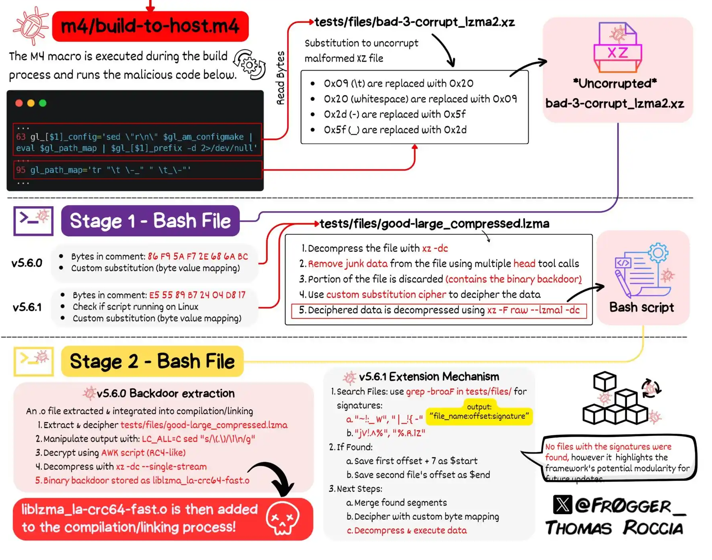
Backdoor – Significance Cont.
Notes:
X – Posting by Filippo Valsorda; Mar 30 2024; https://bsky.app/profile/filippo.abyssdomain.expert/post/3kowjkx2njy2b
“Attacker put the payload into the test folder of the compression library and injected it upon build via some arcane build script”
Hacker News, Comment by Choeger; https://news.ycombinator.com/item?id=39869068
Reddit/Programming – The Role of IFUNC in the XZ Backdoor, Comment by Sjepsa
Shell Script
Compromises
https://www.openwall.com/lists/oss-security/2024/03/29/4
sid – code name for Debian’s development (unstable) distribution https://www.debian.org/releases/sid/
Most Unix software on the net is distributed in the form of a tarball. This just means that all the files have been packed into a tar file, which has been compressed with gzip to save space. The file name thus ends up having extension .tar.gz. Sometimes this is shortened to .tgz. https://computing.help.inf.ed.ac.uk/FAQ/whats-tarball-or-how-do-i-unpack-or-create-tgz-or-targz-file https://www.openwall.com/lists/oss-security/2024/03/29/4
-Attack type: Dynamically loading unneeded libraries (xyst comment; https://news.ycombinator.com/item?id=40207261)
Illustration
https://infosec.exchange/@fr0gger/112189232773640259
https://www.openwall.com/lists/oss-security/2024/03/29/4
sid – code name for Debian’s development (unstable) distribution https://www.debian.org/releases/sid/
Most Unix software on the net is distributed in the form of a tarball. This just means that all the files have been packed into a tar file, which has been compressed with gzip to save space. The file name thus ends up having extension .tar.gz. Sometimes this is shortened to .tgz. https://computing.help.inf.ed.ac.uk/FAQ/whats-tarball-or-how-do-i-unpack-or-create-tgz-or-targz-file https://www.openwall.com/lists/oss-security/2024/03/29/4
-Attack type: Dynamically loading unneeded libraries (xyst comment; https://news.ycombinator.com/item?id=40207261)
Compromises
Upstream xz repository
tests/files/bad-3-corrupt_lzma2.xz
tests/files/good-large_compressed.lzma
xz tarballs
libzma
v.5.6.0
v.5.6.1

Slide 12
Social Engineering
Ubuntu
Debian
liblzma
Sole Maintainer
Stranger
User Network
Dependency Chain of Trust Example
Sustained Upstream, Social Engineering Attack
Notes:
Reddit/Programming – The Role of IFUNC in the XZ Backdoor, Comment by Sjepsa
Remote Code Execution (Shell Script)
IFUNC
ZGRINDZ
SSH
X – Posting by Filippo Valsorda; Mar 30 2024; https://bsky.app/profile/filippo.abyssdomain.expert/post/3kowjkx2njy2b
“Attacker put the payload into the test folder of the compression library and injected it upon build via some arcane build script”
Hacker News, Comment by Choeger; https://news.ycombinator.com/item?id=39869068

Slide 13
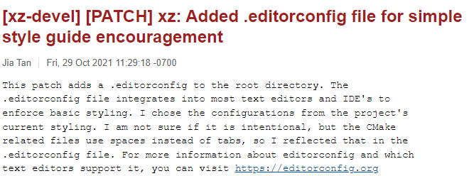
Social Engineering
Notes:
Email: https://www.mail-archive.com/xz-devel@tukaani.org/msg00512.html
Timeline: https://research.swtch.com/xz-timeline
October 2021 Jia Tan [JiaT75] creates GitHub Account: https://github.com/JiaT75

Slide 14
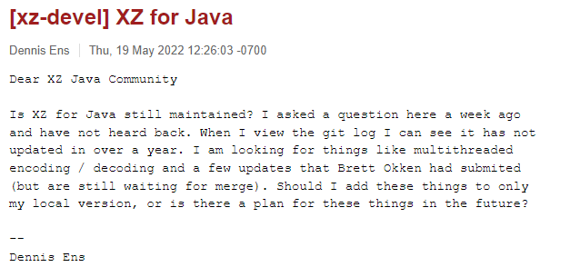
Social Engineering Cont.
Notes:
Email: https://www.mail-archive.com/xz-devel@tukaani.org/msg00562.html
Timeline https://research.swtch.com/xz-timeline

Slide 15
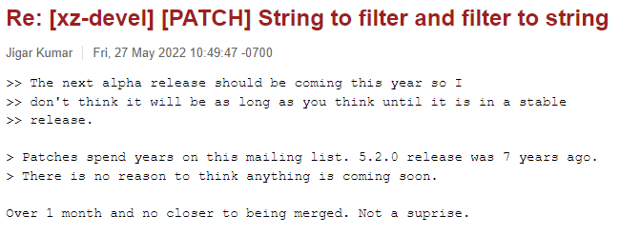
Social Engineering Cont.
Notes:
Email: https://www.mail-archive.com/xz-devel@tukaani.org/msg00565.html
Timeline https://research.swtch.com/xz-timeline

Slide 16
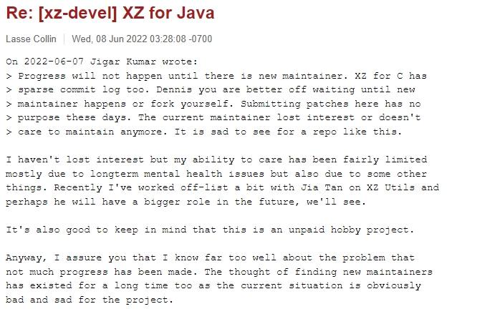
Social Engineering Cont.
Notes:
Email: https://www.mail-archive.com/xz-devel@tukaani.org/msg00567.html
Timeline https://research.swtch.com/xz-timeline

Slide 17
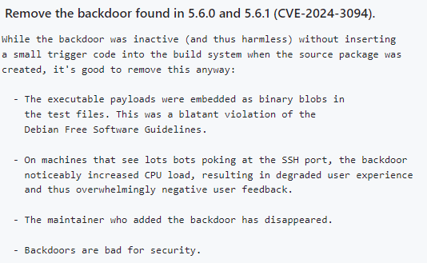
Mitigations
Notes:
https://github.com/tukaani-project/xz/commit/e93e13c8b3bec925c56e0c0b675d8000a0f7f754
No criminal actions taken so far by malicious actor
“[CISA investigating] They can subpoena Google to get IP addresses behind the emails, but it depends on whether and where a VPN was used if they'll get any further than that. If we will ever see a fully public report is anyone's guess.” (rwmj comment; https://news.ycombinator.com/item?id=40207261)
”If it's a state actor, it's not unreasonable to think they'd spin up their own VPNAll you need a Raspberry Pi and some public Wi-Fi network to create a jump point and hide among the 100s of devices going on and off that one public IP. With projects like TailScale you could set it up and plant it somewhere in a matter of hours” (yonatan8070 comment; https://news.ycombinator.com/item?id=40207261)
“If it is a state actor like China or North Korea, they own the gateways and firewalls and can ensure any traffic they do not want to be identified ever will be” (lrvick comment; https://news.ycombinator.com/item?id=40207261)
Detect and replace XZ Utils versions 5.6.0 and 5.6.1
Maintain awareness of dependencies and associated risks
https://www.cisa.gov/news-events/alerts/2024/03/29/reported-supply-chain-compromise-affecting-xz-utils-data-compression-library-cve-2024-3094
throwaway4good ”And from Microsoft / GitHub - who would have a lot additional information (logs, ip-adresses, use of two-factor auth etc.)? Have they made a statement?Usually Microsoft etc. don't hold back identifying "threat actors".
Is there a US police investigation ongoing that could ask Microsoft? The target of this attack has been US firms / persons so if they report it, I assume a US police investigation would be required. https://news.ycombinator.com/item?id=40207261
chrizel Based on a HN comment from a couple of weeks ago, by analyzing the attackers IP addresses from IRC chat logins, it seems they used a VPN service. If you think about it, it makes sense to always use VPN when doing an operation like this. So I think the ip addresses won't be of much use. https://news.ycombinator.com/item?id=40207261
heavyset_go Might be able to tell which VPN service they used and can then subpoena it. https://news.ycombinator.com/item?id=40207261
gzer0 Based on the sophistication we've seen, they probably used Mullvad for their VPN. In that case, a subpoena wouldn't turn up anything. https://news.ycombinator.com/item?id=40207261
mtsr I don’t know if it’s been tried, but if not it would be in everyone’s interest to see what Mullvad will actually cough up. https://news.ycombinator.com/item?id=40207261
trogdor I have seen NordVPN’s response to a subpoena. Their response was that they had no records connecting an IP address at a specific date/time to any particular person. https://news.ycombinator.com/item?id=40207261
emayljames it would be the end of their business if they did, as they have a strict no retention policy. This would mean they are lying to all their customers, so it is not going to happen. https://news.ycombinator.com/item?id=40207261
Mullvad boasts a strict no-logs policy that's been auditedThe audit focused on the security of Mullvad's server infrastructure and its no-logging policy, finding that “significant effort had been put into preserving VPN clients privacy” and “found no logging of user activity data” during the audit.May 29, 2024 Mullvad VPN Review 2024: A Budget-Friendly VPN That Pairs ...
NordVPN doesn't collect, sell, or track your browsing data – ever. Reclaim your online privacy and security without worrying about snoopers. VPN security: Are VPNs safe and secure? - NordVPN

Slide 18
Potential Threat Actor Capabilities
Nation-State Organization
State-Sponsored Group
Criminal Organization
Hacktivists
Notes:
https://github.com/JiaT75
Characteristics
-Jia Tan disappeared once backdoor is discovered
Low Probability of Backdoor Detection Prior to Attack
Threat Actors Characteristics (Patient; Seemingly helpful and collaborative)
Targets
-Potentially all Redhat Package Manager and Debian Distributions (All put sshd in /usr/sbin)
Hacker News; Comment by AshamedCaptain; https://news.ycombinator.com/item?id=39869068
“But xz is a very good target. It seems a lot of care went into selecting it. Consider:* It is extremely critical. Used at multiple places in the boot process, with root or kernel mode* Nevertheless an unnoticeable dependency. Nobody thought about its security implications* Stable and trustworthy for years (decades?)* Managed mostly by 1 person* That person was more than average vulnerable for pressure, but not in a very visible way. (hyperman comment; https://news.ycombinator.com/item?id=40207261)
Remote Code Execution
Gated/Unreplayable
SSH
X – Posting by Filippo Valsorda; Mar 30 2024; https://bsky.app/profile/filippo.abyssdomain.expert/post/3kowjkx2njy2b
“Attacker put the payload into the test folder of the compression library and injected it upon build via some arcane build script”
Hacker News, Comment by Choeger; https://news.ycombinator.com/item?id=39869068
“Probably worth considering here - if this was a state-sponsored attack, it's entirely possible (and exactly what I would do if I was running such a program) that there is one person or department actually writing the code and list messages etc, and another person or team who sits between that department and the internet and whose entire job is to ensure that everything that comes out from the development team takes place at actual times and with timestamps that are consistent with whatever story they're using for the project. Possibly even once in a while intentionally inserting a "mistake" to hint to investigators that the person's real location is another chosen place, which is also different from the real place where the project is being run.” ufmace https://news.ycombinator.com/item?id=39889286

Slide 19
Jia Tan’s GitHub Activity
2021
546 Contributions
2022
204 Contributions
2023
359 Contributions
2024
109 Contributions
Notes:
https://github.com/JiaT75
“Nothing but speculation so far based on the times they were active. No real signatures left behind. All we know is they were active during business hours of the UTC+1/3 timezones. They used a chinese sounding name as one of their front figures, the one who made most of the commits of malicious code. They wrote english messages that some people claim appear to be a Russian trying to write in English. But that last argument is pretty weak as they could have just masked their origin using Google translate, or even ChatGPT. One of the biggest clues is actually one little commit that they let slip with a middle name to the chinese persona. And some people claim the names don't match up with different chinese cultures. After that you can use all your psych 101 experience to try and analyze them but you'll just be guessing. Personally I think using a chinese front name is a very interesting detail. They could have used any name in the world, there are open source contributors from all over the world. Using a name in a country where most people have a very little insight is a good way of not being uncovered as fake of course. But why not use a Ugandan name? Also using a Chinese name can be perceived as pointing the blame at China, which might be sensitive geopolitically. (INTP Comment, https://news.ycombinator.com/item?id=40207261)
“They also used a bunch of other fake names (Jigar Kumar, Dennis Ens) for the personas that put social pressure on the original maintainer. And the ifunc changes were done by one "Hans Jansen" who also later opened merge request to Debian. These are fairly eclectic names with no pattern, which was the point I guess. We don't know what level of misdirection is going on with the names, so "Jia Tan" is interesting but not particularly meaningful either way.” (natrys comment; https://news.ycombinator.com/item?id=40207261)
“I would argue that Hans Jansen and Dennis Ens (and Jigar Kumar? I don't know about Indian perceptions of names) are a a bit off as well. They contain rhymes that make them sound slightly silly. Most parents would want to avoid these. Maybe chosen to avoid matching real people while still seeming commonplace.So these names seem somewhat similar to "Jia Tan" in their almost-but-not-quite real quality.” (ahartmetz comment, https://news.ycombinator.com/item?id=40207261)
“I was referring to the time zone of +8 used in the git commits mentioned here:https://www.wired.com/story/jia-tan-xz-backdoor
The Mystery of ‘Jia Tan,’ the XZ Backdoor Mastermind The thwarted XZ Utils supply chain attack was years in the making. Now, clues suggest nation-state hackers were behind the persona that inserted the malicious code. At a glance, Jia Tan certainly looks East Asian—or is meant to. The time zone of Jia Tan’s commits are UTC+8: That’s China’s time zone, and only an hour off from North Korea’s. (throwaway4good comment, https://news.ycombinator.com/item?id=40207261)
“or is meant to.Indeed. If it's nation state and years in the making then the idea of all the commit times being faked isn't a stretch.
Hell, even five-eyes (UK+AU+US+etc) could seek a linux backdoor and use Perth, Australia (GMT+8) timezones or have a submission bot in the UK that just commits at preset time from preset IP proxy.” (defrost comment, https://news.ycombinator.com/item?id=40207261)

Slide 20
Potential Threat Actor Intent
Nation-State Organization
State-Sponsored Group
Criminal Organization
Hacktivists
Notes:
dist-epoch ”A vulnerability like this one sells for $1 mil.At this point is cheaper to hire 5 full time programmers for a year to just introduce a vulnerability in an open-source project. Do it the old Google way - you work 80% of time on legit features and bug fixes to get credibility and in 20% of time you work on the backdoor.”
realusername ”Especially that a normal vulnerability is exploitable by anybody who finds it.The state actor had then two choices when finding one, keeping it secret at the cost of leaving a lot of their own computers vulnerable or disclosing it but they cannot use it anymore. Backdoors on the other hand can be made reasonably locked to keep it to themselves, like the one introduced in xz. They don't have this dilemma. “
voakbasda “That’s a false dichotomy. Once a vulnerability is found (or manufactured), the attacker can patch their own systems while continuing to exploit other vulnerable systems.”
dist-epoch ”Their own systems might be an entire country. You can't hide patching on that scale.”
realusername ”How many government departments you can realistically reach before it leaks out somewhere though?”
https://news.ycombinator.com/item?id=40059892
Nation-State Hypothesis:
-Attack Sophistication, Level of Psychological Manipulation, Effort Duration, Multiple Personas, Commit Timings (xyst comment, https://news.ycombinator.com/item?id=40207261)
-Actor got sloppy because a patch was about to be introduced to prevent this type of attack. Actor rushing to get it out into the wild and made many mistakes, including performance degradation (xyst comment, https://news.ycombinator.com/item?id=40207261)
State-Sponsoired Actor Hypothesis:
-Unofficial-government backing to give plausible deniability (lenerdenator comment, https://news.ycombinator.com/item?id=40207261)
-Company that hacks stuff and sells it to government (EasyMark comment, https://news.ycombinator.com/item?id=40207261)
Criminal Organization
Hacktivists Hypothesis
-Passion project of a few amateurs - Unlikely (lenerdenator comment, https://news.ycombinator.com/item?id=40207261)

Slide 21
Closing Remarks
Supply Chain Ramifications
Ecosystem
Threat Actors
Industry
Government
Maintainers
Users
Notes:
https://www.crowdstrike.com/global-threat-report/
https://www.rapid7.com/blog/post/2024/05/21/rapid7-releases-the-2024-attack-intelligence-report/
Open-Source vs. Closed-Source
Open-Source (Limited Resources; Risk from Single Project Maintainers)
Low Probability of Backdoor Detection Prior to Attack
“Closed source is a little tougher: Often you need to get a job somewhere in their organization or supply chain.” wolverine876
“Or find a security vulnerability in their network, say a poorly secured FTP server as per SolarWinds.” bashtoni
“And then you wouldn't have random people discovering it! It could even be covered up indefinitely.” shrimp_emoji
https://news.ycombinator.com/item?id=39869068
Autoconf issues
Autoconf is an extensible package of M4 macros that produce shell scripts to automatically configure software source code packages. https://www.gnu.org/software/autoconf/
https://news.ycombinator.com/item?id=39913905
“I'm really hoping that the XZ attack makes folks more wary though given enough time, the feeling of urgency will pass and folks may become more lax again.” Nusl https://news.ycombinator.com/item?id=40059892
“I feel that Jia Tan would also have inspired other, perhaps less well-funded, bad actors to try similar things.Often you'll see one attack succeed or semi-succeed, but the actual plan was a good one, and it gets copied by less sophisticated attackers that can't come up with their own plans but copy other attacks that have had some success.” nusl https://news.ycombinator.com/item?id=40059892
“Shouldn’t performance testing be a part of any standard change process for a distribution? You can hide in the code, but you can’t hide from the laws of physics.” Woleium https://news.ycombinator.com/item?id=40059892
“having the proper infrastructure/tools/resources to automate performance testing is hard” Art049 https://news.ycombinator.com/item?id=40059892
“You can find some computation to optimize just like you can find memory to compact, so getting caught was largely not believing performance was going to be part of the test. But if you aren't in it for ulterior motives, you have predictive branching, etc, so your performance loss may be in the imagination of a CPU designer with a wrong idea of typical that strangely coincides with a uniquely written benchmark.” Bennyhill https://news.ycombinator.com/item?id=40059892
austin-cheney “Sounds like it might actually be cheaper to hire people who can actually program as opposed to the more common pretenders reliant upon NPM and React, Angular, or jQuery do 98% of the job.” https://news.ycombinator.com/item?id=40059892
TheNewsIsHere “I don’t necessarily disagree with your point, but frameworks and libraries are very useful. Their gross value could be said to be relative to whether the risks of relying on them ended up being worth it.A very well vetted library to do something tricky may be more reliable than reinventing the wheel. But to your point — a former employer of mine is the company behind a major SaaS application used everywhere from “you and I” to companies like Apple, Workday, IBM, and Disney. I once overheard an executive remark that “we need to do something” about the (figurative) “million NPM packages and JS libraries” that got pulled down when you compiled the server.”
Open-Source (Linux): often large number “There's a ton of other "basic infrastructure" that gets shipped alongside the kernel, though: coreutils, binutils, gcc, make, autotools, cmake, zlib, xz, etc etc etc.” Vintagedave https://news.ycombinator.com/item?id=40059892
"Open Website Foundation“
"Open Source Security Foundation“
Current Environment Trends
Technology
Increasing Connectedness
Increasing Complexity
Decentralized, independent supply chains (difficult to coordinate security)
Supply Chains
Increasing Dependencies
Increasing Proprietary Solutions
Community
Decreasing Information Sharing
Increasing Fragmentation
Trends Bode Ill
“A reasonable person would expect many more open source projects have been infiltrated and have similar exploits waiting to be found. Hard to prove until the next one is found, but if a second one like this is discovered we probably have a huge problem on our hands.Since the part that takes longest is getting commit rights and there's a lot of waiting to do, what are the chances the attackers put all their eggs on infiltrating one specific project? I'd be trying to infiltrate at least 10 or 20 even if I were alone, to increase my chances. If you dedicate one or two years to build reputation with the current maintainers by doing a PR here and there, you can do that for a few projects in parallel.” (vasco, https://news.ycombinator.com/item?id=40207261)
“I'd go as far as saying this is an issue of national / global security and there's space for an agency like the IMF but for software security that would be funded by all the countries of the world to bring more resources and assuredness to this type of dependencies. Because even if this attacker didn't do more than N=1 and other attackers didn't have the idea before, they surely have it now.” (vasco comment; https://news.ycombinator.com/item?id=40207261)
See Tim Bray's proposal about “Open-Source Qualitry Institutes (OSQI)”: https://www.tbray.org/ongoing/When/202x/2024/04/01/OSQI
Government: Offensive Cyber vs. Defensive Cybersecurity Priorities

Slide 22
Discussion

