Slide 1
Hawaiʻi Office of Homeland Security (OHS)
Planning Updates
20 June 2024

Slide 2
Agenda
Purpose
Workstream 3: Cybersecurity
  Obj. 3 – Statewide Cybersecurity Strategy and Implementation Plan
  Obj. 4 – Subrecipient Cyber Incident Response Plans
  Obj. 5 – Statewide Cyber Workforce Development Strategy
Action Items/Wrap-Up
Open Discussion/Questions

Slide 3
Purpose
Provide an update on OHS planning efforts related to the Cybersecurity Workstream

Slide 4
Cybersecurity Workstream
Notes:
(15 secs)
We'll start off with some quick project background information

Slide 5
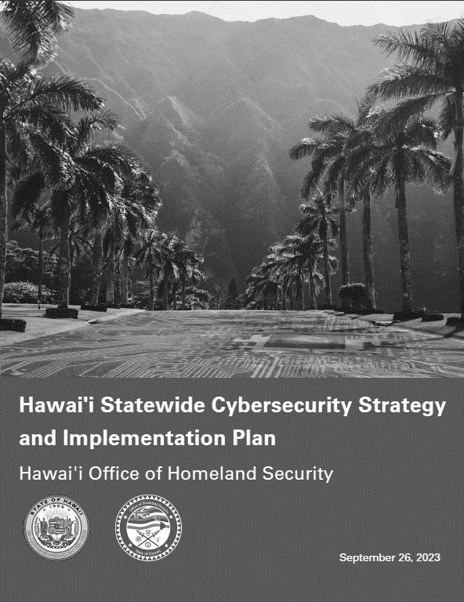

Cyber Workstream
Objective 3
Objective 4
Objective 5
Subrecipient Cyber Incident Response Plans
Develop subrecipient Cyber Incident Response Plans:
  Synchronize to the State Cyber Disruption Response Plan and model after the Office of Enterprise Technology Services Cyber Incident Response Plan
  Develop and implement field county/entity Cyber Incident Response Plan Exercises
Statewide Cyber Workforce Development Strategy
Develop Statewide Cyber Workforce Development Strategy and County/Entity Level Implementation Plans:
Establish continuous testing, evaluation, and structured assessments approach
Define data gathering schema and metrics
Establish strategic relationships with ongoing Hawaii workforce efforts
Statewide Cybersecurity Strategy and Implementation Plan

Slide 6

Obj. 3 Project Scope
Develop Statewide Cybersecurity Strategy and Implementation Plan:
Aligned with DHS guidance for the State and Local Cybersecurity Grant Program (SLCGP)
Articulated multi-year vision for building and strengthening cybersecurity capabilities across the state
Proposed 16 cybersecurity projects for potential future SLCGP funding
Submitted prior to 29 September deadline; approved by DHS in October

Slide 7
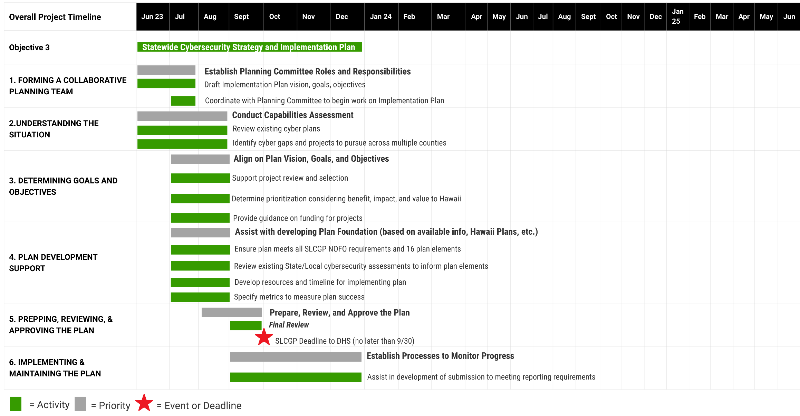
Obj. 3 Project Timeline

Slide 8
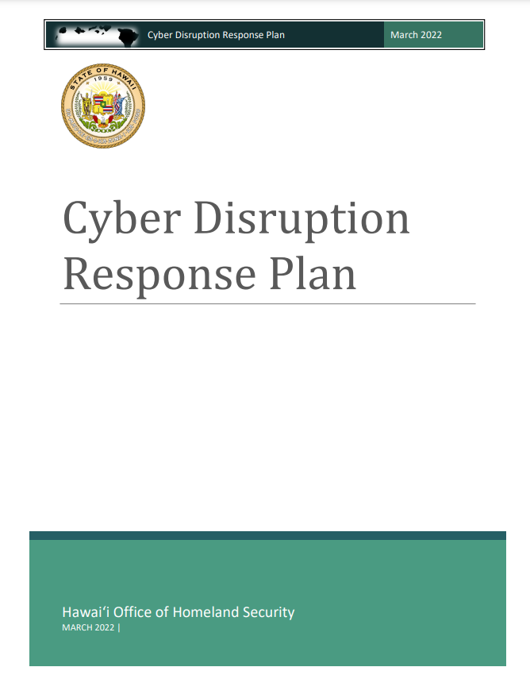
Obj. 4 Project Scope
Develop Subrecipient Cyber Incident Response Plans:
Subrecipient Cyber Incident Response Plans:
Synchronize to the State Cyber Disruption Response Plan and model after the Office of Enterprise Technology Services Cyber Incident Response Plan
Develop and implement field county/entity Cyber Incident Response Plan Exercises

Slide 9
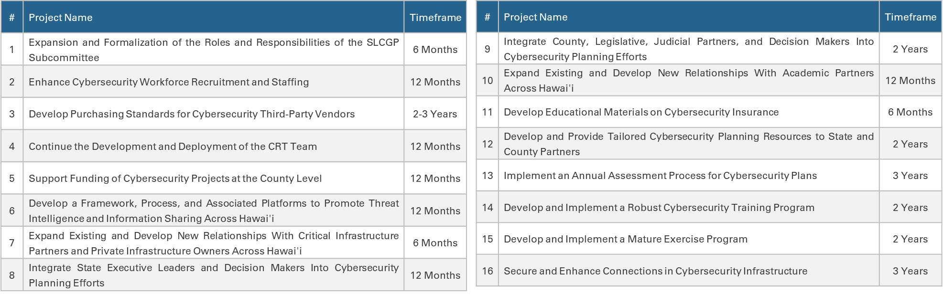
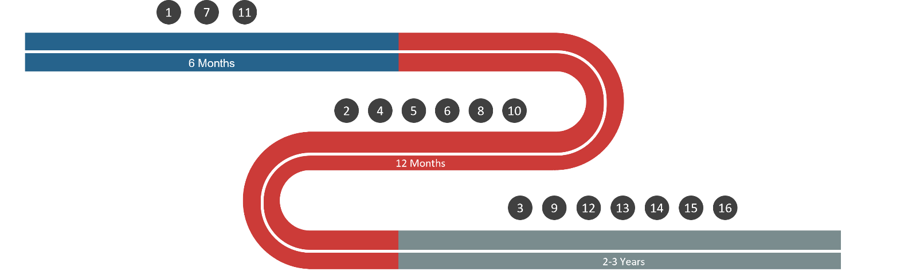
Obj. 3 Implementation Plan
The Implementation Plan serves as a roadmap to steer Hawai'i towards the realization of the strategic timelines, goals, and projects outlined in this plan.

Slide 10
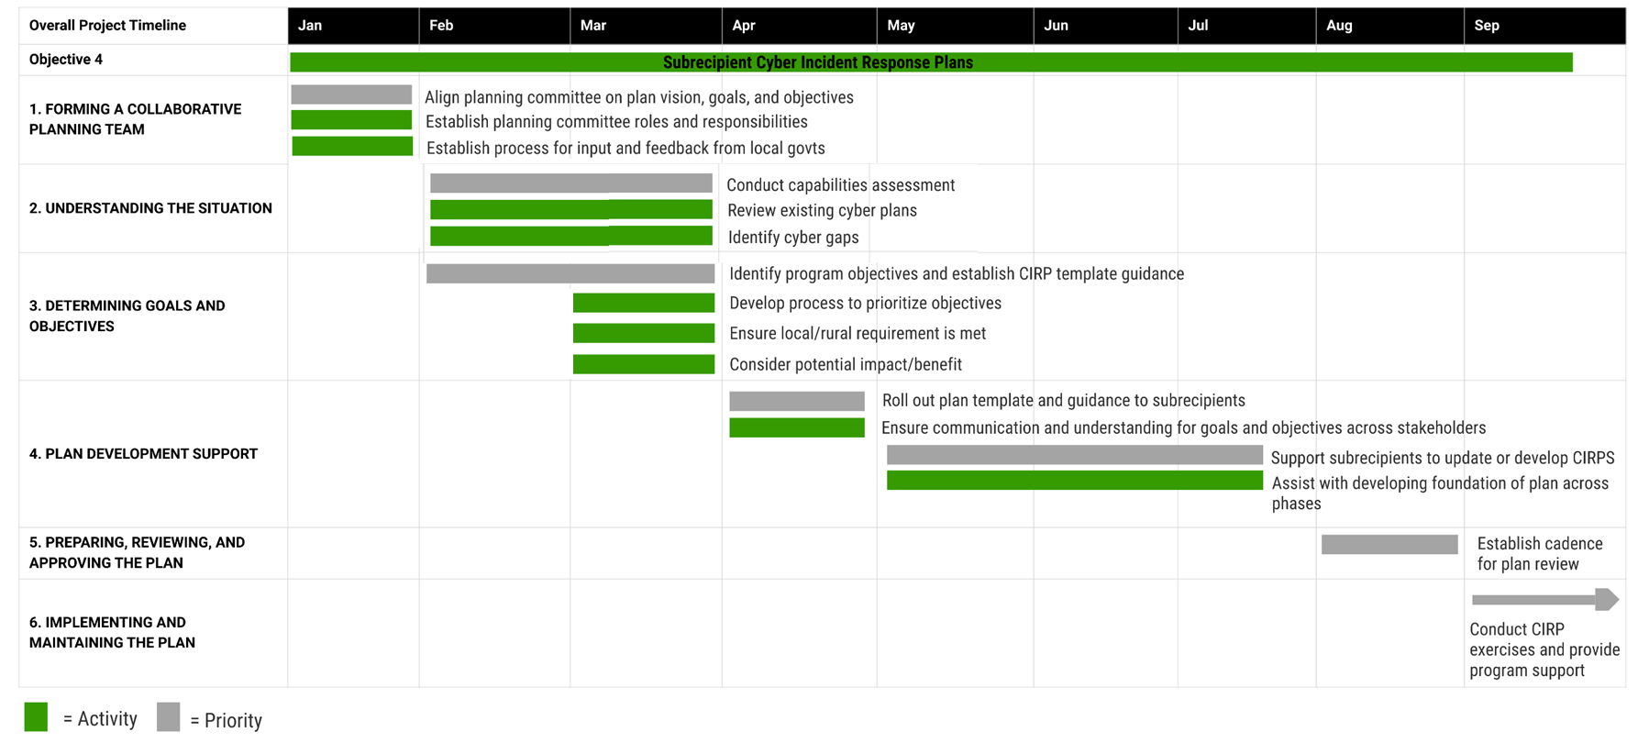
Obj. 4 Project Timeline

Slide 11
CIRP Goals and Objectives
Goals
Limit the overall impact of a cybersecurity incident by establishing procedures for coordinated response and recovery across government organizations, nongovernment organizations, and critical infrastructure partners.
Ensure continuity of operations and timely restoration of critical services.
Establish clear roles and responsibilities during and after a cybersecurity incident, to include both technical and non-technical roles.
Establish a common cybersecurity lexicon allowing for coordinated, effective, and efficient response and recovery activities.
Objectives
Define roles and responsibilities of emergency management officials during and after a cybersecurity incident.
Establish clear and consistent communications plan for cybersecurity incidents which includes notifications to government organizations, critical infrastructure partners, nongovernment organizations, and the public.
Establish common criteria and terminology for the classification of cybersecurity incident severity.
Formalize processes for ensuring a culture of continuous improvement through post-incident activities, such as after-action reporting and integration of lessons identified into future training and exercise opportunities.
Ensure CIRP alignment with existing State plans, including the OHS Cyber Disruption Response Plan, Hawaiʻi Emergency Operations Plan (HI-EOP), and ETS Cyber Incident Response Plan.

Slide 12
CIRP Outline
Introduction
  Goals and Objectives
  Scope
  Authorities
  Legal Considerations
Incident Response Team
  Roles and Responsibilities
  Coordination Group
Incident Classification
  Incident Types
  Severity Schema
Incident Response Procedures
  Pre-Incident
  Detection and Notification
  Investigation
  Mitigation
  Recovery and Monitoring
  Reporting
  Post-incident Activity
Communications Plan
  Contact Directory
Reporting and Documentation
  Notifications
  Information-Sharing
  Public Messaging
Continuous Improvement
Appendices
  Acronyms
  Communication Templates
  Report Templates
  Plan Maintenance

Slide 13
CIRP Exercises
Tabletop exercises targeted for second week in September
Exercises will test and validate the new CIRPs
Planning process will begin in July
Sponsor organizations pending

Slide 14
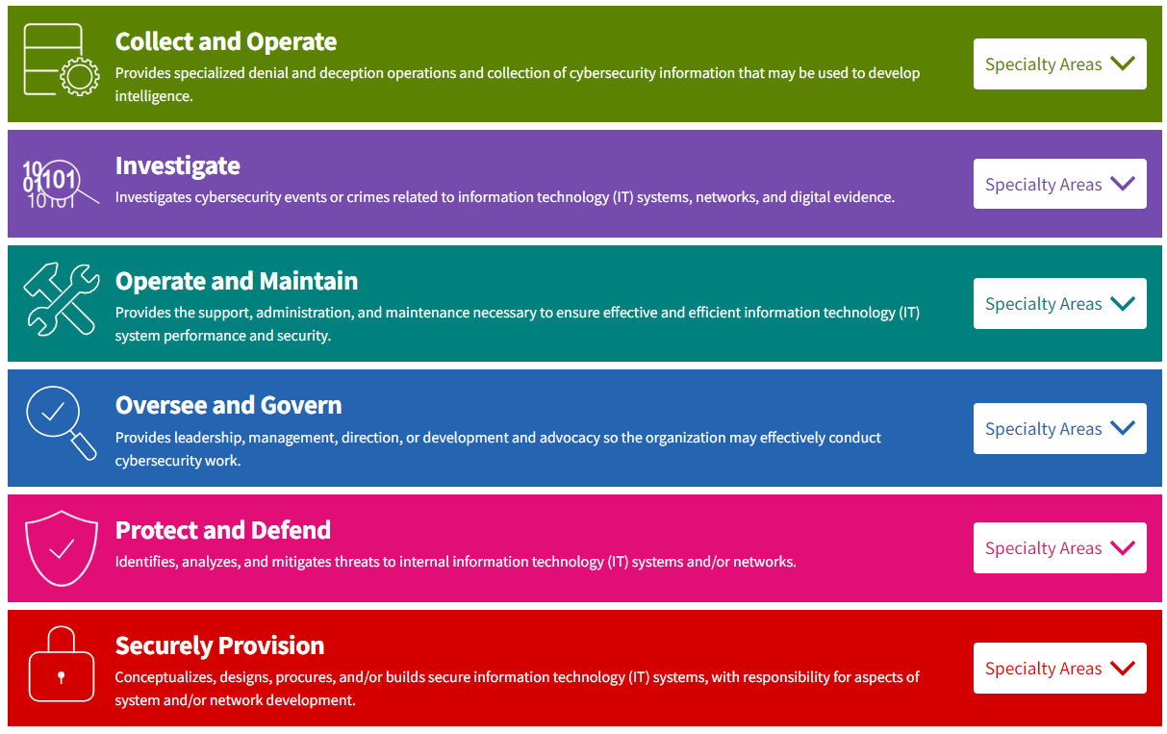
Obj. 5 Project Scope
Develop Statewide Cyber Workforce Development Strategy and County/Entity Level Implementation Plans:
Establish continuous testing, evaluation, and structured assessments approach
Define data gathering schema and metrics
Establish strategic relationships with ongoing Hawaii workforce efforts

Slide 15
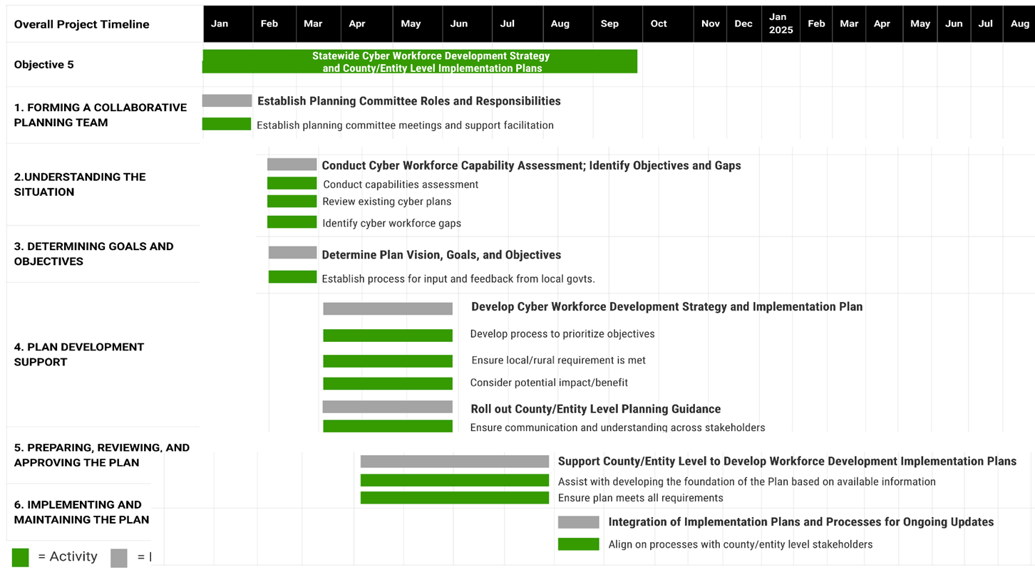
Obj. 5 Project Timeline

Slide 16
Goals and Objectives
Goals
Develop and enhance the technical skills of cybersecurity professionals through training programs, workshops, and certifications to keep the workforce updated with the latest technologies, tools, and best practices in cybersecurity.
Foster the recruitment and retention of cybersecurity talent through initiatives such as marketing, outreach programs, internships, and career development opportunities.
Create the conditions to build a resilient cybersecurity workforce through identifying training and development opportunities, to include non-technical soft skills, so that organizations can build a workforce capable of effectively responding to an ever-evolving cyber threat landscape.
Promote entrepreneurial conditions and foster innovation to attract cybersecurity business to Hawaii.
Objectives
Provide a mechanism to effectively coordinate among existing workforce, to include both cybersecurity-focused and general workforce development efforts.
Consolidate and promote existing cybersecurity professional development opportunities in Hawaii.
Establish marketing campaign for recruiting cybersecurity talent across multiple demographics.
Establish outreach programs targeting K-12 students to promote awareness and interest in the cybersecurity profession.
Create a mechanism for conducting annual reviews of the current cybersecurity workforce in Hawaii to identify gaps in workforce or skills.
Develop performance metrics to monitor progress towards the goals and objectives of the Statewide Cybersecurity Workforce Development Strategy.

Slide 17
Workforce Strategy Outline
Introduction: Goals and Objectives; Executive Summary
Current State: Assessment of existing workforce, gaps, demographic overview, etc.
Education and Training: Defining programs for education, training, and certifications to equip individuals with the necessary cybersecurity skills. This can involve internal training, partnering with educational institutions, or utilizing online courses and resources.
  K-12
  Existing cyber professionals
  Career transition
Recruitment and Retention: Developing strategies to attract and retain talent in the cybersecurity field. This could involve competitive salaries, appealing benefits, career advancement opportunities, and a supportive work environment.
  Outreach, awareness, marketing
Continuous Learning and Development: Promoting ongoing learning and professional development within the cybersecurity workforce to keep pace with evolving threats and technologies. This could include mentorship programs, workshops, conferences, and access to resources for continued learning.
Partnerships and Collaboration: Engaging with industry partners, government agencies, academic institutions, and professional organizations to share knowledge, best practices, and resources for collective growth and development.
Adaptability and Flexibility: Creating a workforce that can adapt to changing cybersecurity landscapes and emerging technologies. This involves fostering a culture of innovation, agility, and adaptability.
Diversity and Inclusion: Encouraging diversity and inclusivity in the cybersecurity workforce to bring in different perspectives and ideas. This might involve outreach programs to underrepresented groups and creating an inclusive workplace culture.
Performance Metrics
Appendix: Implementation Plan
Appendix: Strategy Maintenance

Slide 18
Open Discussion/Questions
Ken Fisher: Workstream 2 (CI)
kenneth.fisher.consultant@hawaii.gov​
Nick Matthews: Workstream 3 (Cyber)
nick.matthews.consultant@hawaii.gov

