Slide 1
Hawaiʻi Office of Homeland Security (OHS)
Critical Infrastructure Security and Resilience
Planning Updates
20 June 2024
Michael Covert
Notes:
5s
Hello and welcome to planning updates for Workstream 2

Slide 2
Agenda
Project Scope
Planning Timeline
CI Security and Resilience Program (CISRP) Implementation Plan Overview
Questions
Notes:
15s
The agenda for today is to provide an update on the CISRP implementation plan

Slide 3
Project Scope
Develop an Implementation Plan for establishing a critical infrastructure data management system to include:
“Articulate” the conduct of a comprehensive inventory and baseline interdependency assessment of the state’s critical infrastructure and their dependencies/interdependencies to inform the development of:
Long-term resiliency investment planning
Incident response capabilities and capacity
Threat mitigation activities
Synchronize plan and execution to current critical infrastructure inventories and related data and systems
Notes:
(30 secs)
The scope of this project is to review the reference materials like the OHS Critical Infrastructure Security and Resilience Program (CISRP), the CISA Infrastructure Resilience Planning Framework (IRPF) Sector-Specific Plans (SSPs), existing owner/operator datasets, and stakeholder input to develop an implementation plan to establish a data management system for Hawaii’s critical infrastructure data.
As you can see, it’s a pretty daunting task if you’re trying to address all the sectors at once. With that in mind, OHS identified specific sectors to begin with [next slide]

Slide 4





OHS Priority Sectors
Communications
Energy
Information Technology
Transportation
Water/Wastewater
Notes:
(20 secs)
Initially, OHS is focusing on these sectors (referred to as Tier 1) that you see on the screen here. OHS will address other sectors in the future.
As part of our call to action, we would like to invite any Owner/operators from Tier 1 sectors to assist OHS with the Data Collection efforts once the implementation plan is final.

Slide 5
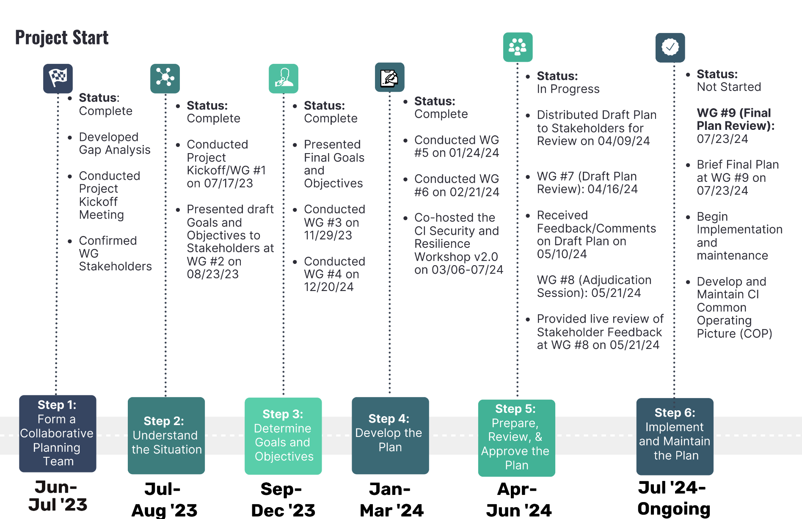
Planning Timeline
Notes:
40s
You’ll see here we have adjusted our project approach to the CPG 101 6-step planning process, and have updated this timeline graphic to include the status of phases, key dates, and key activities during each phase.
As you can see here, we are currently in Step 5: Prepare, Review, and Approve the plan.
The CISRP Implementation plan has gone through various rounds of internal review, and on April 9th we sent the plan out to our Working Group Stakeholders before Working Group 7 as a read-ahead and to gather their feedback and input. We received a handful of feedback, and the team implemented that feedback from May 10th to May 20th, and at Working Group #8 on May 21st we provided the WG Stakeholders with the updates we made and allowed some time for discussion regarding key terminology in the plan.
Our WG Session will be in July, and we’ll provide the stakeholders with a review of the final plan and then OHS begins their Implementation and Maintenance of the Plan.

Slide 6
Critical Infrastructure Security and Resilience Program(CISRP) Implementation Plan
Notes:
We’ll now take a closer look at the CISRP.
5s
(9 minutes for section)

Slide 7
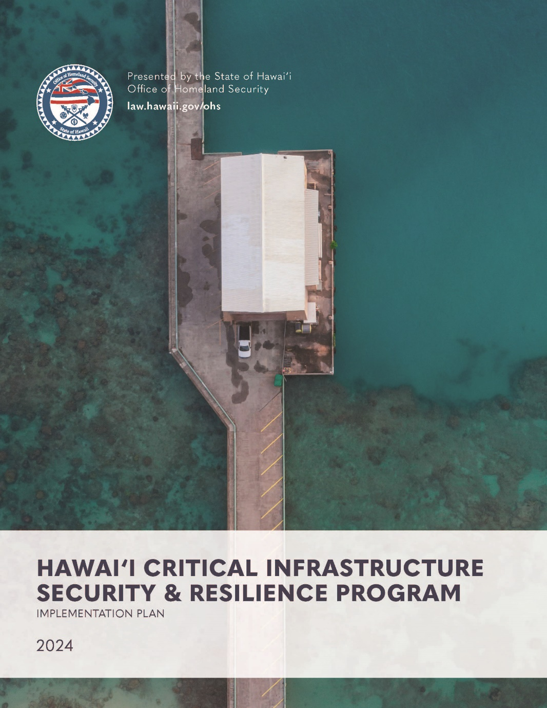
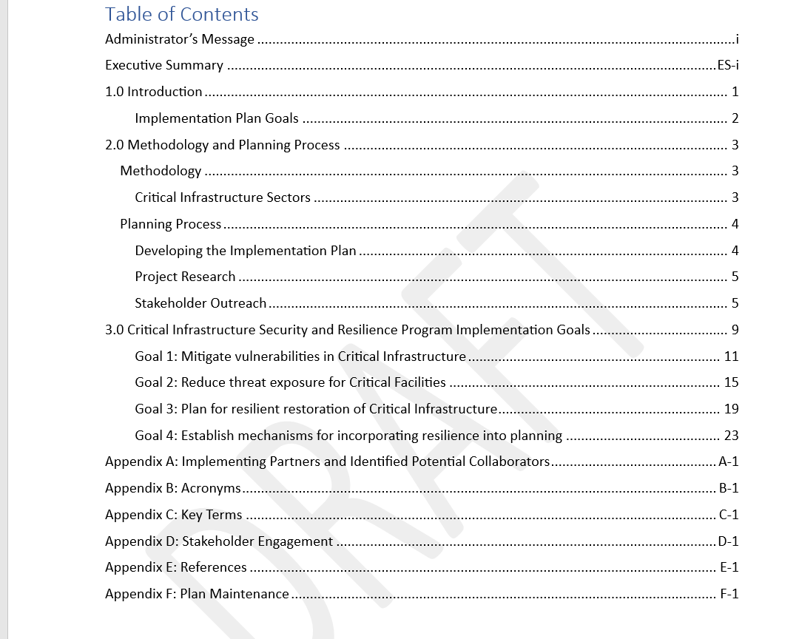
Plan Overview
Notes:
30s
We wanted to provide you with a little bit of a plan overview before we go through each section of the plan today.
This slide shows the cover photo and the Table of Contents.
The plan is currently sitting at 66 pages long.
Orient to TOC – Exec Summary, three sections and six appendices

Slide 8
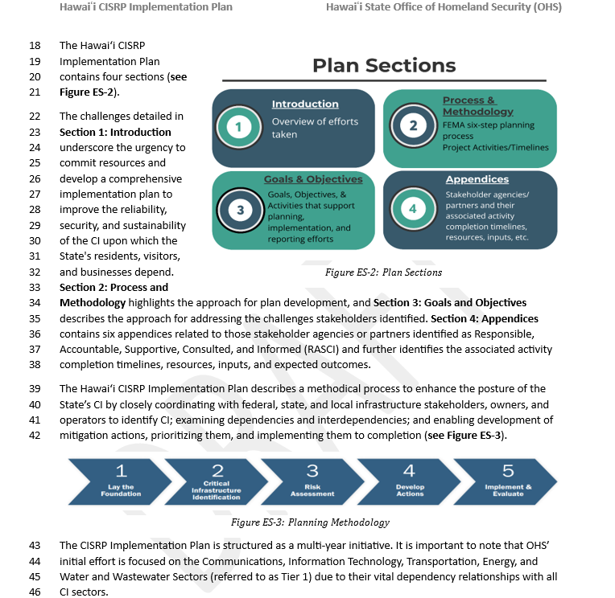
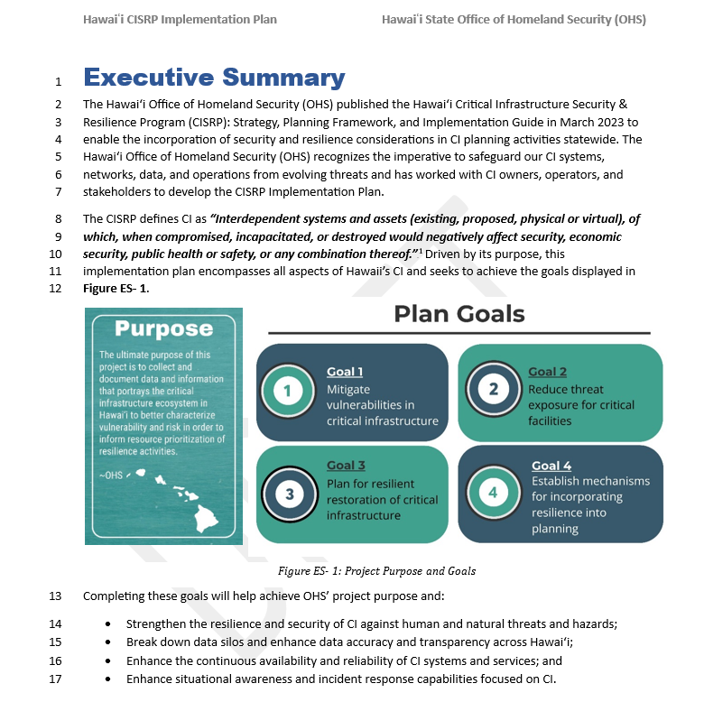
Executive Summary
Emphasizes the need to improve sustainability in Hawaii’s CI environment
Highlights the purpose of this Plan and how OHS developed it
Definition of CI according to the OHS CISRP
Clarifies OHS’ initial effort of focusing on Tier 1 Sectors
Notes:
0931
20s
The Executive Summary briefly describes the overall effort and provides an overview of the goals.
This section also highlights the definition of CI and points to the Critical Infrastructure Security and Resilience Program (CISRP).
It also clarifies those sectors that fall into Tier 1.
The Executive Summary also describes the plan goals, sections, and purpose, and explains how OHS intends to use it.
And finally, it also highlights that the success of the implementation plan relies on several factors, including the timely sharing of information and active participation from federal, state, and local government agencies, CI owners/operators, and other stakeholders.

Slide 9
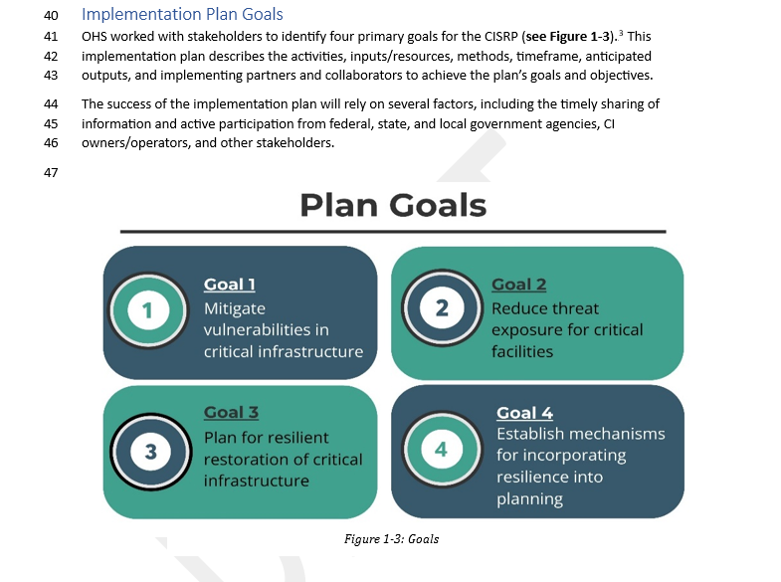
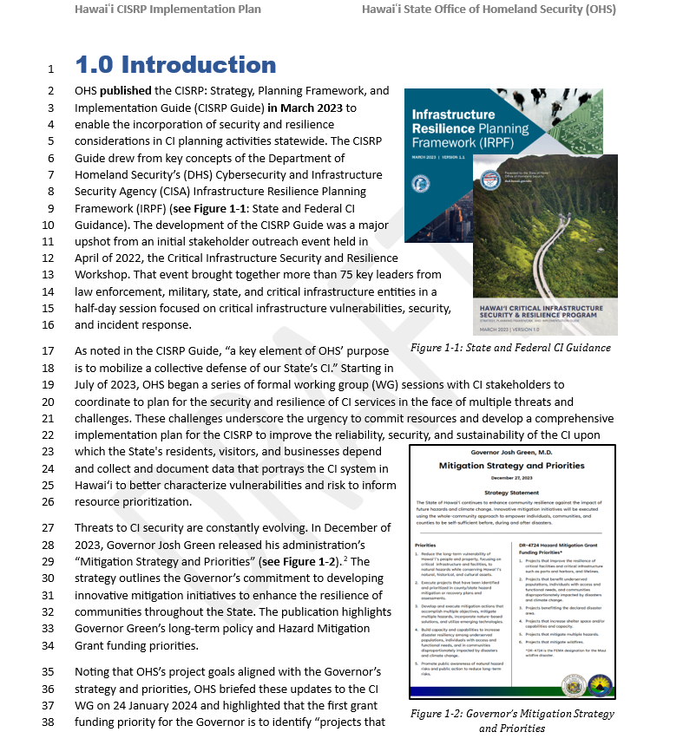
Section 1: Introduction
Highlights OHS’ accomplishments of establishing a CI WG
Discusses Supporting Documentation (i.e., CISRP and IRPF)
Provides an overview of Plan Goals
Emphasizes the Governor’s Mitigation Strategy
Notes:
30s
The first section of the Plan is the Introduction Section.
Section 1 Introduces us to the effort and highlights several accomplishments since our first session back in July.
The section discusses the Hawaii CISRP and the IRPF, provides an overview of all four goals, and it emphasizes how this effort supports the Governor's priorities – one of which is a grant funding priority for the Governor. That priority is to identify, “projects that improve the resilience of critical facilities and critical infrastructure.”
The outcomes from this particular project will inform that priority.

Slide 10
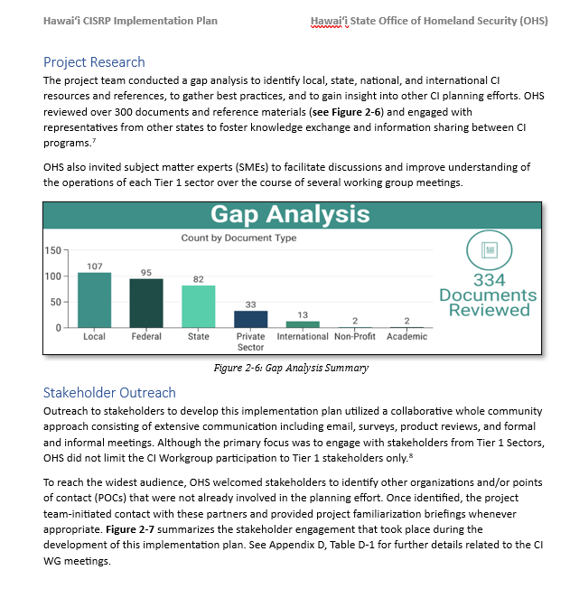
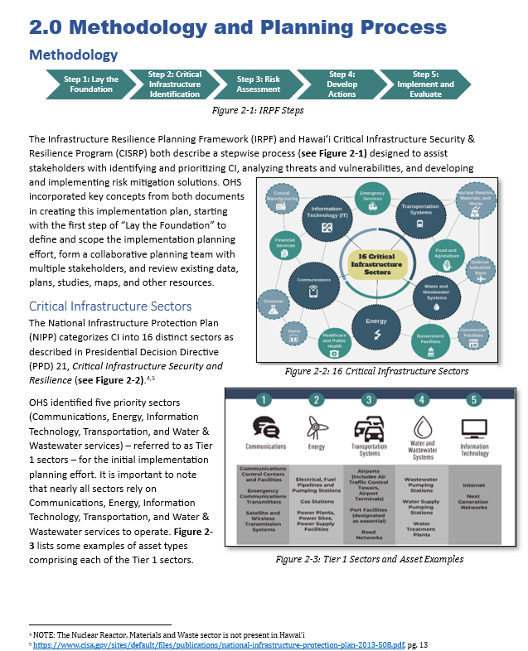
Section 2: Methodology and Planning Process
Provides an Overview of the Plan Development timeline
Highlights OHS’ Stakeholder Engagement
Portrays the number of Documents reviewed in the Gap Analysis
Explains Tier 1 Sectors and provides examples of assets within them
Notes:
45s
Section 2 is the Methodology and Planning Process section. In this section, we highlight the Plan Development timeline using the FEMA Six Step Planning Process, provide an overview of the sectors and those sectors OHS identifies as Tier 1 sectors, and some examples of assets within them.
It also provides an overview of the Gap Analysis process and the types of documents that were reviewed during plan development. During this process, we reviewed over 330 documents, and websites, and coordinated with Fed/State/Local agencies and stakeholders.
Finally, this section highlights the amount of stakeholder engagement that OHS has accomplished to date and provides a summary of significant activities since the beginning.

Slide 11
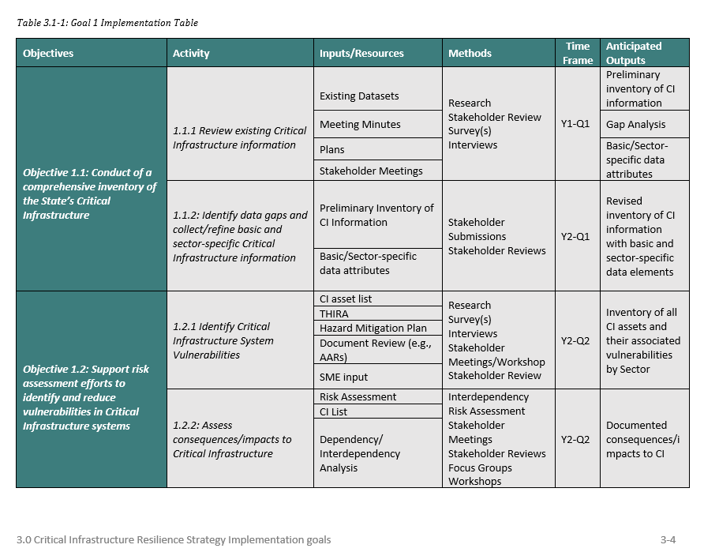
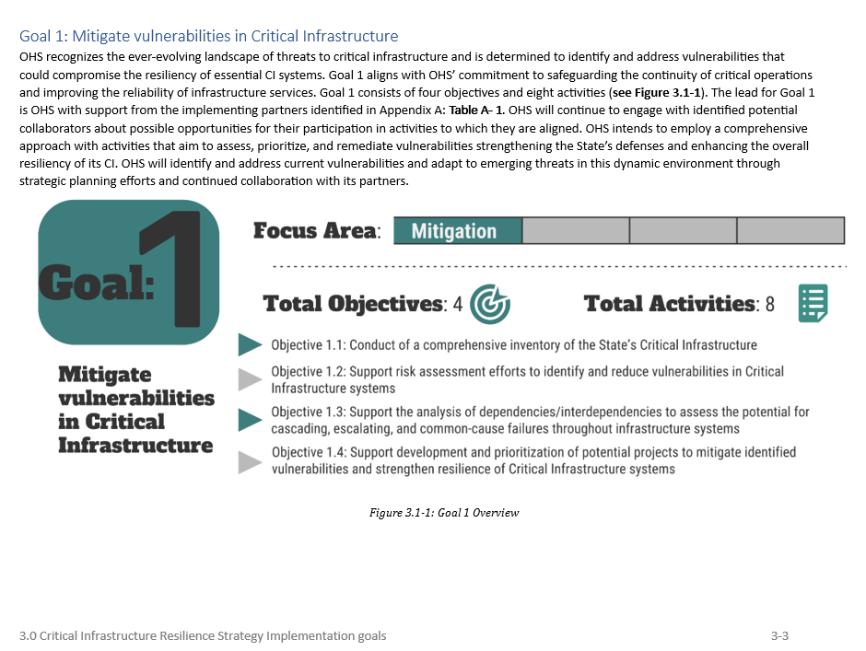
Section 3: Critical Infrastructure Resilience Strategy Implementation Goals
Provides definitions for Table Elements throughout the section
Contains an Implementation Plan table and a Measurement Plan table for each Goal
Clarifies time frames for each activity
Notes:
30s
This section describes the goals, objectives, and activities that support planning efforts and inform the reporting of implementation milestones and outcomes. The tables within this section outline goals, objectives, activities, inputs/resources, methods, time frame, and anticipated outputs. We'll talk more about these items later.
In addition to the information, we've shared here, you'll also be able to review each goal's measurement plan table.
This section also provides definitions for Table Elements throughout the section, clarifies time frames for each activity, and contains an Implementation Plan table and a Measurement Plan table for each Goal. This section will support us in our efforts to monitor implementation activities and achieve our objectives.

Slide 12
Goal 1: Mitigate Vulnerabilities in Critical Infrastructure
Objective 1.1:
Conduct a comprehensive inventory of the State’s critical infrastructure
Objective 1.3:
Support the analysis of dependencies/ interdependencies to assess the potential for cascading, escalating, and common-cause failures throughout infrastructure systems
Objective 1.4:
Support development and prioritization of potential projects to mitigate identified vulnerabilities and strengthen the resilience of Critical Infrastructure systems
Objective 1.2:
Support risk assessment efforts to identify and reduce vulnerabilities in Critical Infrastructure systems
Notes:
45 s
Goal 1 objectives are really focused on data collection efforts, identifying dependencies/interdependencies, and creating and prioritizing a comprehensive list of Tier 1 CI throughout the State.
Goal 1 activities include activities such as:
1. Reviewing existing CI Information; This ties into the data collection efforts that started taking place last year at WG 2. We have been actively requesting feedback and thoughts on Data Attributes as it relates to CI and the development of a comprehensive inventory of CI. Our team has engaged in conversations with the County GIS teams, the State GIS team, and various organizations that could have access to CI data. The biggest gap at this point is understanding the sector-specific data attributes each sector requires.
2. workin with each of the sectors to support risk assessment efforts by identifying vulnerabilities, assessing consequences, and identifying opportunities to reduce vulnerabilities. ​
3. Finally, OHS will use the Tier 1 CI Inventory to assist in analyzing dependencies/interdependencies. This will initially begin with Tier 1 CI Systems as we have previously highlighted, and we’ll move to Tier 2 sectors after the Tier 1 sectors have been analyzed. ​

Slide 13
Goal 2: Reduce threat exposure for critical facilities
Objective 2.2:
Identify and share information on methods to prevent, protect from, and mitigate threats to critical facilities and systems
Objective 2.1:
Support risk assessment efforts to identify, deter, detect, disrupt, and prepare for threats to critical facilities and systems
Notes:
45 s
Goal 2 is focused on collaborating with stakeholders to support risk assessment efforts and to share any information that could help them prevent, protect from, and mitigate vulnerabilities in CI.
Objective 2.1 is about identifying threats to CI and then developing a method that will allow planners to prioritize risks to CI. ​
Our team has already been in the process of developing and implementing prioritization methods for risks to CI. OHS outlines step-by-step instructions on how one may prioritize risks in the CISRP.
Objective 2.2 consists of two activities that really relate to OHS and stakeholders reviewing guidance and learning information and then sharing/disseminating guidance to stakeholders (as we did throughout the WG Sessions and will continue to do moving forward). For example, when OHS learns of any new guidance from CISA relating to threats, OHS will review, analyze, and share that guidance with stakeholders.
OHS wants to ensure that the planning team continues to collaborate across the CI community and to remove any potential silos. This Goal allows for an ongoing dialogue between OHS and our supporting partners.
Overall, these activities will assist OHS with supporting risk assessment efforts and ensuring that our stakeholders stay up to date on the latest CI information and guidance.

Slide 14
Goal 3: Plan for resilient restoration of Critical Infrastructure
Objective 3.1:
Conduct outreach to Critical Infrastructure stakeholders to encourage collaborative efforts to improve capacity of stakeholders and resiliency of Hawaii's Critical Infrastructure systems
Objective 3.2:
Support collaborative continuity of operations planning, training and exercises to facilitate the rapid restoration of Critical Infrastructure
Notes:
45 s
Here we have Goal 3: Plan for the resilient restoration of CI
This Goal focuses on conducting outreach to encourage collaboration to improve resiliency and to support COOP planning, training and exercises to facilitate rapid restoration following an event.
Objective 3.1 focuses on the formation of a collaborative planning team (like the one we have already created, and we have conducted 6 WG’s to date) and focuses on defining and scoping the planning efforts, which our team has already completed.
Objective 3.2 is focused on forming an ongoing dialogue with stakeholders, using SME input to confirm the goals and objectives of the project, and ensuring that OHS works with SHs to identify CI resources and capabilities. ​

Slide 15
Goal 4: Establish Mechanisms for incorporating resilience into planning
Objective 4.1:
Support stakeholder efforts to incorporate Critical Infrastructure threat mitigation into long-term comprehensive planning to improve resilience in Hawaiʻi
Objective 4.2:
Develop a common operating picture of Critical Infrastructure in Hawaiʻi to support planning and mitigation efforts and enhance situational awareness
Notes:
1 min
Goal 4 is focused on OHS supporting SH efforts with incorporating threat mitigation measures into resilience planning efforts and creating a CI Common Operating Picture (COP)
The creation of the COP software will allow OHS to foster critical asset visibility, data-driven decision support, and a collaborative approach to protecting and building the resiliency of the essential infrastructure in Hawaii.
Objective 4.1 really relates to OHS’ intent to support stakeholder efforts with incorporating threat mitigation and resilience into planning efforts. This is an objective where OHS will need assistance from stakeholders in evaluating, monitoring and providing feedback to OHS on how those strategies that were developed are working, and how they incorporate them into their planning efforts. We would also like to know if the measures aren’t working, and we’ll ask them to share with us why they aren’t working, and what they think can be done to improve them before ingesting them into planning efforts.
The activities associated with Objective 4.2 all have to do with the stages of developing and maintaining the CI COP. ​
For this objective, OHS will use the already identified CI Inventory that will be accomplished in Goal 1. ​
​As we move through this project, OHS will continue to identify stakeholders to inform COP development. ​
OHS will be working with our stakeholders to ensure that their data is the most recent and accurate version. This will assist OHS in Updating and Maintaining the CI data that was retrieved from Goal 1 in the CI COP Software.

Slide 16
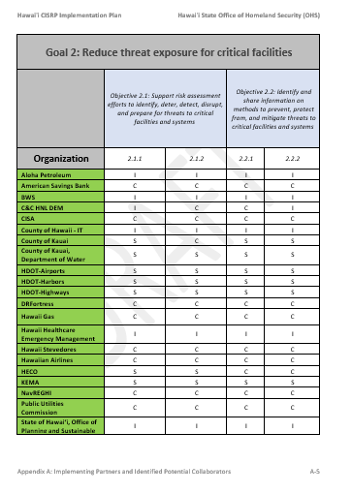
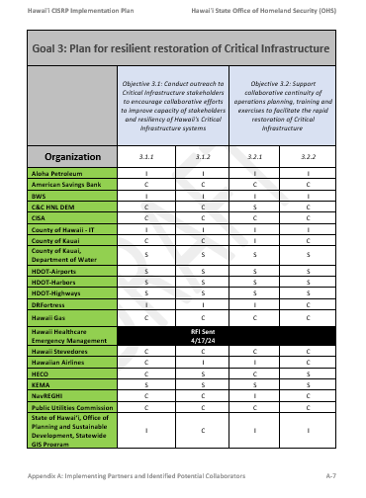
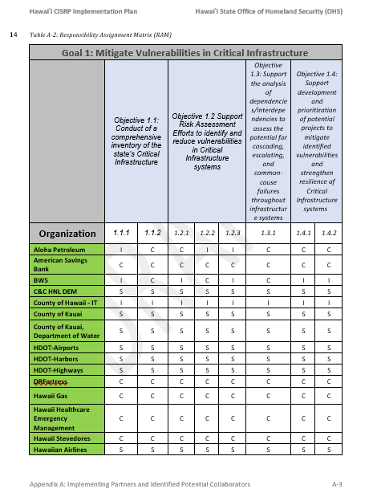
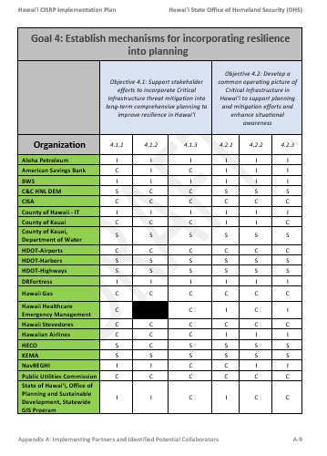
Appendix A: Implementing Partners and Identified Potential Collaborators
Notes:
30s
Appendix A provides a list of Identified Potential Collaborators and Implementing Partners. These tables are called the “Responsibility Assignment Matrix” or RAM Tables.
An Implementing Partner is an organization that responded to a RASCI survey that OHS sent out asking how/if the organization wanted to support each goal, objective, and activity.
An identified potential collaborator is an organization that did not respond to a survey, but they were a member of the WG sessions. We listed those organizations as potential collaborators in case we need to leverage them for future collaboration on the CI Security and Resilience Program.

Slide 17
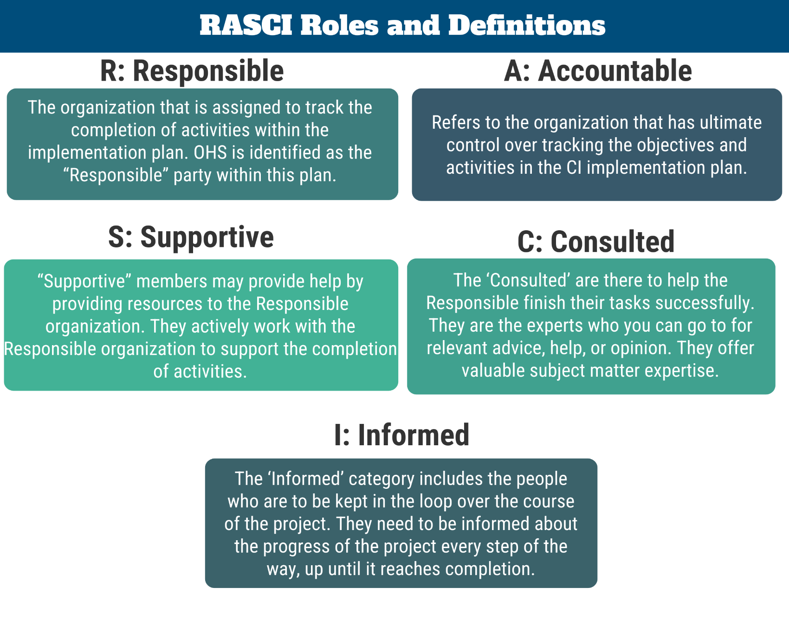
RASCI Definitions
Notes:
30s
To get the list of Identified Potential Collaborators and Implementing Partners, we sent out a survey to over 130 stakeholders to solicit their input. For this effort, we defined OHS as Responsible and Accountable for the overall management of this effort. For the stakeholders, that leaves the SCI roles.
Supportive members are those who will be actively participating and providing OHS with data, plans, or any relevant CI information that OHS requests assistance with.
The Consulted members are those who will help via their expertise. We likely won’t ask consultants to provide any physical data, but we will ask for plan reviews, and SME input.
Finally, the Informed members are those who will not be providing any input on the Goals, objective, or Activity. They simply want to be kept informed and want to be in the know.
All three of these categories of members are members of the CI WG.

Slide 18
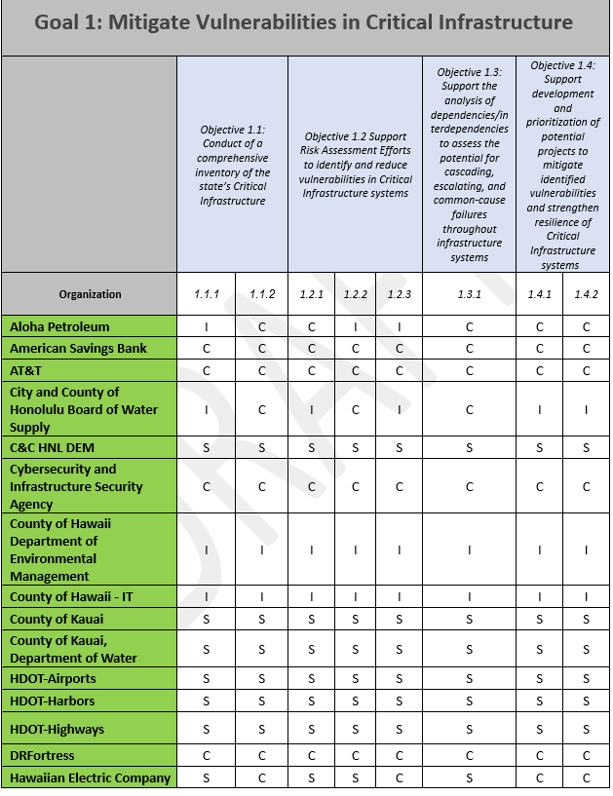
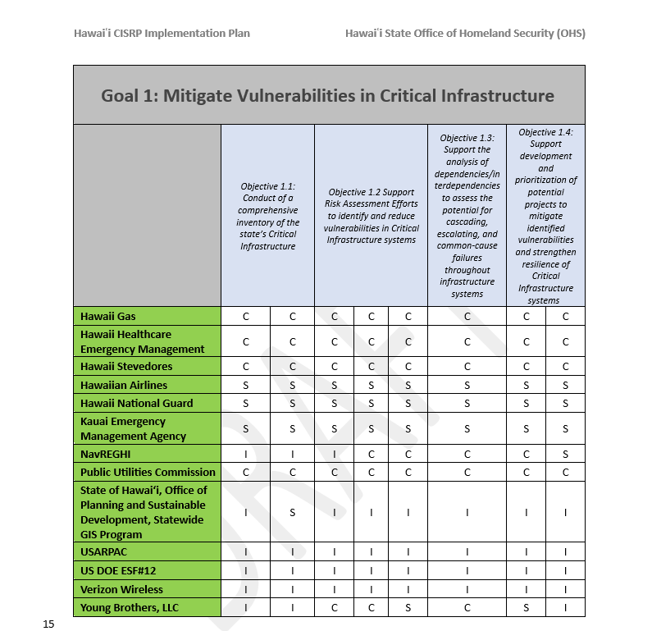
Goal 1 RAM
Notes:
45s
Orient Stakeholders to table. ​
Link to sheet: https://readyzonehq.sharepoint.com/:x:/r/sites/test/_layouts/15/Doc.aspx?sourcedoc=%7B2CC77BEC-3023-4E14-AE0A-70D82ECCC9B2%7D&file=OHS%20Obj%202%20GoalsAndObjectivesImplementationPlanTable_041724.xlsx&action=default&mobileredirect=true&wdsle=0
The table you see here is the Goal 1 Responsibility Assignment Matrix with the orgs that have completed the survey. This table is where you will see the RASCI assignments based on how your organization responded. ​
Starting from the top to the bottom rows, the first row is the Goal, the second are the objectives, and the third are each individual activity for each objective. ​
On the left hand side of the table is where the organizations will be listed.

Slide 19
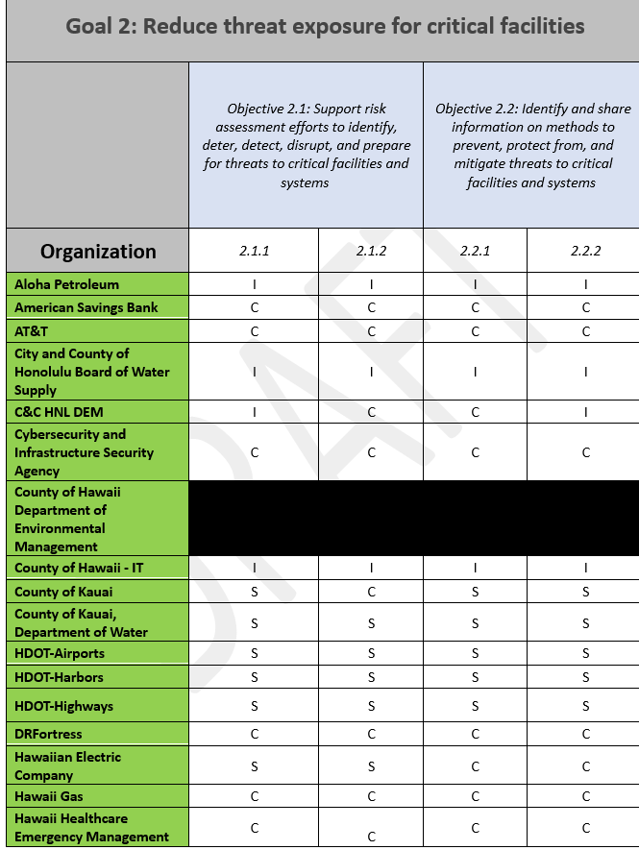
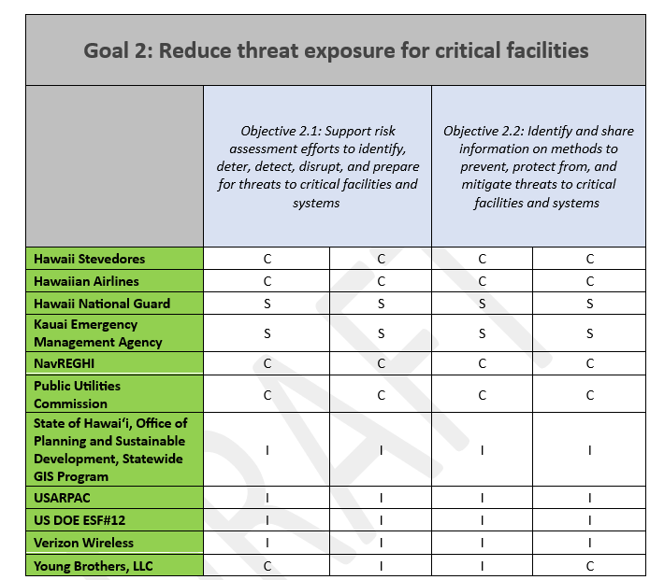
Goal 2 RAM
Notes:
0916
15s
Here is a look at the current RAM table for Goal 2.
Again we had an additional 2 Orgs added.

Slide 20
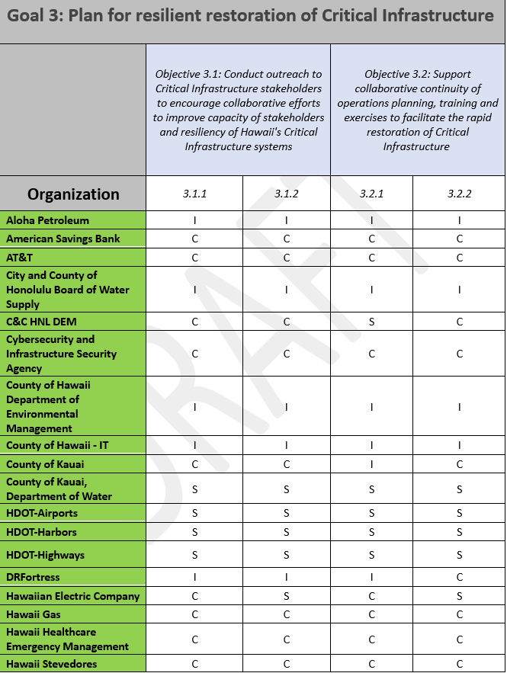
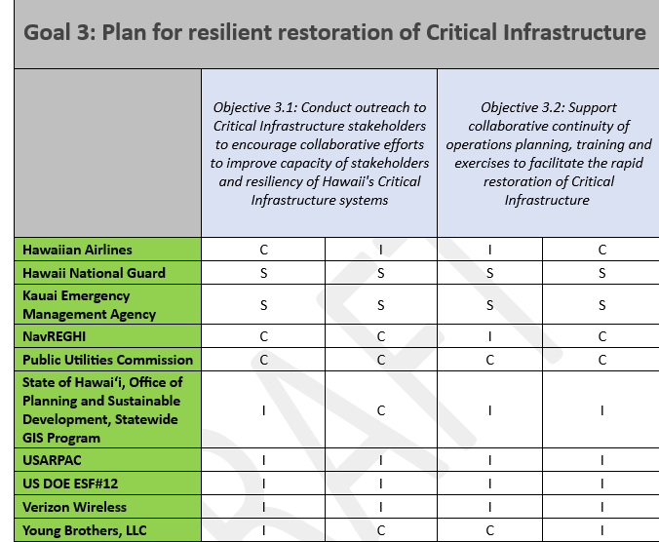
Goal 3 RAM
Notes:
0916
30s
Goal 3 RAM table

Slide 21
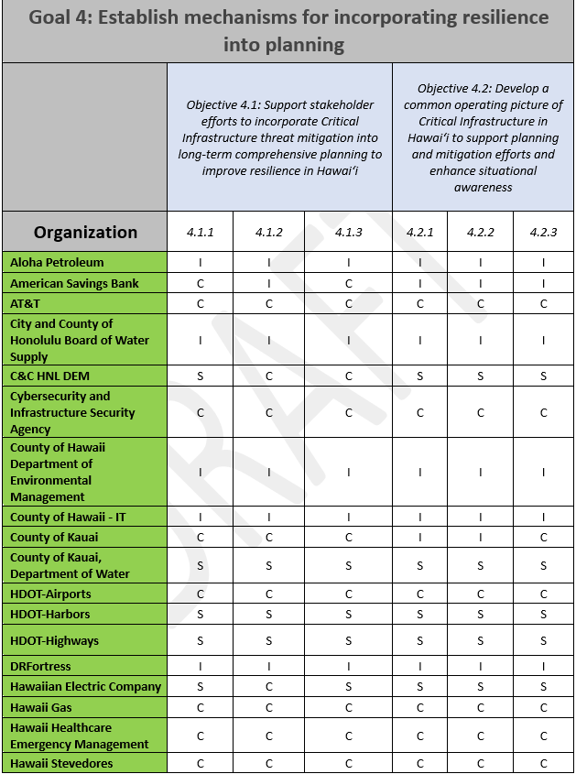
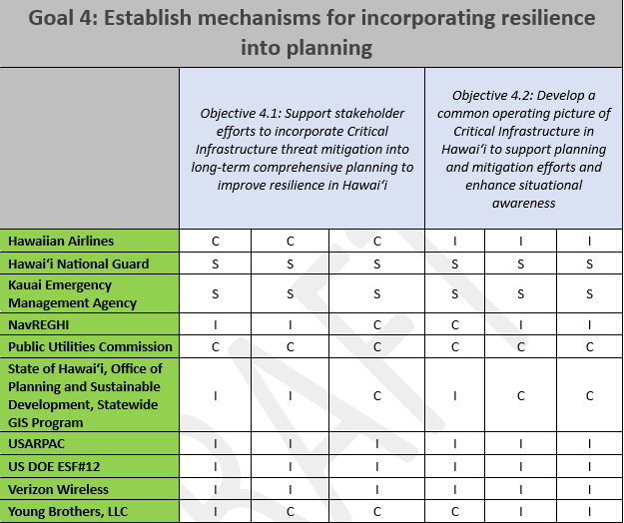
Goal 4 RAM
Notes:
0917
30s
Goal 4 RAM table
For your review, we ask that for those organizations who have filled out the survey - that you take a close look at the RAM tables to ensure that your org is listed in the correct role in the correct spot.
Please feel free to reach out to us if you note any errors or have other questions related to level of effort.

Slide 22
Identified Potential Collaborators
Identified Potential Collaborators
Federal Aviation Administration
Hawaiʻi Department of Defense
Hawaiʻi Emergency Management Agency
Hawaiʻi Office of Enterprise Technology Services
Hawaiʻi State Energy Office
Hawaiʻi Transportation Association
Island Energy Services
Kauai Fire Department
Kauai Island Utility Cooperative
Maui Emergency Management Agency
Statewide Interoperability Coordinator
T-Mobile
U.S. Coast Guard
Notes:
15s
Here is the list of OHS’s identified Potential collaborators.
potential collaborators may be aligned to as few as one or as many as all the activities associated with the goals; however, as of the publishing date of this plan, they have not confirmed their role in the RAM goal tables above.

Slide 23
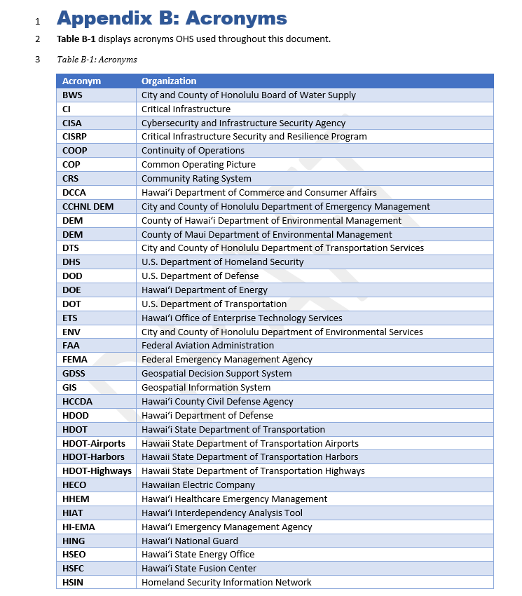
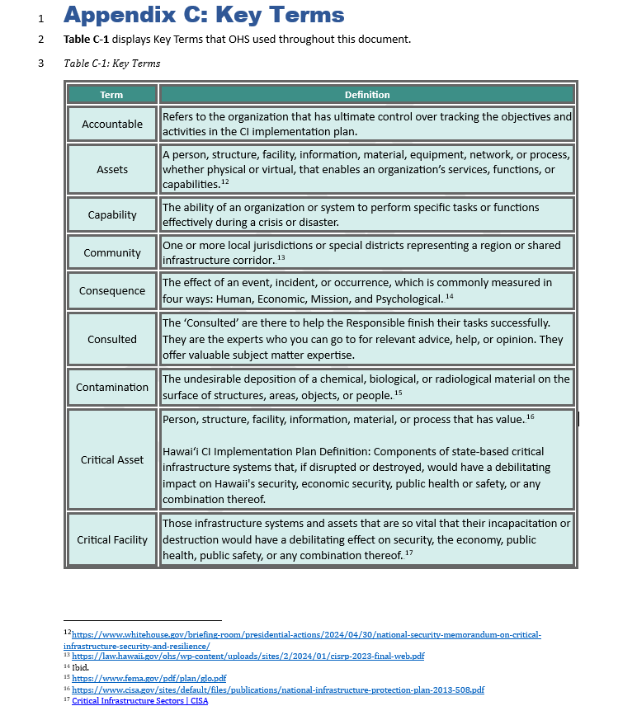
Appendix B: Acronyms
Appendix C:
Key Terms
Notes:
15s
App B and C are where you can find the Acronyms used throughout the plan and the Key terms used throughout the plan along with their citations.

Slide 24
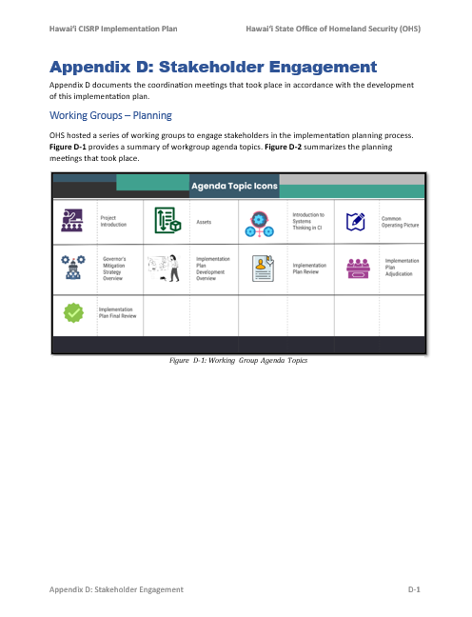
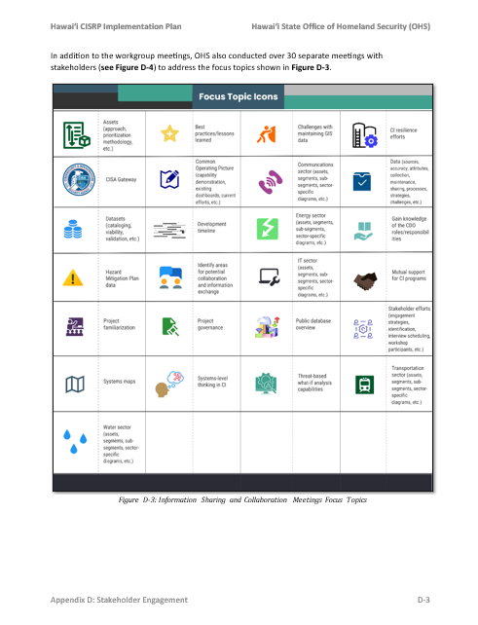
Appendix D: Stakeholder Engagement
Workgroup Agenda Topics
Completed Workgroup/non-Workgroup Meetings
Focus Topics for non-Workgroup meetings
Overview of Workgroup Activities
Notes:
15s
Appendix D holds our stakeholder engagement information. Within the appendix, you will find an Overview of our WG sessions and their agenda topics, and you will also find other stakeholder engagement meetings that our team conducted throughout the duration of the project.

Slide 25
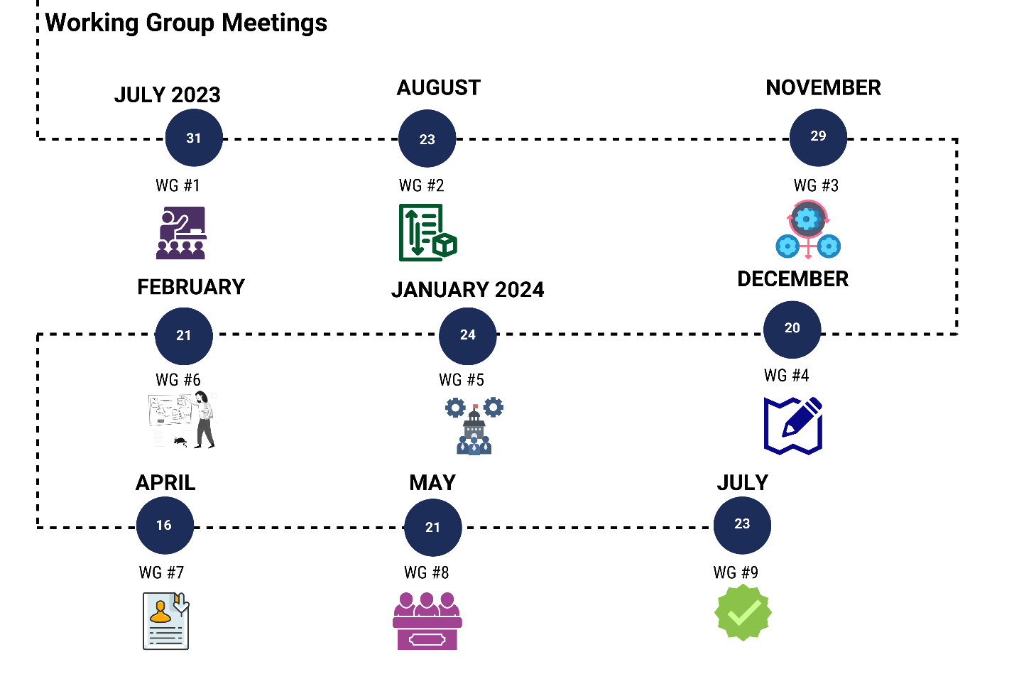
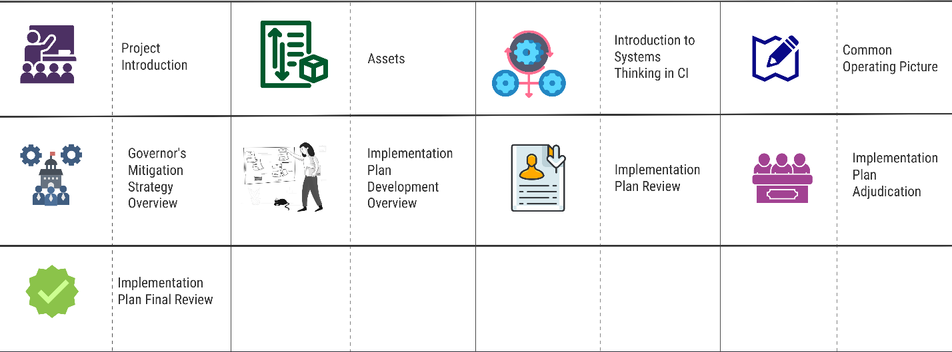
Appendix D: Working Group Meetings
Notes:
15s
The first section of Appendix D highlights the working groups that took place between July of 2023 and July of 2024 and their primary topics of discussion.

Slide 26
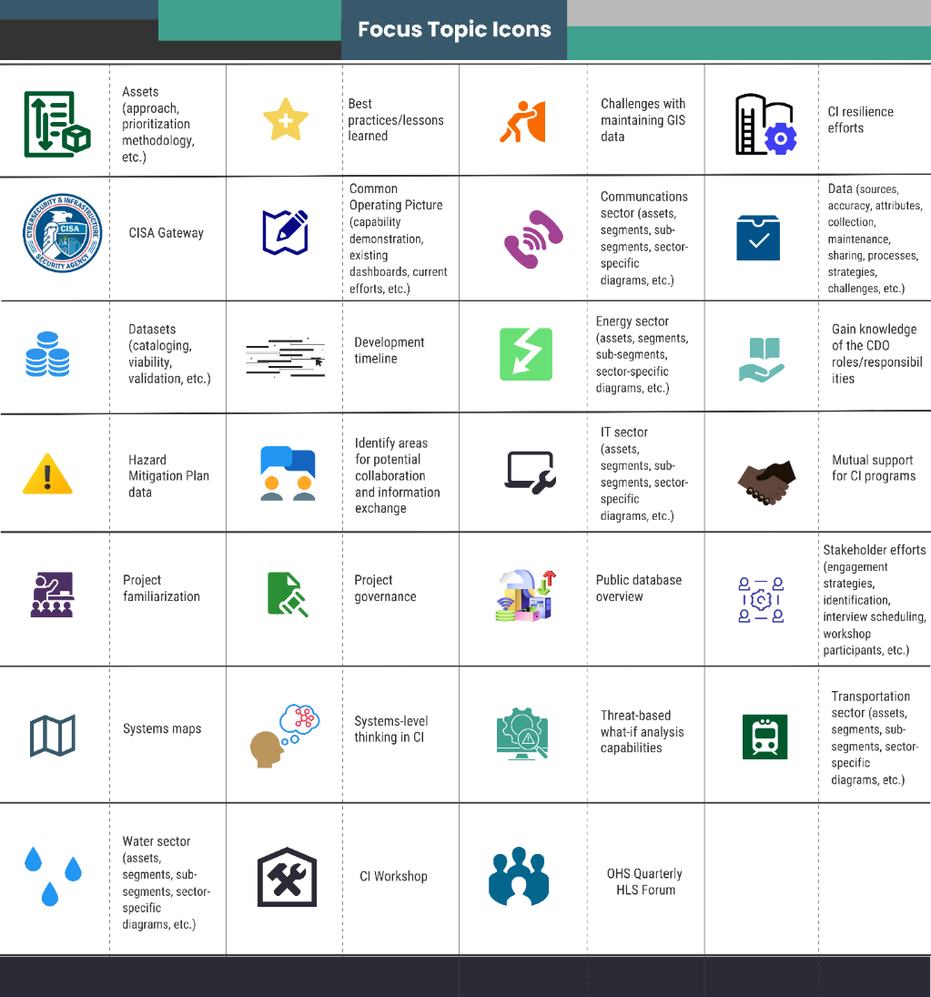
Appendix D: Working Group Meetings
OHS Hosted over 30 additional meetings to facilitate information sharing and collaboration between local, State, federal, and private sector partners
Notes:
15s
OHS also hosted over 30 additional meetings to facilitate inforamtion sharing and collaboration between local, State, federal, and private sector partners.

Slide 27
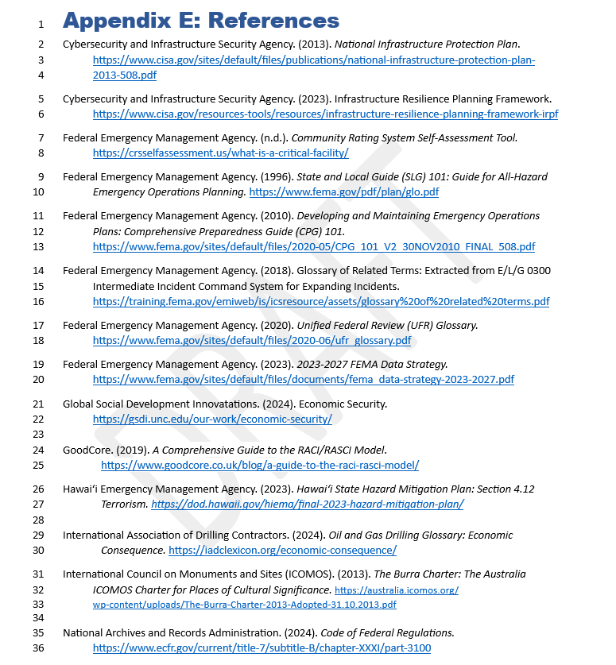
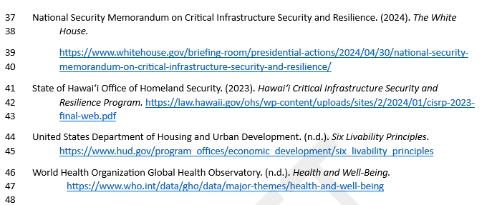
Appendix E: References
Notes:
15 s
App E is where all the references used throughout the plan will be listed

Slide 28
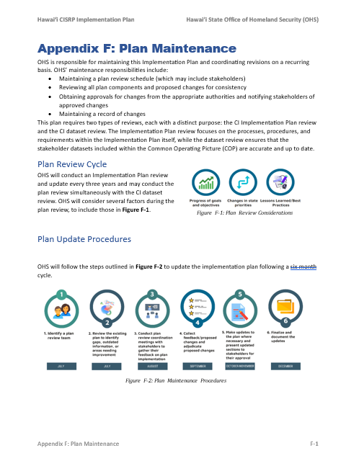
Appendix F: Plan Maintenance
Plan Review Cycle
Plan Update Procedures
Supporting Checklists
Out of Cycle Updates
Dataset Update Procedures
Notes:
30 s
App F is our plan maintenance section. This section is all about how OHS will update and maintain both the plan itself and the CI COP.
This plan requires two types of reviews, each with a distinct purpose: the CI Implementation Plan review and the CI dataset review. The Implementation Plan review focuses on the processes, procedures, and requirements within the Implementation Plan itself, while the dataset review ensures that the stakeholder datasets included within the CI COP are accurate and up to date.
This section addresses:
Maintaining a plan review schedule (which may include stakeholders)
Reviewing all plan components and proposed changes for consistency
Obtaining approvals for changes from the appropriate authorities and notifying stakeholders of approved changes
Maintaining a record of changes
PCII
Plan review guidance and timeframes

Slide 29

Call to Action
Email our team to get involved in future Working Group meetings:
  kenneth.fisher.consultant@hawaii.gov
  michael.covert.consultant@hawaii.gov
Notes:
(30 Secs)
If anyone is interested in participating in future working groups or learning more about the CI projects and receiving a copy of the final plan when it goes out, please contact the project lead Ken Fisher, or Michael Covert whose email addresses are both listed on this slide.

Slide 30
Open Discussion/Questions
Ken Fisher, ReadyZoneHQ, Project Lead
kenneth.fisher.consultant@hawaii.gov​
Michael Covert, ReadyZoneHQ
michael.covert.consultant@hawaii.gov
Notes:
5 mins for questions

Slide 31


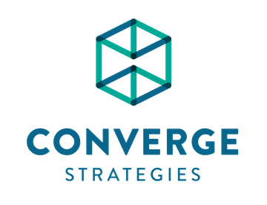
Critical Infrastructure Security And Resilience Workshop V2.0
Project Concepts Overview
Project | Big Idea | Champion | Post-Workshop Engagement
Statewide Installation Resilience Review | A joint initiative between DON and OHS to define resilience requirements in the region during times of conflict | OHS / Jimmie Collins | Initial follow-on conversations between OHS, CNRH, ASN (EI&E)
A Well-Ness Approach | Development of Well No. 3-2429-002 as a new source of water for the windward water system in Oahu | HBWS | Project is actively being pursued by HBWS (currently in design phase)
MCBH Potable Water Project | A comprehensive initiative to reduce water demand at MCBH through a suite of water conservation measures | MCBH / Amra Brightbill | HBWS and MCBH are meeting to determine WCM options for the base
Critical Resources and Essential Employee Deployment (CREED) | An initiative to develop emergency shelters for essential employees at strategic locations across Oahu (e.g. ports) | Young Brothers and Hawaii Gas | YB and Hawaii Gas actively surveying members on interest
Hawaii Power Grid Upgrades (HPGU) | A comprehensive statewide electric sector master plan to strengthen energy resilience planning between DoD/Hawaii | N/A | Minimal engagement with project concept group since workshop
Hawaii State Comms Resilience Mandate (HI-SCRM) | A state mandate focused on establishing resilient communications capabilities | OHS / Jimmie Collins | Some engagement; group members believe it should be state-led (OHS)
Notes:
OHS Critical Infrastructure Security and Resilience Workshop v2.0 co-sponsored by the Office of the Assistant Secretary of the Navy (Energy, Installations and Environment) (ASN(EI&E)).
5/9 notes from meeting w/OLDCC:
Statewide Installation Resilience Review – OLDCC candidate
A Well-Ness Approach – in design, likely some other funding mechanism … what about the HMGP?
MCBH Potable Water Project – OLDCC can’t do on-installation
Critical Resources and Essential Employee Deployment (CREED) – not likely OLDCC in total, but perhaps in a study that links to military readiness/nexus
Hawaii Power Grid Upgrades (HPGU) - likely some other funding mechanism if it focuses on a master plan, but possible if focused on nexus between mil/civ infrastructure and mission assurance … what about the BRIC?
Hawaii State Comms Resilience Mandate (HI-SCRM) – OLDCC candidate if we can tie to military readiness/civ-mil CI nexus

