Slide 1
HSFC Threats Program Update
Hawaiʻi Office of Homeland Security
Quarterly Homeland Security Forum
20 June 2024

Slide 2
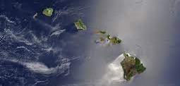
AGENDA
Introduction
Brief threats program background
Program updates: January-June 2024
Upcoming events
UNCLASSIFIED * DO NOT DISSEMINATE

Slide 3
INTRODUCTION
Hawaiʻi Dept. of Law Enforcement
Office of Homeland Security
Hawaiʻi State Fusion Center
HSFC Threats Program
UNCLASSIFIED * DO NOT DISSEMINATE

Slide 4
INTRODUCTION
HSFC Threats Program:
The Targeted Violence and Terrorism Prevention Program seeks to prevent acts of targeted violence and terrorism via a public health-inspired approach to violence prevention.
UNCLASSIFIED * DO NOT DISSEMINATE

Slide 5
BACKGROUND: HSFC
Previously: Threat prevention efforts were loosely related activities that had some quality of threat prevention built in.
Special Event Threat Assessments
Specific Intel Questions
Suspicious Activity Reporting
Executive Travel Briefs
Realtime Open Source Analysis
Partners Meetings
HSIN Requests For Information
Topical Products and Briefings
Support for Major Events
Training Opportunities
UNCLASSIFIED * DO NOT DISSEMINATE

Slide 6
BACKGROUND: THREAT ASSESSMENT
2017: FBI initiated and co-founded Threat Team Oahu with HSFC + Honolulu PD.
Late 2019: OHS got grant to support threat assessment in HI-DOE schools; personnel sat with HSFC.
March 2020: COVID-19 takes priority.
How to maintain progress?
UNCLASSIFIED * DO NOT DISSEMINATE
UNCLASSIFIED * DO NOT DISSEMINATE

Slide 7
BACKGROUND: INTEGRATION
2020-2022: Integrate efforts to build threat assessment teams with HSFC’s other threat prevention activities. Examples:
Some terrorism/extremism products also relevant to threat assessment teams.
U.S. Secret Service, Nat’l Counterterrorism Ctr.
EDU questions about social media, vaping, etc.
Topical Products and Briefings
Training Opportunities
Specific Intel Questions
UNCLASSIFIED * DO NOT DISSEMINATE
UNCLASSIFIED * DO NOT DISSEMINATE

Slide 8
BACKGROUND: STRATEGY
2022-2024: Organize into a strategy.
UNCLASSIFIED * DO NOT DISSEMINATE

Slide 9
2024 PROGRAM UPDATES
UNCLASSIFIED * DO NOT DISSEMINATE
UNCLASSIFIED * DO NOT DISSEMINATE

Slide 10
2024 PROGRAM UPDATES
Lines of effort:
Understand threat landscape and needs
Resource and communication hub
Behavioral threat assessment and management
Program administration
UNCLASSIFIED * DO NOT DISSEMINATE
UNCLASSIFIED * DO NOT DISSEMINATE

Slide 11
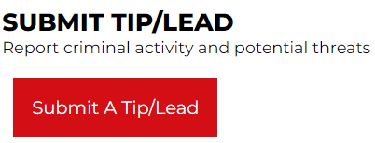
2024 PROGRAM UPDATES
Understand threat landscape and needs
Hawaiʻi AOR
Analysts
Campus Security
Leaders
UNCLASSIFIED * DO NOT DISSEMINATE
UNCLASSIFIED * DO NOT DISSEMINATE

Slide 12
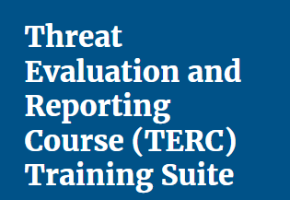
2024 PROGRAM UPDATES
Resource and communication hub
Briefings:
-Defeating the Algo
-Online Exploitation
UNCLASSIFIED * DO NOT DISSEMINATE
UNCLASSIFIED * DO NOT DISSEMINATE

Slide 13
2024 PROGRAM UPDATES
Behavioral threat assessment and management
UNCLASSIFIED * DO NOT DISSEMINATE
UNCLASSIFIED * DO NOT DISSEMINATE

Slide 14
2024 PROGRAM UPDATES
Program administration
Event planning
Grant monitoring
Implementation plan
Networking outside Hawaiʻi/U.S.
Grant applications
UNCLASSIFIED * DO NOT DISSEMINATE
UNCLASSIFIED * DO NOT DISSEMINATE

Slide 15
UPCOMING EVENTS
Just a few…
June 21: TTE scenario practice
June 26-27 and 28-29: CVCC - Mass Violence Incident Response
July 1: Prevention Practitioners Network – BTAM Referrals
July 15-16: FBI and Honolulu PD – Targeted Violence Prevention
July 17-19: UH-WO – Hawaii Threat Assessment Conference
August 20: CISA + HSFC – Left-of-Boom TTX
HSFC Fusion Liaison Officer Training
UNCLASSIFIED * DO NOT DISSEMINATE

Slide 16
QUESTIONS?
Patricia Kickland
Program Manager, HSFC
patricia.kickland@hawaii.gov
808-271-0082
hsfc@hawaii.gov
https://www.hsfc.hawaii.gov
UNCLASSIFIED

